Slide 1
suture selection

Slide 2
Suture selection
Principles of wound closure
Suture sizes
Suture types
Mono-filament vs multi-filament
Absorbable vs non-absorbable
Needle types
Selecting the right suture

Slide 3
Principles of wound closure
You only need suture around for as long as it takes for tissue to regain its tensile strength (ie until the tissue can withstand its usual stress without additional support)
Goal-create optimal healing in minimal time and minimize the risk of infection
http://www.uphs.upenn.edu/surgery/Education/facilities/measey/Wound_Closure_Manual.pdf

Slide 4
Suture sizes
Size denotes diameter
Stated numerically (as number of 0’s increases, diameter decreases)
0, 2-0, 5-0
The smaller the size, the less tensile strength
Use the smallest size that will have adequate tensile strength for that tissue →minimizes the amount of foreign body left in the patient

Slide 5
Suture types
Mono-filament | Multi-filament
Single strand | Several strands braided together
Less resistance through tissue | Greater tensile strength, pliability, flexibility
Less infection (resist harboring organisms)
Tie down easily

Slide 6
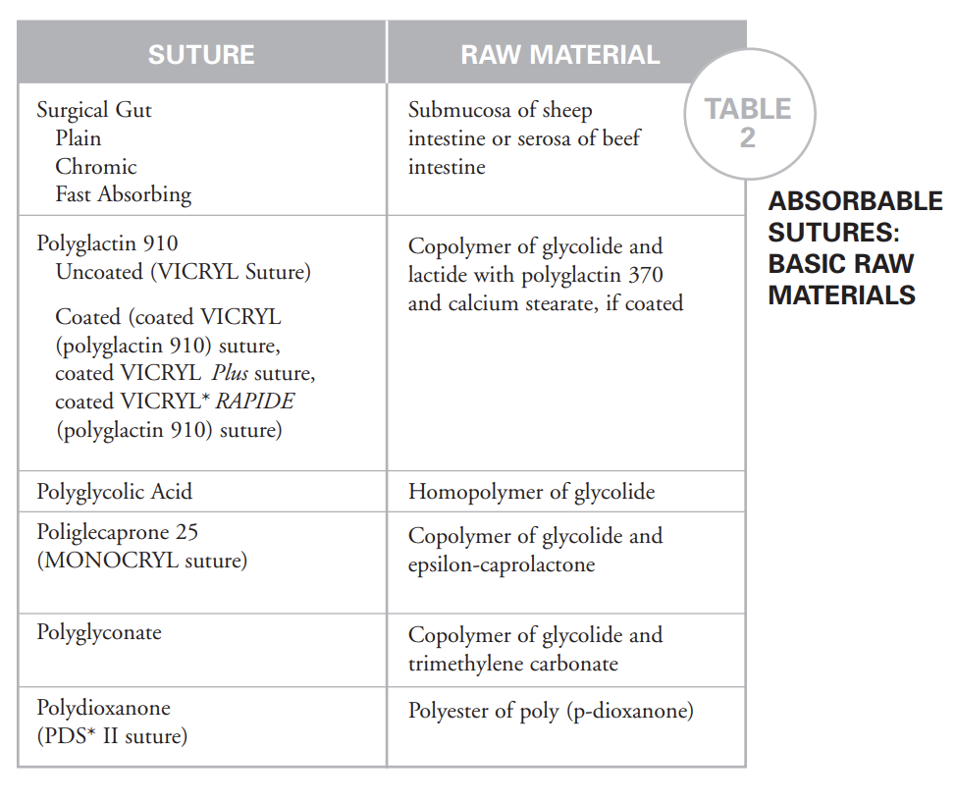
Absorbable vs Non-absorbable
Classified by degredation properties
Absorbable
lose tensile strength within 60 days
May be treated or chemically structured to lengthen absorption time
Natural sutures-digested by body enzymes
Synthetics-hydrolyzed, lesser tissue reaction
May accelerate in presence of fever/infection
Non-absorbable-retain tensile strength >60 days
Encapsulated by fibroblasts
Remain permanently
May be preferred in patients with reaction to absorbable suture, keloid, or hypertrophic scarring

Slide 7
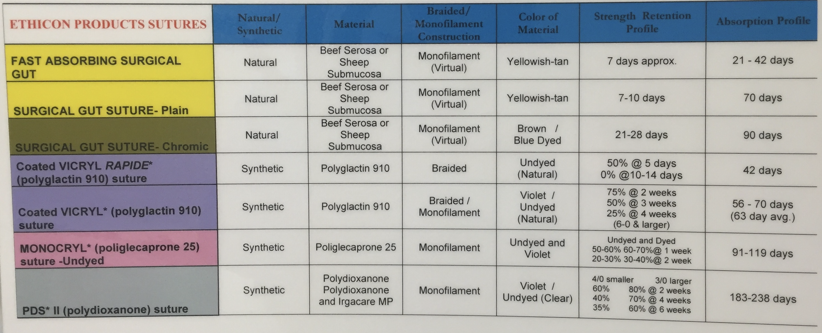

Slide 8
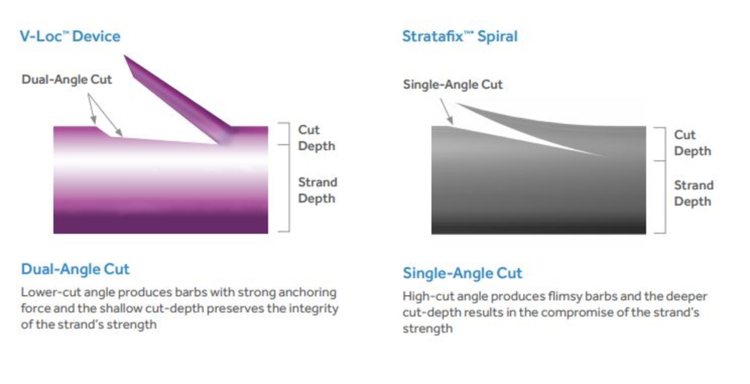
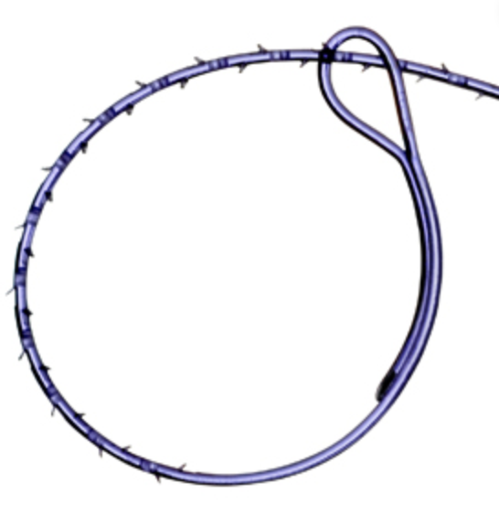
Barbed sutures
V-loc
Dual angle barb
Preformed loop
More difficult/impossible to remove
90 vs 180 day closure
Stratafix
Single angle barb
Adjustable loop
Can overcome barb to readjust slightly
90 vs 180 day closure

Slide 9
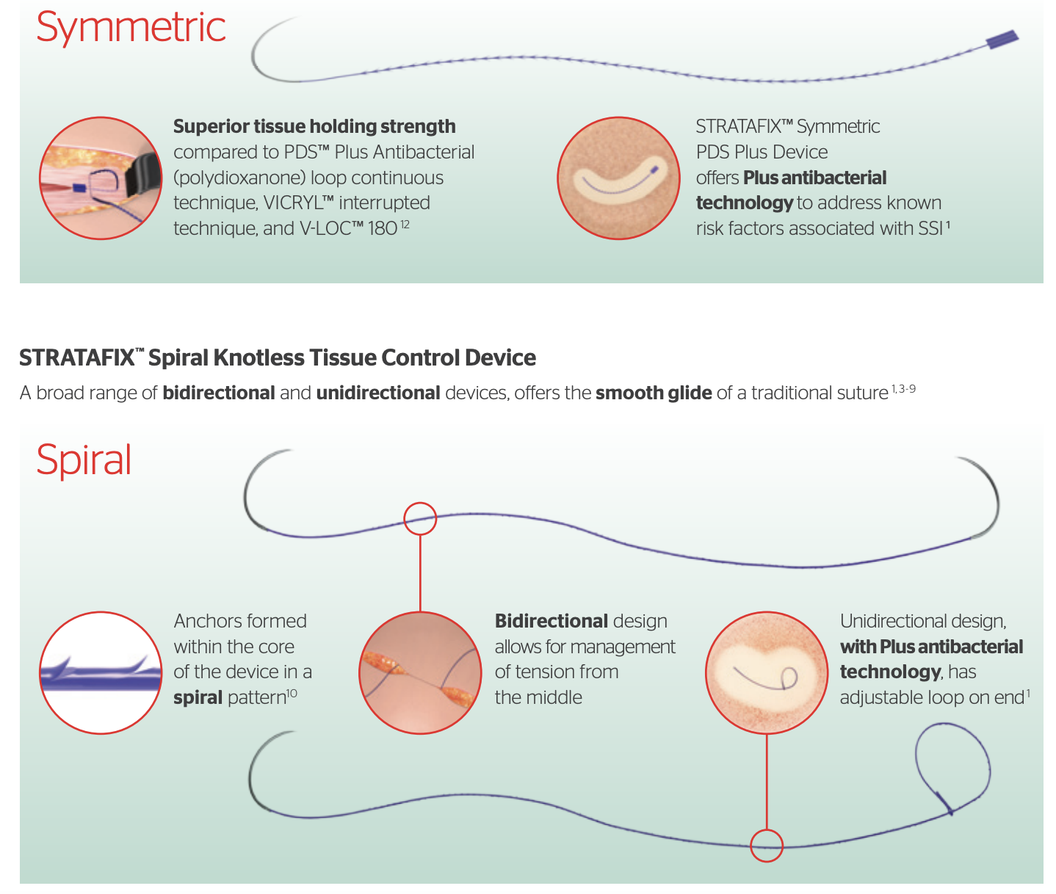

Slide 10
Lapra-ty
Only approved for Vicryl, sizes 2-0, 3-0, 4-0 and 2-0 PDS

Slide 11
Suture selection
When a wound reaches maximal strength, suture is no longer needed
Tissues that heal slowly (skin, fascia, tendons)-close with non-absorbable suture or absorbable sutures with extended wound support
Those that heal rapidly (stomach, colon, bladder)-may be closed with absorbable suture
Foreign bodies in potentially contaminated tissues may convert contamination to infection
When cosmesis is important, close and prolonged apposition of wound edges produces best results
Use smallest inert suture, close subcuticular, skin adhesive or tape may aid is apposition
Foreign bodies in presence of high concentrations of crystalloids my act as a nidus for stone formation (ie bladder)-use rapidly absorbed sutures

Slide 12
Suture selection
Fascia
Prolene
PDS/Maxon
Subcutaneous fat
Vicryl/Polysorb
Subcuticular
Chromic
Monocryl
Skin
Vicryl Rapide
Monocryl
Drains, retention sutures
Ethibond

Slide 13
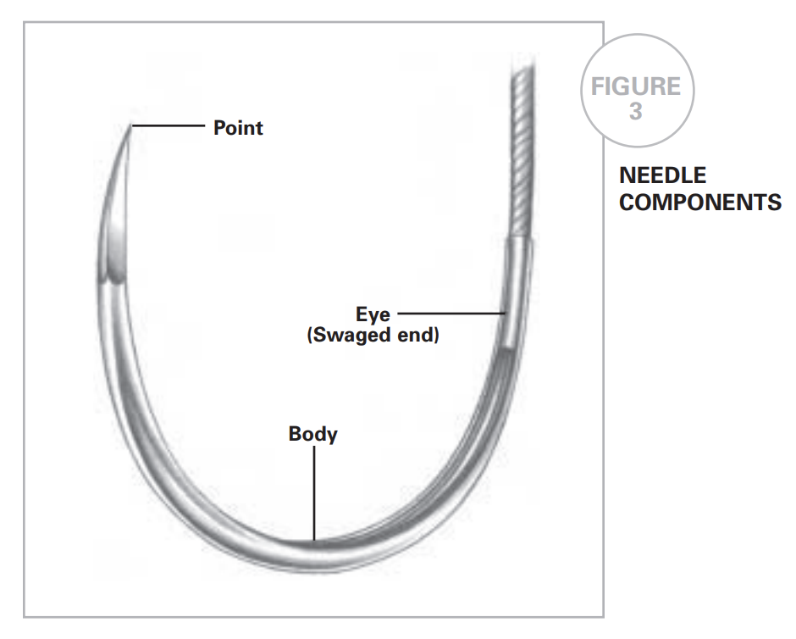
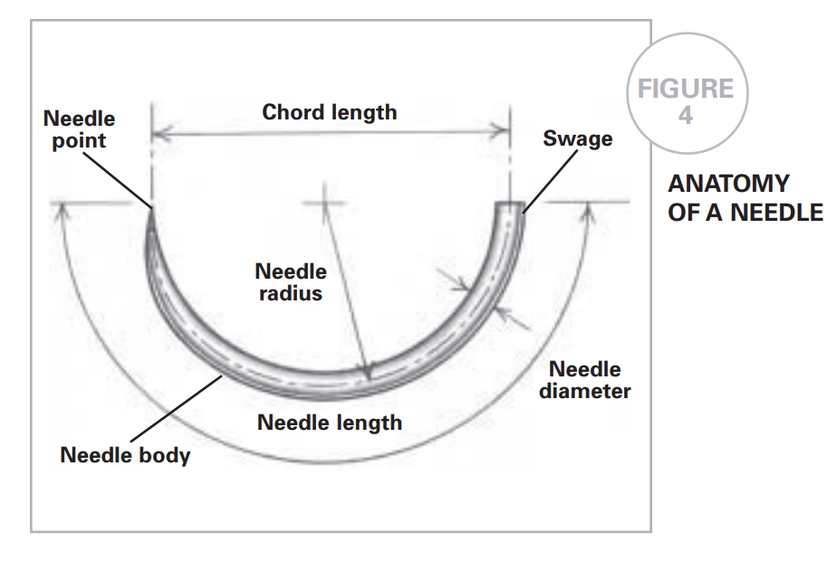
Needle types
Swaged on vs pop-off

Slide 14
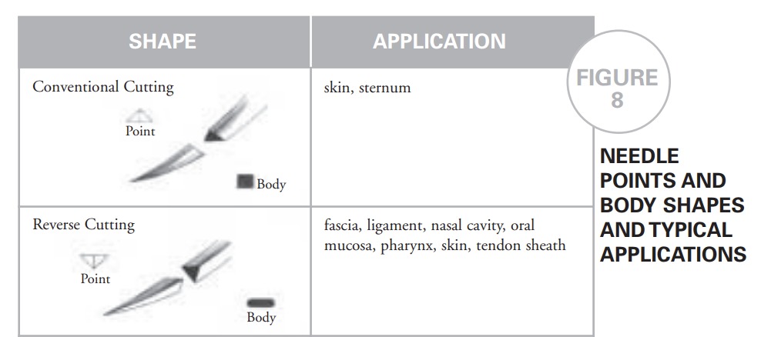
Needle types
Needle shape
Taper
Typically used in tissue that is easy penetrated
Cutting
Used in difficult to penetrate tissues (fascia, skin,
Reverse cutting
Attachment
Swaged on
Control release (ie pop off)
Notes:
Conventional cutting-may cut out a portion of tissue given design
Reverse cutting-for difficult to penetrate tissues (skin, tendon), more strength than conventional needle, less danger of cut out

