Slide 1
Fundamentals of Laparoscopic Surgery (FLS) Reference guide

Slide 2
Learning Objectives
By the end of this session, you should be able to:
Identify the components of the FLS exam
Understand the tasks required to become FLS certified
Meet baseline times for task completion and establish goals for skills improvement

Slide 3
Exam structure
Standardized certification
Cognitive/Written component
Designed for general surgery residents
Skills/Manual component
Developed by the Society of American Gastrointestinal and Endoscopic Surgeons (SAGES) and ACS for general surgery board certification.
ABOG requires all OBGYN residents to pass FLS by December of their fourth year in order to sit for the Qualifying Exam (written boards)

Slide 4
Exam components
Cognitive/Written
Computer-based
Multiple choice (80 questions)
90 minutes
You must take the test in order. You cannot skip or go back and change your answers.
Skills/Manual
5 tasks
General Reference
https://www.flsprogram.org/fls-information

Slide 5
Exam preparation: online modules

Slide 6
Exam online prep: Content
Exam preparation: online modules
Module 1: Preoperative considerations
Module 2: Intraoperative considerations
Module 3: Basic laparoscopic procedures
Module 4: Postoperative care and complications
Module 5: Manual skills instruction and practice
(contains video)
give yourself about a month to get through them
Notes:
Module 1: Preoperative Considerations • Laparoscopic Equipment • Energy Sources • Room Setup • Patient Selection & Preoperative Assessment Module 2: Intraoperative Considerations • Anesthesia and Patient Positioning • Pneumoperitoneum Establishment & • Trocar Placement • Physiology of Pneumoperitoneum • Exiting the Abdomen Module 3: Basic Laparoscopic Procedures • Current Laparoscopic Procedures • Diagnostic Laparoscopy • Biopsy • Laparoscopic Suturing • Hemorrhage and Hemostasis Module 4: Postoperative Care and Complications • Postoperative Care • Postoperative Complications Module 5: Manual Skills Instruction & Practice • Training Exercises & Data Analysis Module 6: Final Review

Slide 7
Exam: scheduling
Online registration through SAGES
https://www.webassessor.com/sages
Recommend scheduling at least 2 weeks in advance
Closest FLS site for URMC residents: Roswell Park
Jenna Bizovi <Jenna.Bizovi@RoswellPark.org>​
Plan to be on site for two hours

Slide 8
Exam day
Duration: approximately 2 hours
Bring
Photo ID
Test voucher
Your own instruments (if you prefer)
Avoid
Caffeine (can make you overly jittery)

Slide 9
Manual Skills Instructions and Guidelines
https://www.flsprogram.org/wp-content/uploads/2014/03/Revised-Manual-Skills-Guidelines-February-2014.pdf

Slide 10
Task 1: Peg transfer
Instruments: two Maryland graspers, pegboard, six rubber objects
Task: Grasp peg with one hand, transfer to other hand, transfer to other side of pegboard. Then reverse order of transfer
Points
Deducted if object dropped out of view or where can’t be retrieved
If dropped in view, pick up with the hand it was dropped with and continue
Timing: Begins when first object is touched, ends with release of last object
Max time: 300 seconds (5 min)
Peg transfer video: https://www.youtube.com/watch?v=gAQPXHWqdXQ

Slide 12
Task 2: Precision cutting
Instruments: One Maryland grasper, one pair of endoscopic scissors, circle gauze (double circle is practice gauze). Open edge inside clip
Task: Using Maryland grasper as counter-traction, cut on the INNER circle of the gauze (only top layer scored) until it is fully removed. You must start from the edge of the gauze. You may switch the instruments in your hand as desired.
Points deducted: deviating from the circle line >5mm
On practice gauze, must stay in between two circles
Timing: Begins when gauze is touched, ends when circle is completely removed from gauze
Max time: 300 seconds (5 min)
Most failed task due to lack of practice
Pattern cutting video: https://www.youtube.com/watch?v=mUBZoSO3KA8

Slide 14
Task 3: Loop ligation
Instruments: One grasper (either Maryland or one with locking/ratcheted handle), one endoscopic scissors, one pre-tied ligating loop or endoloop, one red foam organ with appendages
Task: Use your Maryland grasper to help place a pre-tied ligating loop around the provided mark on the middle appendage of the foam. Cinch the knot by pushing the applicator from outside the box (ideally with one hand). Cut the suture.
Penalties: deviating from the mark on the foam
Timing: begins with instrument or loop visible, ends when you cut the end of the loop
Max time: 180 seconds (3 min)
Loop ligation video:https://www.youtube.com/watch?v=4Vhkx-pi5mE

Slide 16
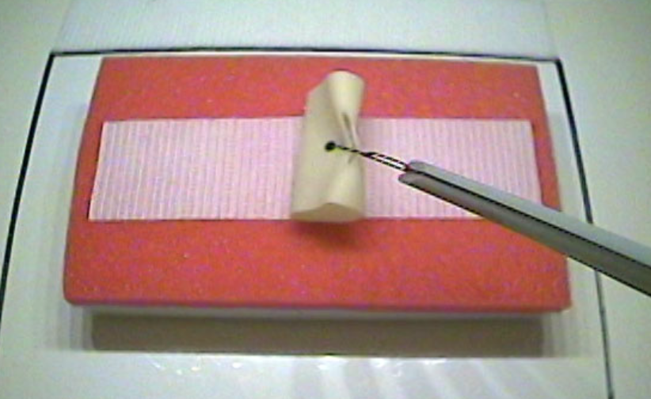
Task 4: Extracorporeal suturing
Instruments: Two needle drivers (or one driver and one Maryland), one knot pusher, 2-0 silk (36inch), one pair of endoscopic scissors, one Penrose drain
Task: place suture through the Penrose drain, then tie three single throws of a knot extracorporally, then cut both ends of the suture inside the trainer. You cannot use a hemostat as a counter-weight.
Penalties: deviation from two marks on the drain, not properly closing slit in drain, knot slips when tension applied to it. Avulsing the drain = automatic failure.
Timing: begins when first instrument visible, ends when both suture tails are cut
Max time: 420 seconds (7 min)
Extracorporeal suturing video: https://www.youtube.com/watch?v=ie0o6_xt5ec

Slide 18
Task 5: Intracorporeal suturing
Instruments: two needle drivers, one 2-0 silk suture (15cm), one pair of endoscopic scissors, one Penrose drain with targets
Task: Tie three throws of a knot intracorporeally. The first throw must be a surgeon’s knot. You must alternate hands holding the needle in between each throw. You can start tying with either hand.
Penalties: deviation from two marks on the drain, not properly closing slit in drain, knot slips when tension applied to it. Avulsing the drain = automatic failure
Timing: begins wen first instrument is visible on the monitor, ends when the suture is cut.
Max time: 600 seconds (10 min)
Intracorporeal suturing video: https://www.youtube.com/watch?v=hAzhqYid5jc

Slide 20
Manual skills: goal times
Max time
Goal time
300
300
180
420
420
Notes:
Proficiency-based training should be conducted using the performance levels and the suggested protocol listed.
For Task 1, the task should be practiced until it can be performed in 48 seconds with no pegs dropped outside of the field of view; this level of performance should be achieved on 2 consecutive repetitions and then again on 10 more nonconsecutive repetitions for reinforcement. If a trainee cannot achieve this level of performance in 80 repetitions, that trainee should proceed to Task 2.
For Task 2, the task should be practiced until it can be performed in 98 seconds with all cuts made within the section between the two lines of the Training Gauze; this level of performance should be achieved on 2 consecutive repetitions or for a maximum of 80 repetitions.
For Task 3, the task should be practiced until it can be performed in 53 seconds with up to 1mm accuracy errors; this level of performance should be achieved on 2 consecutive repetitions or for a maximum of 80 repetitions.
For Task 4, the task should be practiced until it can be performed in 136 seconds with up to 1mm accuracy errors; this level of performance should be achieved on 2 consecutive repetitions or for a maximum of 80 repetitions.
For Task 5, the task should be practiced until it can be performed in 112 seconds with up to 1mm accuracy

