Slide 1
Perioperative Management of the Gynecologic Surgery Patient
Ashley Gubbels MD FACOG

Slide 2
Objectives
After completion, the learner should be able to:
Perform appropriate preoperative work up and counseling of patients
Know the legal expectations for informed consent and appropriate documentation
Recognize postoperative milestones and educate on potential complications

Slide 3
Perioperative Care
Preoperative
Intraoperative
Postoperative
Notes:
3 phases of care
Equal importance but I'd argue the preop phase is the most important to your success and a smooth procedure

Slide 4
Notes:
are you going to operate & why,
where-hospital vs surg center
how-route
when-emergent vs elective

Slide 5
Preoperative Care
Perioperative risk assessment begins at the initial visit.
Consultation for surgery
Indication for surgery
Medical/Surgical history
Medication review
Laboratory evaluation
Procedural selection
Preoperative visit
Confirmation of safety and stability to proceed
Informed consent
Enhanced recovery protocol
Postoperative expectations

Slide 6
Preoperative: Initial Consultation
Indication for surgery
Necessary to offer surgery
Patients desiring surgery which is not indicated → unnecessary malpractice risk
Medical/Surgical history
Review with patient to ensure accuracy
Diagnoses are often missing or inaccurate in E-record
Your responsibility to ensure this is correct
Identify conditions requiring preoperative work up or need for additional intra -or post-operative management
Exercise tolerance
Notes:
Among gynecologic surgery patients with none of these risk factors, the risk of a major cardiac complication is less than 1% (prior myocardial infarction, heart failure, cerebrovascular disease, insulin-dependent diabetes, and serum creatinine >2.0 mg/dL)
The patient's exercise tolerance can be used as a guide: Poor exercise tolerance is defined as inability to walk four blocks or to climb two flights of stairs as a part of normal daily activities

Slide 7
Preoperative: Initial Consultation
Medication review
Suggest diagnoses patient hasn’t disclosed?
Require perioperative adjustment?
Increase risk of complications?
Laboratory/Imaging evaluation
Detect issues prior to immediate preoperative time frame
Diabetic control, severe anemia etc
Gather further information to guide decision making
Procedural selection
Determine best route of procedure
Notes:
Classic-”I don’t have hypertension”
Unknown anemia in patients with heavy menstrual bleeding
Insurance may require certain labs to authorize the procedure

Slide 8
Preoperative: Preop visit
Confirm stability of medical conditions and ability to tolerate procedure
Discuss procedure to be performed and obtain informed consent
Initiate enhanced recovery protocol
Review postoperative expectations
Prepare admission documentation
*Billing pearl*
Preop visit is part of global surgical fee (ie non-billable) unless there is another diagnosis separate from perioperative counseling that is managed during this visit
Notes:
Confirm stability of medical conditions and ability to tolerate procedure
Has patient had a recent asthma exacerbation or pneumonia and case needs delayed?
Discuss procedure to be performed and obtain informed consent (which we’ll discuss next)
Initiate enhanced recovery protocol
Review postoperative expectations-increases patient satisfaction and (potentially) decreases phone calls
Prepare admission documentation

Slide 9
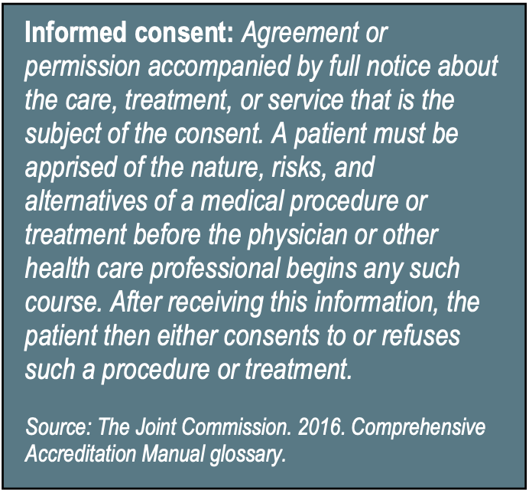
Informed Consent
“Informed consent is not just the signing of a form. Informed consent is about a thorough process of communication between patient and provider.”
Aaron Fink, MD
LINK: MLMIC NY Informed Consent Guidelines
Notes:
Informed consent is a legal doctrine affirming a patient’s right to determine and control his or her own medical treatment. In essence, it is the discussion that takes place between the physician who is rendering care and the patient.
Failure to procure an adequate informed consent from the patient can lead both to malpractice and professional misconduct charges
Although a signed consent form is helpful in defense, a patient’s signature is not conclusive evidence of an informed consent discussion
The signed consent document merely confirms that such a discussion took place. That is why the discussion and documentation of it are so important.
The note should be dated and should include the following, “The risks, benefits, and alternatives, including no treatment, were discussed with the patient. The risks discussed included, but were not limited to . . .” and list a few of the most severe and a few of the most frequent risks or complications. Finally, note that “the patient understood, had all his/her questions answered, and consented to the treatment or procedure.” This type of documentation will confirm and be evidence that a discussion actually took place with the patient

Slide 10
Informed consent
What is the planned procedure (what are we planning to remove, how, & why?)
Anticipated benefits of the procedure
Alternatives to this procedure (some detail about this likely should be written in your initial consultation or the note where you decided to pursue this specific procedure)
Risks to the procedure
Bleeding
Infection
Injury to nearby structures requiring repair (now or at later time)
Blood clots in legs or lungs
Anesthesia risks
Death
Involvement of trainees (and pelvic exams for training purposes)
According to the MLMIC Insurance based in NY: A thorough note should be written and should include the following, “The risks, benefits, and alternatives, including no treatment, were discussed with the patient. The risks discussed included, but were not limited to . . .” and list a few of the most severe and a few of the most frequent risks or complications. Finally, note that “the patient understood, had all his/her questions answered, and consented to the treatment or procedure.” This type of documentation will confirm and be evidence that a discussion actually took place with the patient.
Notes:
Whiteboard conversation
1]) What is the procedure-what are we planning to do/remove, how, and why?
2) alternatives to this procedure? (expectant management/do nothing, medications, XYZ surgical option) 3) benefits to the procedure/what are we trying to treat?
4) Risks to the procedure?
bleeding, infection, injury to nearby organs, blood clots, death
5) Involvement of trainees-GYN exams: must be consented for training exam (JCAHO “encourages” written patient consent to video procedures though technically you can record and use for educational purposes if patients face or other identifying features do not appear)
**Who can obtain IC? NY law-may not be delegated to any staff member, must be provided by the physician
A signed form is helpful in defense, signature is not conclusive evidence of an informed consent discussion, only that a conversation took place.
According to the MLMIC Insurance based in NY: A thorough note should be written and should include the following, “The risks, benefits, and alternatives, including no treatment, were discussed with the patient. The risks discussed included, but were not limited to . . .” and list a few of the most severe and a few of the most frequent risks or complications. Finally, note that “the patient understood, had all his/her questions answered, and consented to the treatment or procedure.” This type of documentation will confirm and be evidence that a discussion actually took place with the patient.
BEST advice: Don’t just use hospital forms and dot phrases. Tailor them (and consents if able) to your specific surgeries and counseling.

Slide 11
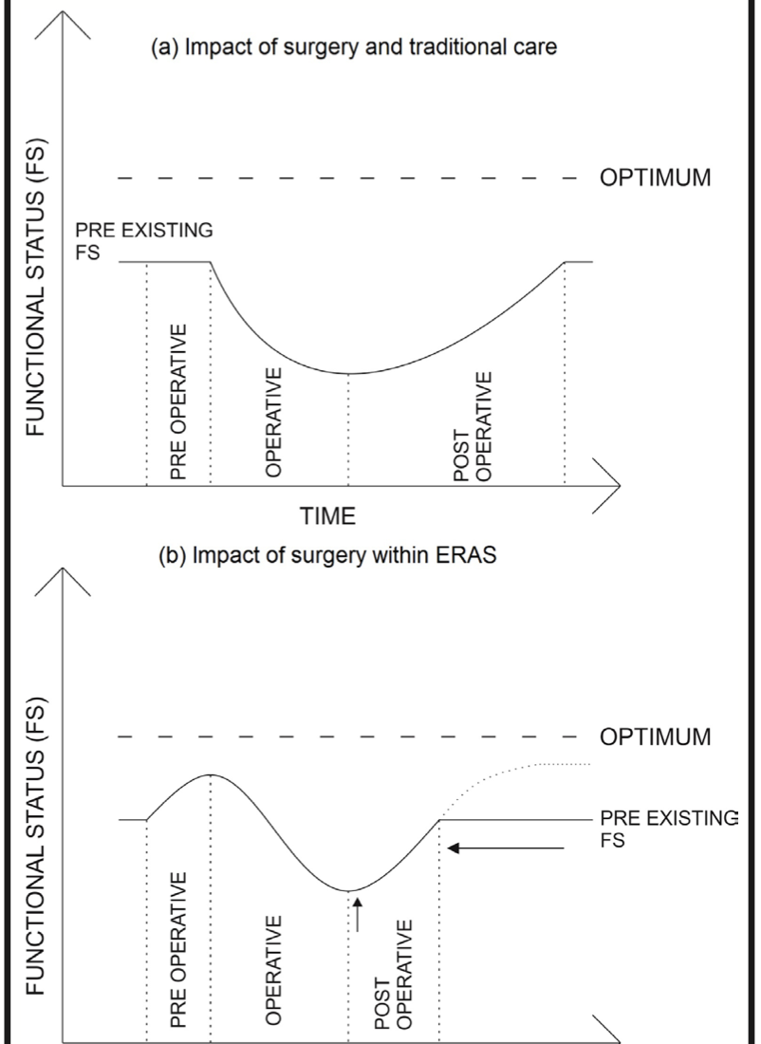
Preoperative: Preop visit
Initiate Enhanced Recovery Protocol
Education
Preoperative expectations
Nutrition instructions
Prophylactic pain management plans
Smoking cessation
Laboratory testing
Relay postoperative expectations
Anticipated recovery process
Postop pain management plans
Activity instructions/restrictions
Follow up plan and return precautions
Notes:
ERAS-maintaining normal physiology in the perioperative period, thus optimizing patient outcomes without increasing postoperative complications or readmissions.
Preoperative phase is meant to improve functional status prior to surgery. Intra and postoperative phases are meant to shorten the impact of surgery on functional status.
If smoking cessation is attempted in close proximity to a planned surgical procedure (<6 weeks), the improvement in mucociliary clearance in combination with reduced cough may lead to a secretion burden that paradoxically increases the risk of PPCs

Slide 12
Preoperative: Preop visit
Perioperative nutrition
Clear fluids up to 2 hours and light meals up to 6 hours before elective procedures requiring GA
Preoperative carbohydrate load (50g) 2-3 hours before induction of anesthesia
Clearfast
Ensure Clear
Pedialyte
Gatorade thirst quencher
Prophylactic pain management
Perioperative gabapentin or pregabalin
Preop TLC regiment (Tylenol, Lyrica, Celebrex)
Notes:
ASA guidelines-we should NOT be telling patients NPO after midnight (the hospital still does)
Carb load attenuates the catabolic response induced by overnight fasting, ideally 50g carbohydrates-ClearFast
Improves perioperative well being, reduces postoperative insulin resistance, enhanced return of bowel function, decrease protein breakdown, and beneficial cardiac effects. No effect on complication rates. Avoid in patients with known delay in gastric emptying
intake of clear fluids up until 2 hours before surgery does not increase gastric content, reduce gastric fluid pH, or increase complication rates
Preop gabepntin vs TLC (Tylenol, Lyrica, Celebrex)
Acute postop pain can lead to chronic pain in 10-50%

Slide 13
LINK: Perioperative Medication Management
Notes:
depending on hospital system, you may be the one instructing them regarding medications so it is important to know what to do w each

Slide 14
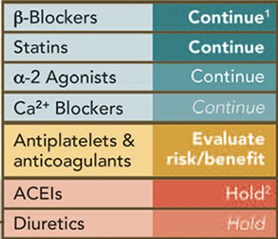
Cardiovascular medications
Notes:
in conjunction w prescriber

Slide 15
Diabetic medications
Notes:
Diet: check pre and postop, supplemental prn
Oral hypo: hold meds AM of proc, restart as scheduled once tol diet, supp prn, q2hrs?
Metformin: same, restart once adequate renal fxn
Insulin
Short proc (<2hrs): cont basal insulin, hold AM dose (can decr by 10-20% if runs on low side)
Long surg: omit AM short acting
Insulin (AM only): ½-2/3 of total morning dose as int or long acting for basal
Insulin (2+/d): 1/3-1/2 total morning dose as int or long acting for basal
Pump: cont basal rate
Hyperglycemia: supplemental short/rapid acting

Slide 16
Endocrine medications
Glucocorticoids
OCP’s/patch/ring
HRT
SERM’s
Thyroid medications
Notes:
OCPs/HRT-Consider risk of thromboembolism versus benefits of pregnancy prevention. Combined oral contraceptives may be continued in women with moderate to high risk of thromboembolism who could have difficulty complying with other forms of contraception. If the choice is made to discontinue consider discontinuing 4 to 6 weeks prior to surgery.
SERMs-hold day of
Synthroid-continue

Slide 17
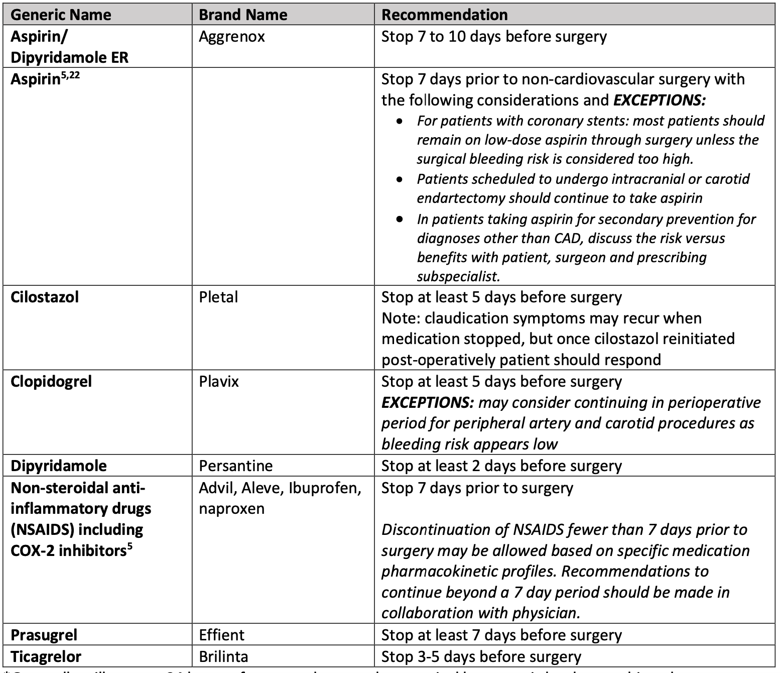
Hematologic medications
Aspirin
NSAIDS
Antiplatelet meds
Notes:
ASA-stop 7 days prior
Hornor, Melissa & Duane, Therese & Ehlers, Anne & Jensen, Eric & Brown, Paul & Pohl, Dieter & da Costa, Paulo & Ko, Clifford & Laronga, Christine. (2018). American College of Surgeons’ Guidelines for the Perioperative Management of Antithrombotic Medication. Journal of the American College of Surgeons. 227. 10.1016/j.jamcollsurg.2018.08.183.

Slide 18
Hematologic meds
Warfarin
Lovenox (therapeutic)
DOAC (Xarelto, Elliquis)
*Get assistance from prescribing physician/service*

Slide 19
Herbal medications
Ginseng: discontinue 7 days preop
Ephedra: discontinue 24hrs preop
Garlic: discontinue 7 days preop
Ginkgo: discontinue 3 days preop
Kava: discontinue 24 hours preop
St John’s wort: discontinue 5 days preop
Echinacea: no data
Valerian: taper 1week preop

Slide 20
Day of Surgery/ Intraoperative

Slide 21
DOS & Intraoperative
Laboratory evaluation
Antibiotic prophylaxis
Thromboprophylaxis
Pain control
Temperature control
Nausea management
Time out/Patient safety
Tasks

Slide 22
Intraoperative
Test | Routine? | Recommendation
CBC | Known or at risk of anemia | ASA class ≥2 undergoing intermediate or major surgery (Level D)
BMP |  | ASA class ≥2 undergoing intermediate or major surgery (Level D)
Type and Screen | All patients undergoing major surgery (Level c) | All patients undergoing major surgery, routine crossmatch not recommended (Level C)
Coagulation studies | Not recommended | Intermediate or major surgery on anticoagulation or ASA ≥3 with bleeding disorder or cirrhosis
Urinalysis/Culture | Not recommended | Limited data re: preop culture in urogynecologic surgery
EKG | Known CAD or structural heart disease | >65yo or ASA class ≥3 undergoing general anesthesia
CXR | Not recommended (level D) | No specific guidelines
Laboratory evaluation
Nearly $18 billion dollars spent on preoperative testing annually
50-70% unindicated
DShields 2019. Preop Eval for MIGS. JMIG

Slide 23
Intraoperative
TABLE 8.3 Johns Hopkins Bayview Medical Center Preoperative Evaluation Center Preadmission Screening Guidelines
MEDICAL CONDITION |  | CBC | SERUM ELECTROLYTES | PT/PTT | LIVER FUNCTION TESTS | EKG
Age >50 |  |  |  |  |  | X
Hypertension |  |  | X |  |  | X
Cardiac disease or arrhythmia |  | X | X |  |  | X
Diabetes |  |  | X |  |  | X
Renal disease |  |  | X |  |  | X
Diuretic/ACE inhibitor/chemotherapy |  |  | X |  |  | X
Hematologic or liver disease |  | X |  | X | X
Hysterectomy |  | X
Hysteroscopy |  |  | X
Highly invasive procedures: |  | X | X | X |  | X
 | Radical surgery
 | Preoperative bowel prep
 | Anticipate >500 mL blood loss
These are screening guidelines only; further testing based on the patient's medical history, surgeon's evaluation, or primary care physician's discretion. Data from Johns Hopkins Bayview Medical Center Preoperative Evaluation Center pre-admission guidelines.

Slide 24
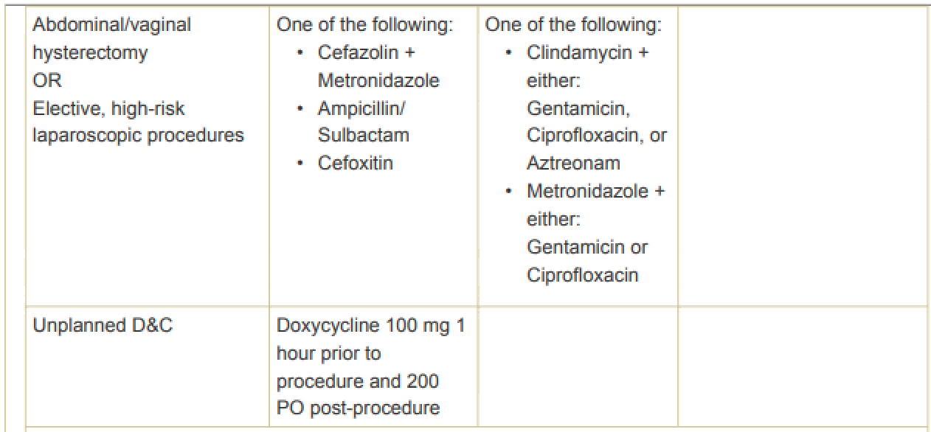
Intraoperative
Antibiotic prophylaxis
Hysterectomy
second generation cephalosporin (ACOG guidance last updated 2018)
One study in 2017 suggesting addition of flagyl further decreases infection
ACOG
URMC
Notes:
PB 195 June 2018
In addition, American College of Obstetricians and Gynecologists recommends screening for and treating bacterial vaginosis before hysterectomy to minimize the risk of cuff infection. However, an alternative is the routine use of preoperative metronidazole. This option may be cost-effective at the time of hysterectomy if the prevalence of bacterial vaginosis is at least 1%.
Till 2017 Reducing surgical site infection after hysterectomy. JMIG

Slide 25
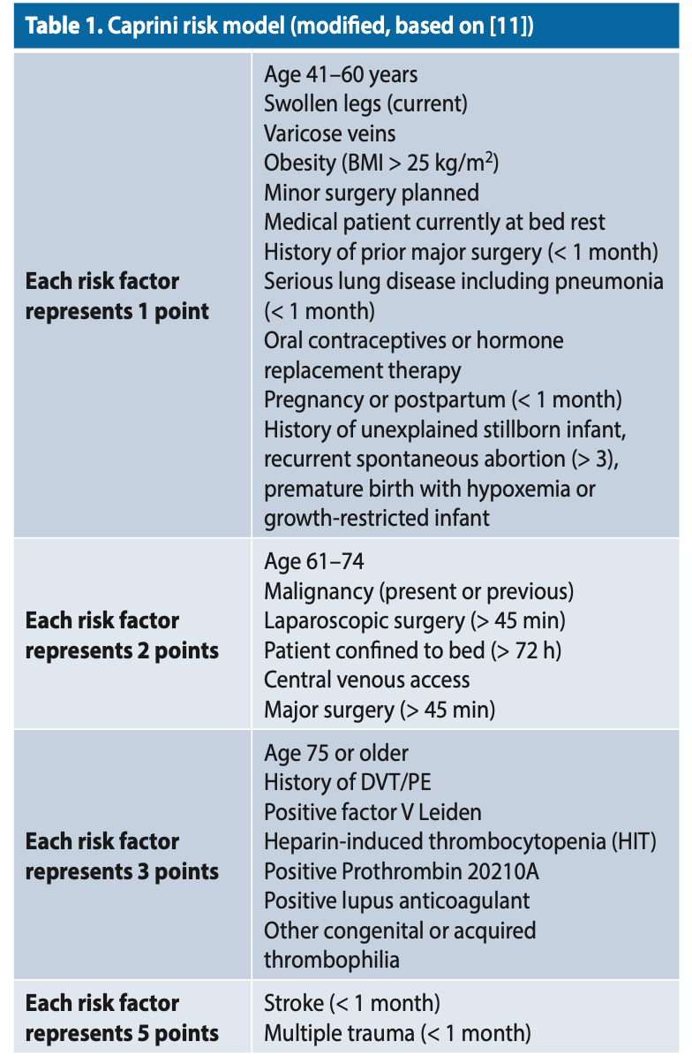
Intraoperative
Venous thromboprophylaxis
Prevalence of DVT:
15-40% in absence of thromboprophylaxis
Unknown in benign gynecologic laparoscopy
Paucity of data in minimally invasive gynecologic surgery, particularly in benign cases
Caprini risk model
Notes:
Typical laparoscopy >45 minutes=2 pts
Age=1
Obesity=1
OCPs/HRT=1
Often score 3-5 at baseline

Slide 26
Intraoperative
URMC is aggressive, recommend all surgeries >45 mins get pharmacologic prophylaxis
Notes:
Guidelines
Heparin 2 hours prior
Lovenox 2-12 hours prior, <2 hrs can be a/w increased bleeding risk

Slide 27
Notes:
Some literature to support pre-emptive analgesia in decreasing postoperative pain rather than postop injection-TAP vs local pending skill of operator, extent of procedure/incisions

Slide 28
Intraoperative
Safety
Site mark
Visualize consents yourself
Review surgical risks again
Time out
Leader dependent on hospital requirement
Circulating nurse vs Surgeon
Notes:
Site mark-for unilateral procedures, initials and side, near incision site. Surgical marker will not wash off
"time out" is performed in the operating room (OR) as a final recapitulation immediately prior to surgery confirming identity, surgical site, planned procedure
-everyone stops moving, talking
-introductions when new team members
Patient ID, Procedure, consent verified, allergies, abx, fire risk, temp mgmt., dvt risk, duration/ebl, pregnancy test, special concerns, needs

Slide 30
Postoperative
Notes:
Pain control, ambulation, diet, flatus, voiding
Milestones
Management of lines
Wound Care
Discharge planning and follow up care

Slide 31
Postoperative
Pain control
Diet
Ambulation
Voiding
Notes:
Active management of pain
-Manageable pain level
-multimodal
-scheduled Tylenol, Toradol/motrin, gabapentin/lyrica. PRN muscle relaxant, opioid
-oral regimen with IV breakthrough, if consistently using IV POD1, adjust meds or doses
-Decreases risk of atelectasis, shortens hospital stay
Diet
-Tolerating general diet
Ambulation
-steady without assistance, dizziness
Voiding
-Pelvic surgery increases risk of urinary retention. Risk low in patients without pre-existing bladder dysfunction.
-Spontaneous vs back fill void trial (remove catheter and allow spontaneous fill vs backfill with known volume prior to foley removal)
-Bladder scan, goal PVR<100 or 1/3 of total volume ***inpatients with risk factors or symptoms
-Back fill-Reduced time to first void but not to hospital discharge

Slide 32
Postoperative
SCD’s
Especially if contraindication to pharmacologic prophylaxis
Incentive spirometry
Open cases
Ensure devices are on patient AND turned on
Those having issue with pain control
Ensure they know how to use it correctly
Activity
Ensure patient getting up
Nursing vs PT order

Slide 33
Postoperative
Discharge counseling
Expectations for recovery
Restrictions
Call/Return precautions
Follow up call
Reasonable for major surgeries with same day discharge
Early recognition of postoperative complication
Follow up appointment
If possible, make prior to surgery or discharge
Date dependent on procedure
Laparoscopy: 2-4 weeks
Hyst: 2 & 6 weeks
Concern for malignancy: 1-2 weeks (based on timing it typically takes to get path back)
WRITTEN instructions
Who performs-hospital vs surgeons office?
Notes:
Patients used to be in hospital for 3-5 days postop. Provided time to recognize complications. Now with same day or POD1 discharge, important to educate patients on what is normal and not

Slide 34
Discharge counseling
Review expectations: should generally feel better every day though may be dependent on how active they are
Call precautions:
Fevers >100.4
Vaginal bleeding (amt variable pending procedure type)
Uncontrolled pain despite using your pain medications
Redness, drainage, bleeding from an incision
Nausea/Vomiting that is worsening
Shortness of breath
Swollen or tender leg
Do NOT use MyChart for any of these concerns, call X number day or night
Activity restrictions
No driving until off narcotics or until pain free enough to hit the brake
No lifting more than X lbs for X weeks
No sex until you feel comfortable vs until seen in the office and given the OK
Hyst patients-discusse that lifting and sex increase risk of vagina opening and guts falling out (sometimes need the shock factor to make them follow the rules)
Notes:
What do you tell patients postop?
Anticipated course
What to call for and how to communicate
Activity restrictions

Slide 35
In summary
Perform appropriate preoperative work up and counseling of patients
Know the legal expectations for informed consent and appropriate documentation
Recognize postoperative milestones and educate on potential complications

Slide 36
Questions/Discussion

