Slide 1
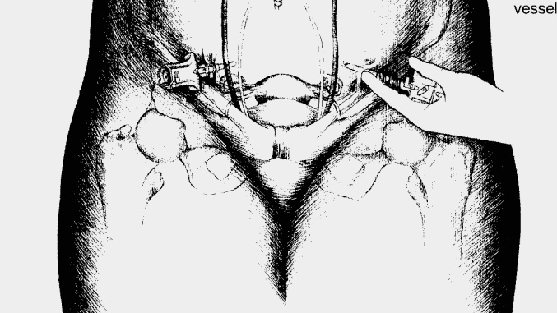
Laparoscopic Entry

Slide 2
Laparoscopic entry techniques: Objectives
Position of patient
Primary port closed entry
Secondary port entry
Primary port alternatives
Exit techniques

Slide 3
Positioning
Dorsal lithotomy
Stirrups
Non-slip mattress
Bean bag
Pink foam
Trendelenberg after initial port placed

Slide 4
Positioning
The operating table should be horizontal (not in Trendelenberg) at the start of the procedure
The abdomen should be palpated to check for any masses before insertion of the port
Angle of entry is dependent on body habitus

Slide 5
Primary port
Veress vs Direct vs Open entry
Umbilical vs LUQ (Palmer’s point)
Why enter through the umbilicus?
Fixed peritoneum
Thin
Least vascular
Cosmetic
Why enter through LUQ?
Less likelihood of adhesions (depending on surgical history)

Slide 6
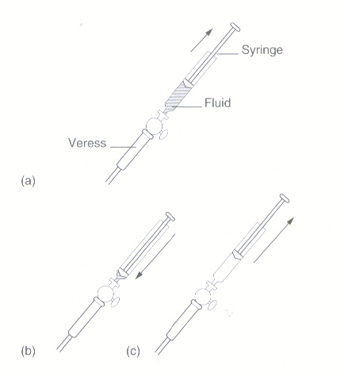
Primary port-Veress
Insertion of Veress needle
Pencil grip
Vertical through skin then towards pelvis
Double “click”: fascia → peritoneum
The lower abdominal wall should be stabilised in such a way that the Veress needle can be inserted at right angles to the skin
Elevating the abdominal wall has a higher rate of failed entry
Towel clips are superior in maintaining constant fascial elevation compared to grasping the skin
Excessive lateral movement of the needle should be avoided.
May convert a small needle point injury in the wall of the bowel or vessel into a complex tear

Slide 7
Primary porT-Veress
Saline test
Apply syringe, Withdraw, Instill saline, Withdraw
Proceed with insufflation if no fluid, frank blood, or feces
Not 100% accurate
The most valuable test of correct placement of the Veress needle is to observe that the initial insufflation pressure is relatively low
Less than 10mmHg
Flows freely
After 2 failed attempts to insert the Veress needle, either the open Hasson technique or Palmer’s point entry should be used.
Pressure
Flow
Volume

Slide 8
Primary port-Veress
Insufflation
Set pressure cut off to no more than 20-25mmHg for entry (typically 15mmHg)
Start at low flow (1L/min)
Check gas entering at low pressure (<10 mmHg)
After low entry pressure confirmed, flow rate can be increased
Insufflate to pressure cut off
Insert primary trocar once max pressure reached

Slide 9
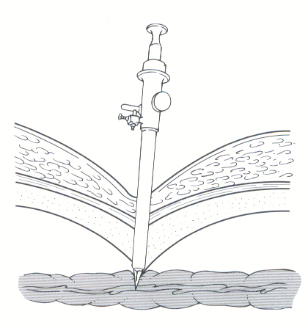
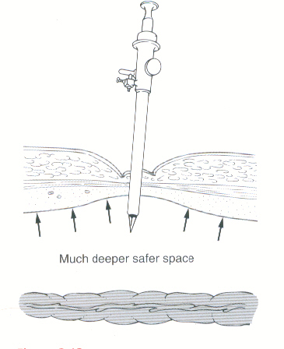
Primary port-closed entry
The greater the gas bubble & abdominal wall tension the less the risk of bowel injury
Abdominal pressure= 8mmHg
Abdominal pressure=20-30mmHg

Slide 10
Primary port-closed entry
An intra-abdominal pressure of 20-25 mmHg should be achieved before inserting the primary trocar
The distension pressure should be reduced to 10–15 mmHg once the insertion of the trocars is complete
The primary trocar should be inserted at 90 degrees to the skin initially then decreased to 45-60 degrees depending on body habitus, through the incision at the base of the umbilicus
Once the laparoscope has been introduced look straight down and rotated 360 degrees below entry site to check for any evidence of injury

Slide 11
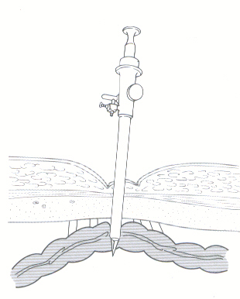
Primary port-closed entry
Closed entry can still cause bowel injury, especially if adhesions are present
Other injuries
Vascular injury
Retroperitoneal haemorrhage
Bladder injury
Injury to over inflated stomach

Slide 12
Primary port – Alternatives
Consider alternatives to closed umbilical entry when:
Risk of umbilical adhesions - previous (midline) laparotomy
Very slim or morbidly obese women
Failed saline test or Veress insertion x2
Unsatisfactory Veress insufflation
Alternatives include:
Open entry – variations of Hasson technique
Palmer’s point closed entry
Epigastric (Guan’s point)
RUQ
Perforation of uterine fundus
Posterior cul de sac
infrequent

Slide 13
Primary port – Palmer’s point/LUQ
Palmer’s point is the preferred alternative trocar insertion site, except in cases of previous surgery in this area or splenomegaly
Disadvantages
Limited use as camera port (far from anatomy, limited visualization of right side of abdomen)
May be limited use as insufflation site (may become blocked in Trendelenberg)
May not even be used after entry
Not cosmetic
x

Slide 14
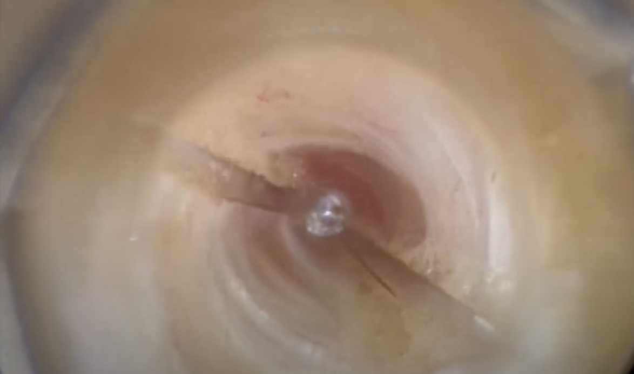
Primary port – Palmer’s point/LUQ (optical)
Skin
SubQ
Anterior Rectus Sheath
Obliques and TA
Posterior Rectus Sheath
Peritoneum
Video: Layers at Palmers Point

Slide 15
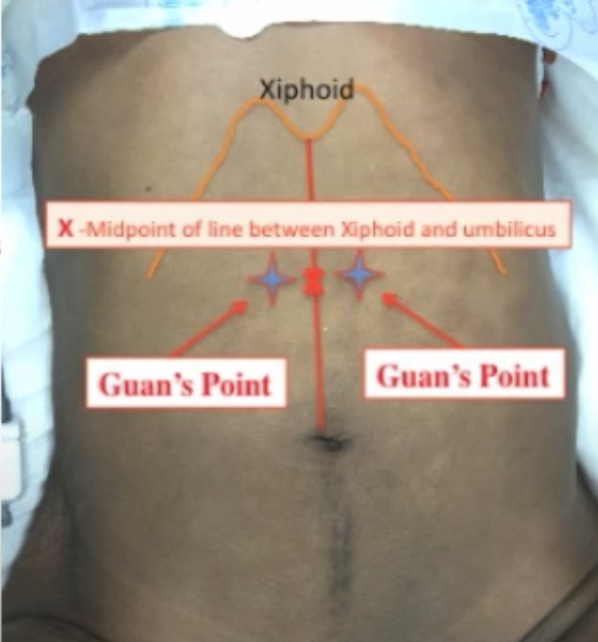
Primary port – GUAN’s POINT/Epigastric
Useful in same population you would use Palmer’s point
Less risk to stomach or liver, similar risk of vascular injury as umbilical
Located midway between xiphoid and umbilicus, 1-2cm left or right of midline
Can be moved higher if uterus is larger
May be used as camera port for entire procedure

Slide 16
Primary port – Open Entry/Hasson
Steps
Skin incision-through umbilicus or infra-umbilical
Sharply or bluntly take down subcutaneous tissues
Grasp fascia with Kocher clamps and incise
Place stay sutures
Bluntly dissect pre-peritoneal fat & enter peritoneum sharply
Place index finger inside to confirm entry into peritoneum and lack of adhesions
Place port
Typically performed in a periumbilical location
May take longer than closed entry
Requires closure of fascia on completion
Easily extended for specimen removal
Video: Hasson Entry

Slide 17
Secondary ports
Secondary ports are inserted under direct vision - an inadvertent injury from a secondary port could be considered negligent
Principles
Avoid inferior epigastric vessels
Identify location by finding intersection of round ligament and external iliac near inguinal ring
Epigastric vessels arise from this location and travel lateral to medial in the anterior abdominal wall
Avoid nerve injury
Keep secondary ports above anterior superior iliac spine (ASIS) to avoid ilioinguinal and iliohypogastric nerves
Avoid bowel/vascular injury
Controlled entry
Take down adhesions if needed to clear site for port placement or place in alternative location
Minimize hernia risk-use smallest ports possible

Slide 18
Secondary ports
Specific configurations may vary depending on surgeon preference, anatomy, and surgical pathology.
ASIS
±
Laparoscopy
Robotics

Slide 19
Secondary ports
Secondary ports inserted under direct vision at right angles to the skin at 20–25 mmHg pneumoperitoneum
Inferior epigastric vessels should be visualised laparoscopically prior to secondary port placement
Once the trocar has pierced the peritoneum it should be angled towards the anterior pelvis

Slide 20
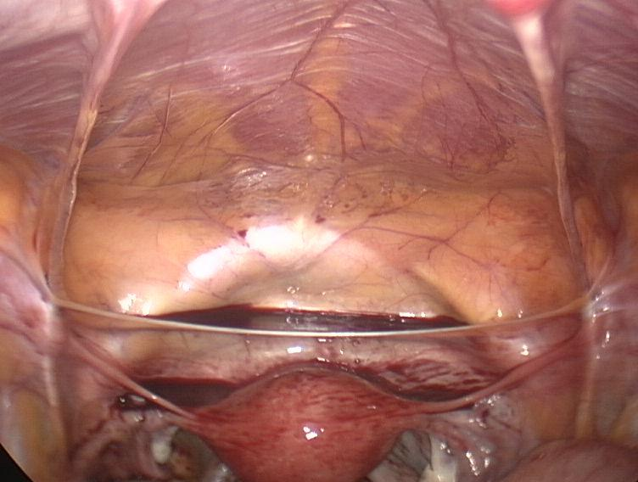
3. Secondary ports - Anatomy
Mid-line
Rectus muscles
Obliterated umbilical artery
Round ligament

Slide 21
3. Secondary ports - Anatomy
Epigastric vessels
Lateral umbilical fold
Medial umbilical fold
Round ligament

Slide 22
Entry techniques
Visualize primary port to identify:
Bleeding
Injury to omentum
Injury to bowel
(partial/complete)

Slide 23
5. Exit techniques
On removal of a laparoscope check by direct visualisation that there has not been a through-and-through injury of bowel adherent under the umbilicus
Secondary ports should be removed under direct vision to ensure that any hemorrhage can be observed and treated, if present.
Proper closure of fascia within umbilical port site to prevent wound dehiscence or hernia
Avoid hernia risk by closing fascia:
Typically close anything larger than 10mm
Some recommend:
Midline port sites > 7mm
Lateral port sites > 5 mm

