Slide 1
Instruments: laparoscopic and Robotic surgery

Slide 2
Telescope
Hysteroscopes
0 degree
12.5 degree
30 degree
Cystoscopes
30 degree
70 degree
Laparoscopes
Various sizes
2-3mm needlescopes
5mm
10mm
Visualization capabilities
0 degree
30 degree
45 degree

Slide 3
Light source

Slide 4
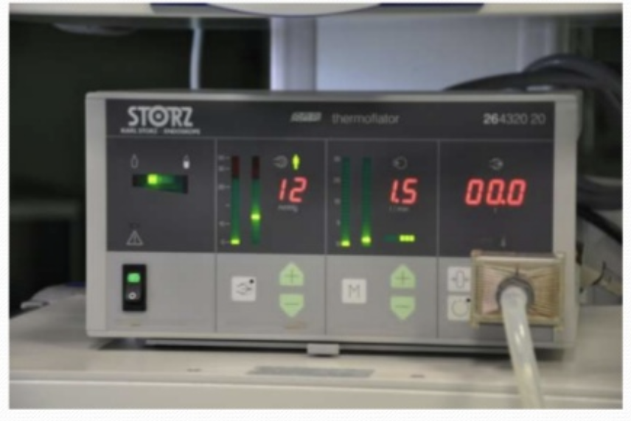
CO2 insufflator

Slide 5
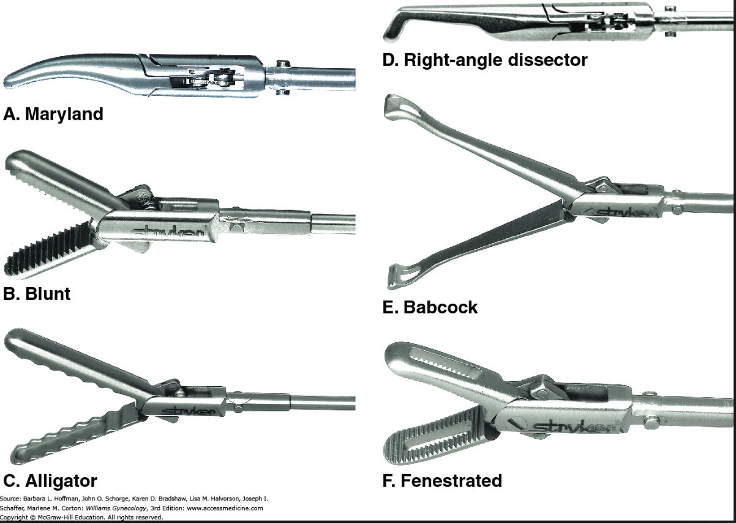
Instruments: Laparoscopic surgery

Slide 6
Instruments: Energy sources

Slide 7
Energy types
Harmonic
Ligasure
Enseal
Gyrus ACMI
Combination
Thunderbeat

Slide 8
Energy types
Monopolar
Active electrode within surgical wound
Return electrode elsewhere on patient (typically thigh)
Current must flow through the patient to the return electrode to complete the circuit
Bipolar
Both active and return electrode functions are in the surgical wound
Two tines of the forceps perform the functions of the active and return electrodes
Only the tissue grasped is included in the electrical circuit

Slide 9
Tissue Effects
ENERGY SOURCE | TISSUE EFFECTS
Monopolar electrosurgery | Vaporisation, fulguration, desiccation, coaptation*
Conventional bipolar electrosurgery | Desiccation, coaptation
Advanced bipolar electrosurgery** | Desiccation, coaptation, blade tissue transection
Ultrasonic technology | Desiccation, coaptation, mechanical tissue transection
Vessel sealing achieved with coagulation and compression.**Tissue impedance monitoring optimizes activation time

Slide 10
Monopolar

Slide 11
Bipolar

Slide 12
Advanced Bipolar Energy
Ligasure (Covidien)
Enseal (Ethicon)
Gyrus ACMI (Olympus)

Slide 13
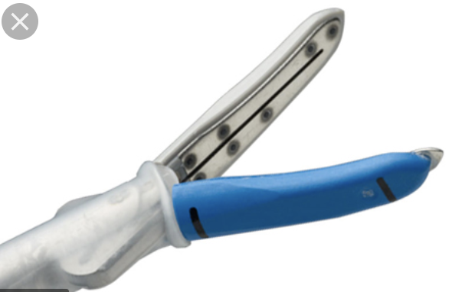
Advanced Bipolar-Ligasure
Combination of pressure and energy leading to denaturation of collagen and elastin creating a permanent seal
Hydrothermal rupture of collage crosslinks
Adjusts energy levels according to tissue impedance
Permanently fuses tissue and vessels without dessication
Seals up to 7mm, withstands up to 3 times systolic pressure
https://www.youtube.com/watch?v=26cMx8LWk_A

Slide 14
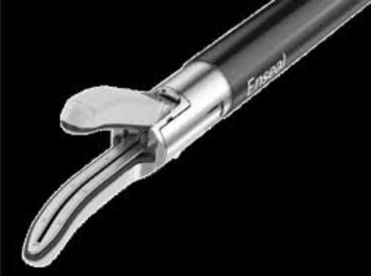
Advanced Bipolar-Enseal
Adjusts energy based on impedance
Nanotechnology adjusts and shuts off current when temperature reaches a set point→minimizes thermal spread
Vessels sealed with compression, protein denaturation and renaturation
Seals up to 7mm, withstands up to 7x systolic BP
1 mm thermal spread
https://www.youtube.com/watch?v=Nj9NLkZmliM
Notes:
Enseal
Uses a nanotechnology feedback system which adjusts the temperature by feedback from the device
minimizes thermal spread
Seals up to

Slide 15
Advanced bipolar-gyrus acmi
Plasma kinetic energy, delivered impulses
Forms vapor zones which collapses causing tissue sealing
Intermittent tissue cooling (prevents thermal damage and sticking)
Audible impedance and end point indicator
Notes:
Gyrus ACMI

Slide 16
Ultrasonic Scalpel
Converts ultrasonic to mechanical energy, 55000 vibrations/sec
Lysis of H bonds→heat→denaturation of protein→separation of tissue
Simultaneous cutting and coagulation
Seals vessels up to 5mm (up to 7mm with ACE7)
BENEFITS: greater precision in tight spaces near vital structures, less char, less smoke
https://www.youtube.com/watch?v=1SFUjk7nSqI

Slide 17
Hybrid energy-thunderbeat
Combination of advanced bipolar and ultrasonic energy
Seals vessels up to 7mm
https://www.youtube.com/watch?v=20eSwDHrjIg

Slide 18
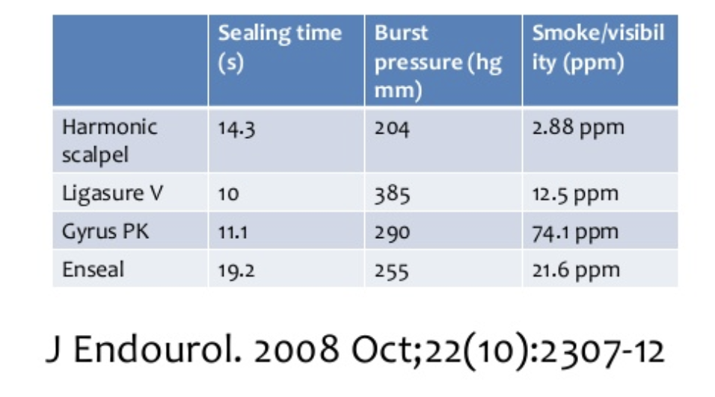
Energy sources

Slide 20
Cost comparison

Slide 21
Laparoscopic Suture devices
EndoLoop

Slide 22
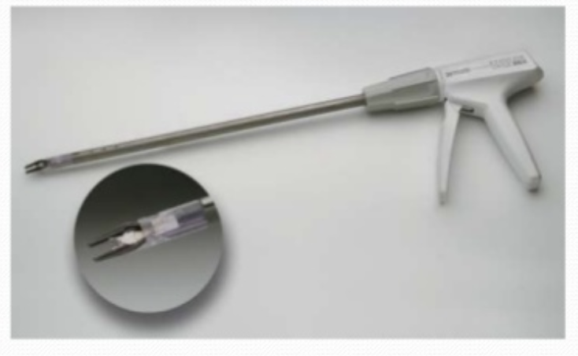
Laparoscopic clip applier
Ligate blood vessels and other tubular structures
Titanium or absorbable
Clip applier
Hemo-lock
Bulldog clamp

Slide 23
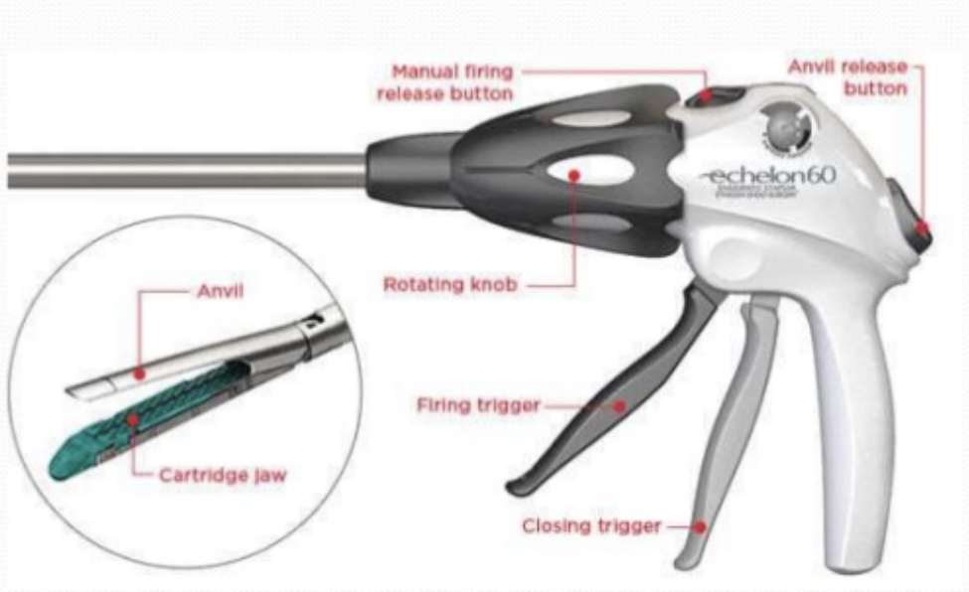
Staplers
More commonly used in general surgery
Bowel transection/anastomosis
Appendectomy
Range of loads corresponding to staple height
Blue = bowel

Slide 24
Uterine Manipulators
Notes:
he slightly curved shanks and tips provide the user a better view when suturing intravaginally,

Slide 25
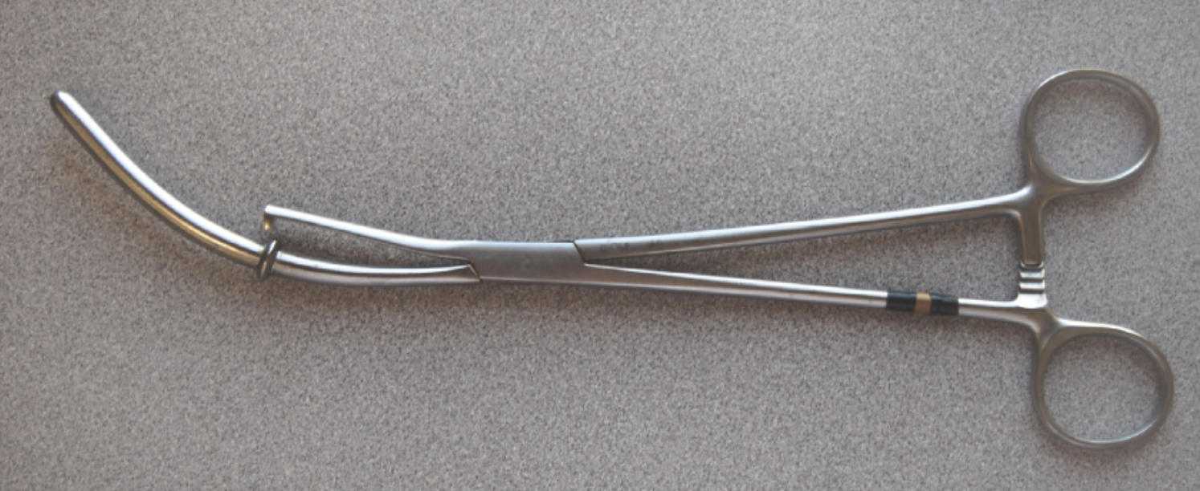
Basic
Hulka
Rubin/Cohen/Acorn

Slide 26
Humi
Modified endotracheal tube
Cheap
Disposable

Slide 27
Clear view
Uterine manipulator and injector
Balloon seal for chromopertubation
Can perform all manipulations with patient in supine position
https://www.youtube.com/watch?v=NCZRfDMA7AE

Slide 28
Colpotomy cups
Normal relationship of ureter to fornix and uterine artery
Pushing up with cup after vesicouterine peritoneum divided. Distance between fornix and ureter has increased

Slide 29
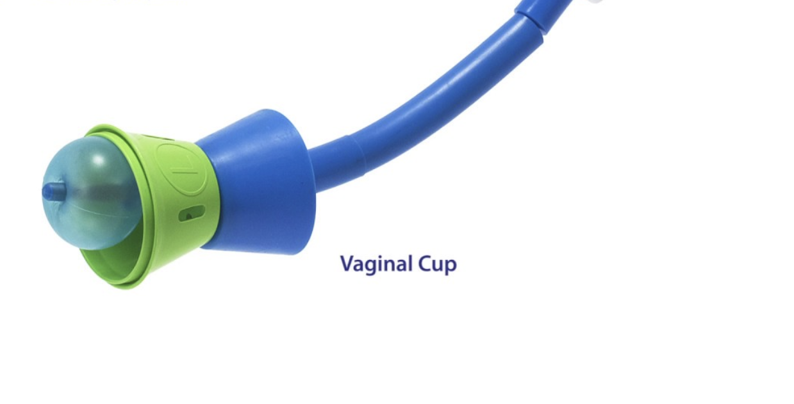
V-Care
Single use device
Variable sized colpotomy cups (Harmonic compatible)
Back cup designed to limit loss of pneumo
Variable success
Can use separate Colpo-Pneumo-Occluder
May not work well for very large uteri
Vcare Dx-Can perform chromopertubation (not an option in regular Vcare)
VCare and VCare Dx
https://www.youtube.com/watch?v=mOp4mmEnH18
https://www.youtube.com/watch?v=nRqQ8ClfEXE

Slide 30
RUMI
Reusable hand piece
Variable length tips
Koh rings in variable sizes, materials (plastic or stainless steel)
Colpo-Pneumo-Occluder-prevents loss of pneumoperitoneum
More difficult to put together and place, particularly in narrow vaginas
https://www.youtube.com/watch?v=YSDUNXI_EAs
https://www.youtube.com/watch?v=VMB42641H9I

Slide 31
RUMI ARCH
Reusable hand piece
Similar tips to RUMI, variable KOH ring sizes
Attached Colpo-Pneumo-Occluder balloon

Slide 32
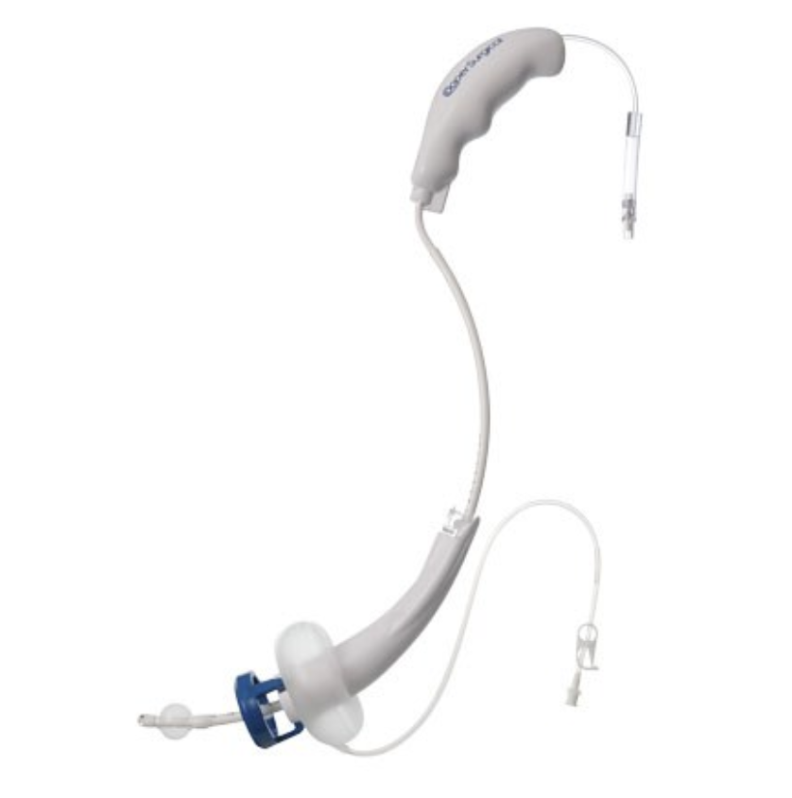
Advincula delineator
Disposable
Integrated Koh cup
Plastic, steel, flexible soft
Intrauterine tip within device-adjustable

Slide 33
Fornisee
Illuminated cup delineates fornices
Reusable uterine sound/tip
Multiple sizes
Baffled vaginal occlude built in to maintain pneumoperitoneum

Slide 34
Cost comparison

Slide 35
Trocars
Notes:
he slightly curved shanks and tips provide the user a better view when suturing intravaginally,

Slide 36
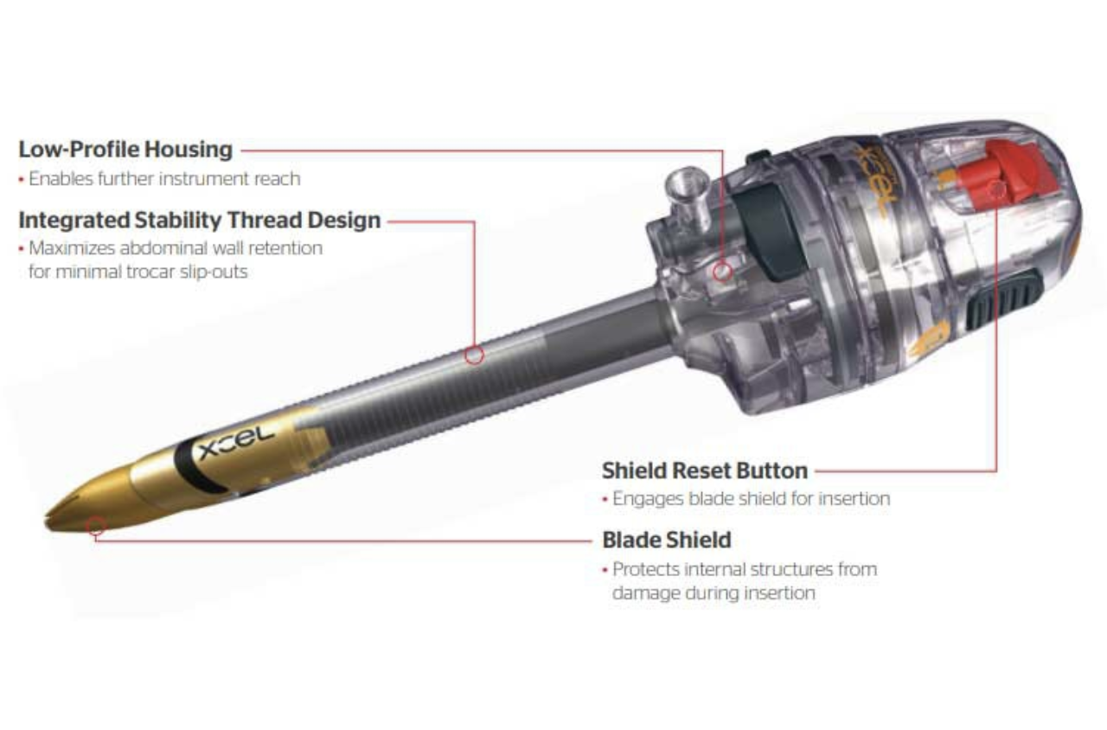
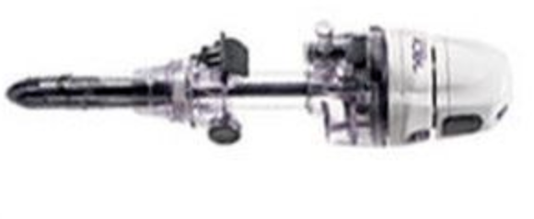
types
Cutting
Shielded
Non-shielded
Blunt

Slide 37
Versastep system
Combines a nylon stretchable sheath over a disposable Veress needle
Sheath then dilated with a blunt conical dilator
May create a smaller fascial defect with less need for closure

Slide 38
Single site/multiport systems

Slide 39
Cost comparison

Slide 40
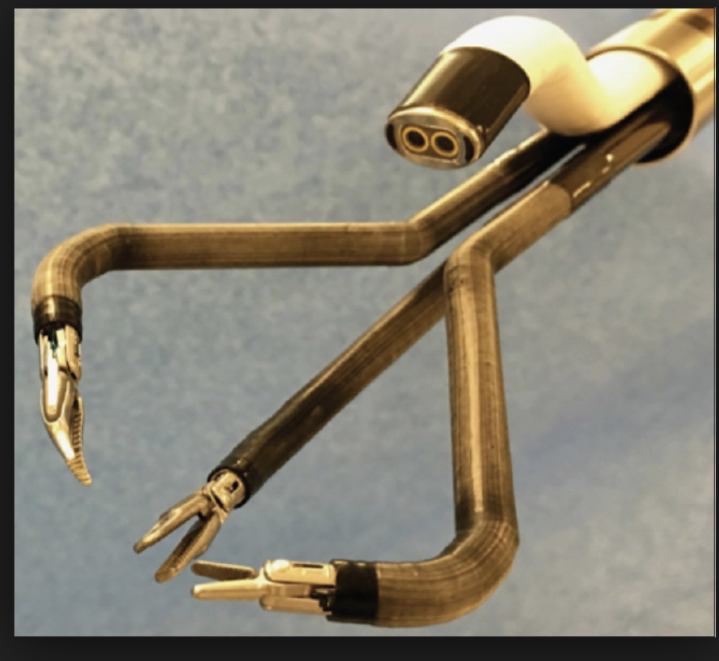
SILS surgery

Slide 41
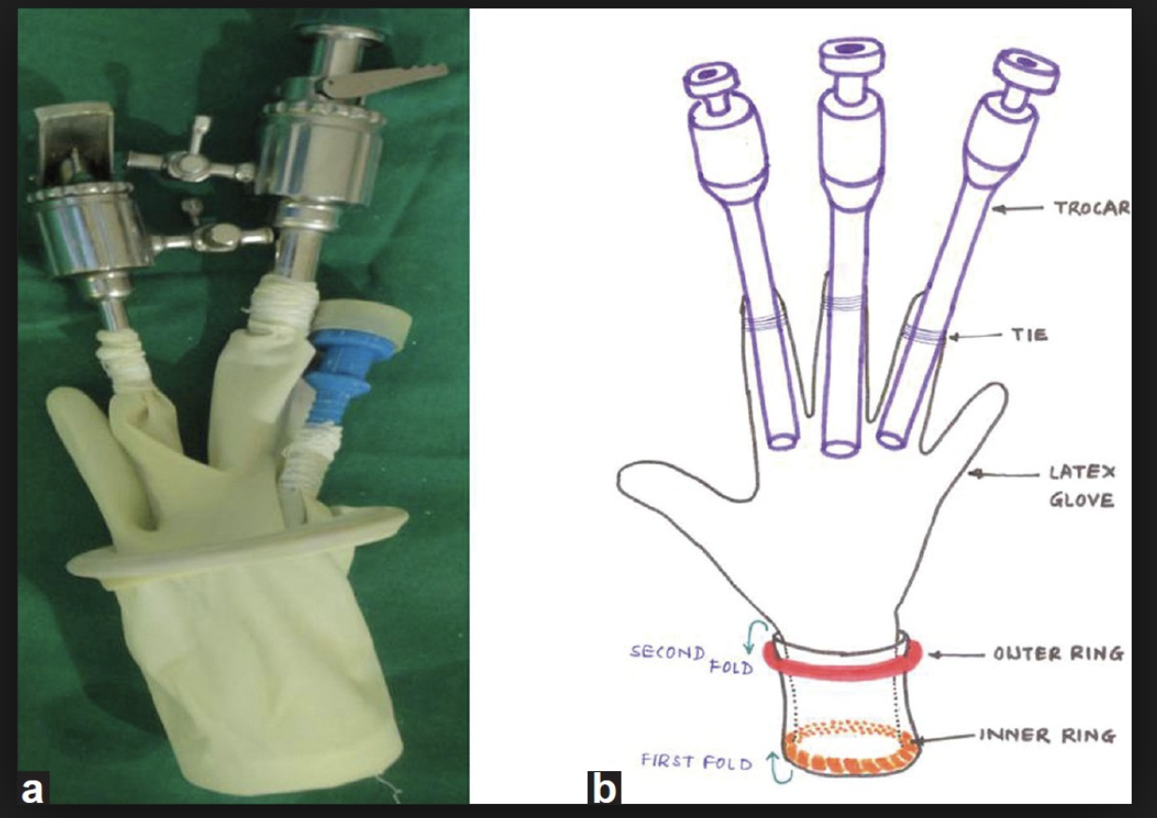
Cheap variety

Slide 42
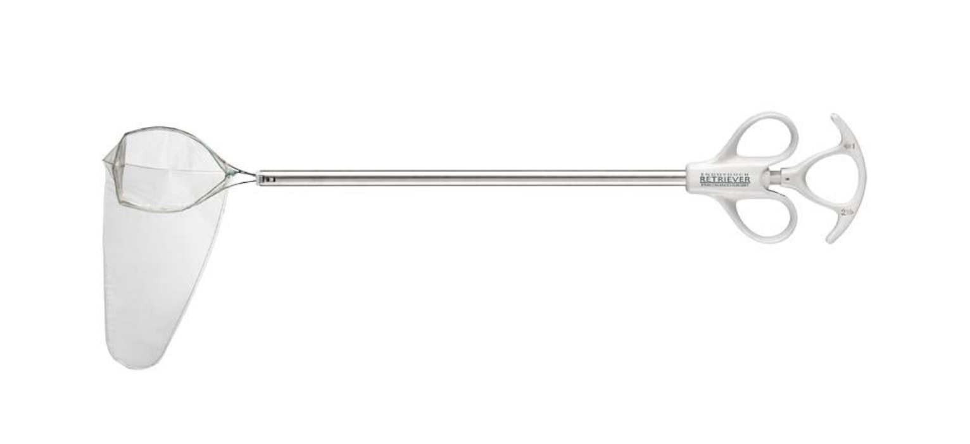
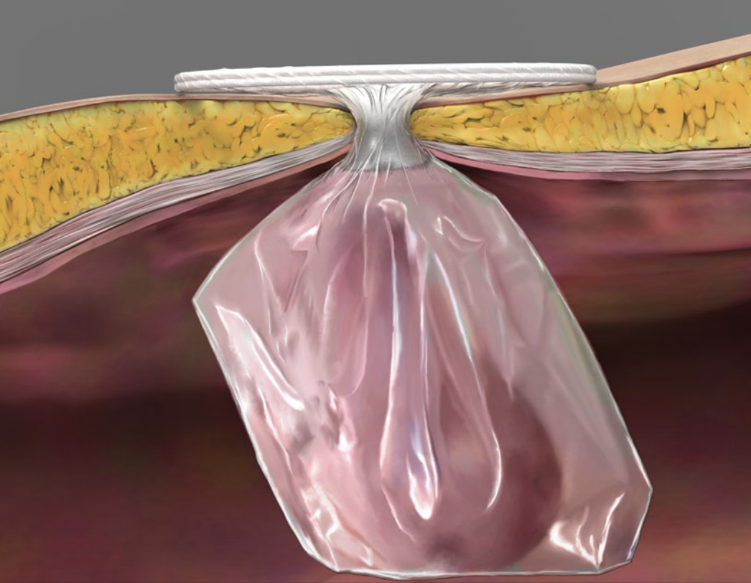
Specimen retrieval bags
EndoPouch
Anchor
Genistrong (reusable)
Alexis containment system

Slide 43
Instruments: Robotic surgery
Notes:
he slightly curved shanks and tips provide the user a better view when suturing intravaginally,

Slide 44
robotic surgery
Low grasp strength
High grasp strength
High grasp strength
Low grasp strength
High grasp strength

