Slide 1

The Urogyn CREOG Review

Slide 2
Most common cause of new-onset or acute urinary incontinence.
Urinary tract infection.

Slide 3
33 year-old woman POD # 2 s/p TAH for endometriosis. Complains of sharp pain & burning at incision. Also notices some numbness over mons & labia.
1. Diagnosis.
Ilioinguinal/Iliohypogastric Nerve Injury
2. Most likely cause.
Direct injury, incorporation in fascial closure or scar tissue when Pfannenstiel incision edges extend beyond edge of rectus muscles laterally.

Slide 4
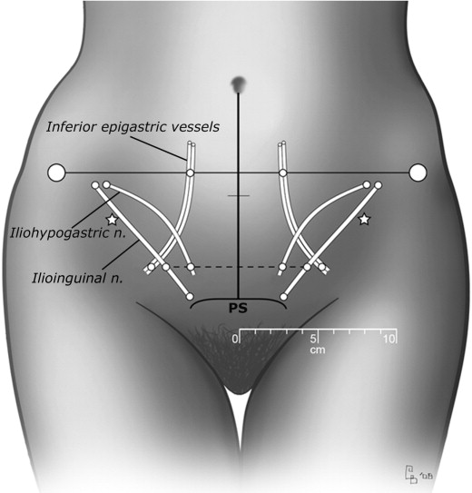
Ilioinguinal/Iliohypogastric Injury
Rahn et al. 2010
Iliohypogastric
3.8 cm lateral to midline
range 1.3-5.7 cm
ends 2 cm above SP
Ilioinguinal
5.9 cm lateral to midline
range: 4-8 cm
Neuropathy: burning or sharp groin pain radiating to vulva
Pfannenstiel Incision

Slide 5
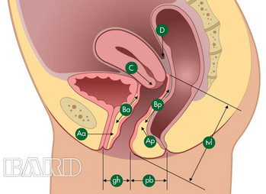
In a woman with Stage III uterovaginal prolapse, what are the possible values for POP-Q point Aa?
-3 to +3
Aa = point on anterior vaginal wall that is 3 cm proximal to hymen (if support is perfect, then Aa is -3)

Slide 6
Shuffling gait, dementia, urinary incontinence.
Normal pressure hydrocephalus.

Slide 7
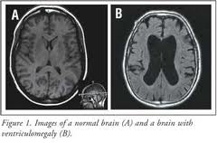
Normal Pressure Hydrocephalus
pathologically enlarged ventricles
normal opening pressures on LP
no structural blockage of CSF circulation
Cause:
impaired absorption of CSF
intraventricular & subarachnoid hemorrhage
meningitis, head injury
Features:
Gait difficulty: shuffling, like feet are stuck to the floor, short steps, feet rotated outward, turns take several steps
Cognitive disturbance: apathy, decreased attention & concentration, loss of executive function
Urinary incontinence: starts with urgency, later shows lack of concern regarding incontinence
Dx: MRI

Slide 8
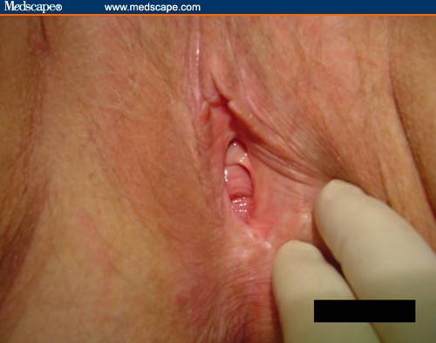
Louise is a 55 yo G3P3 PM ♀ with complaints of occasional burning with urination, itching, and pain with intercourse.
Best option for initial treatment is:
Water-based lubricant
b. Estrogen cream
c. Clobetasol ointment
d. Boric acid tabs + weekly Fluconazole x 4 weeks

Slide 9
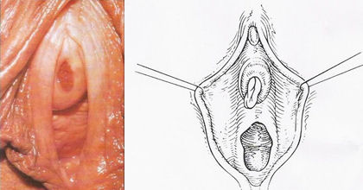
Vulvovaginal Atrophy
Signs
Atrophy of introitus & labia
Pale dry mucosa
Redness or petechiae
Loss of vaginal rugae
Cervix flush with vagina
Narrowing of vaginal canal
Thin watery discharge
Urethral caruncle

Slide 10
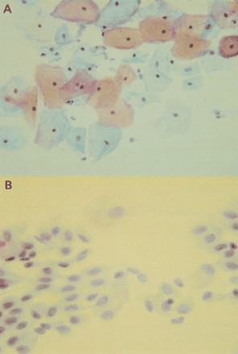
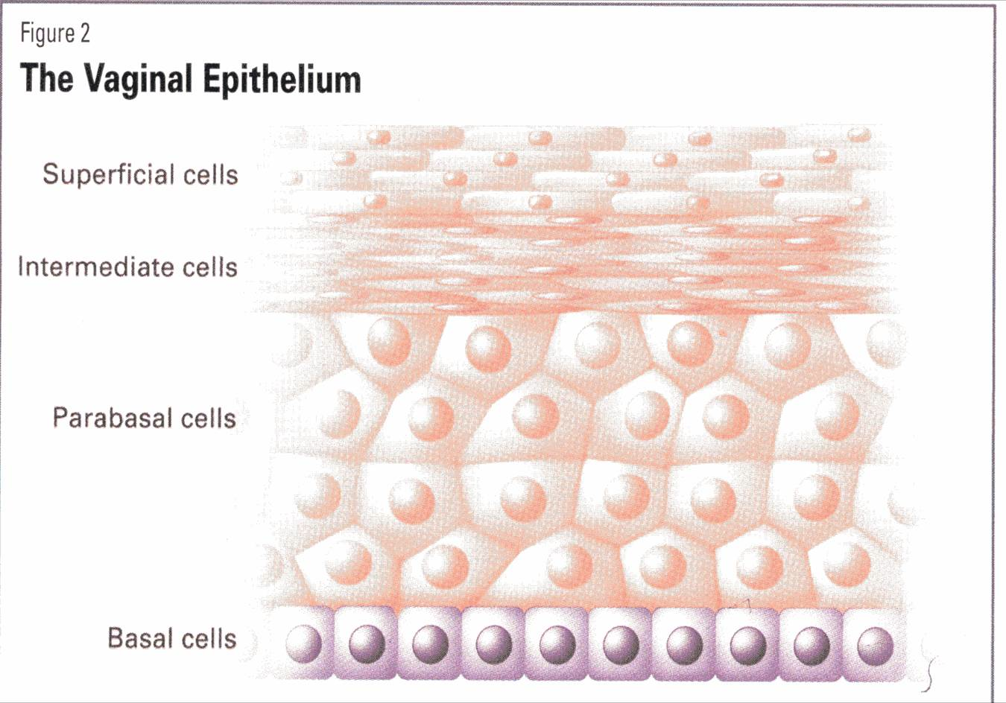
Vulvovaginal Atrophy
Diagnosis
CLINICAL
pH > 4.6 (no BV)
Vaginal Maturation Index (VMI)
- <5% superficial cells
- predominance of parabasal cells

Slide 11
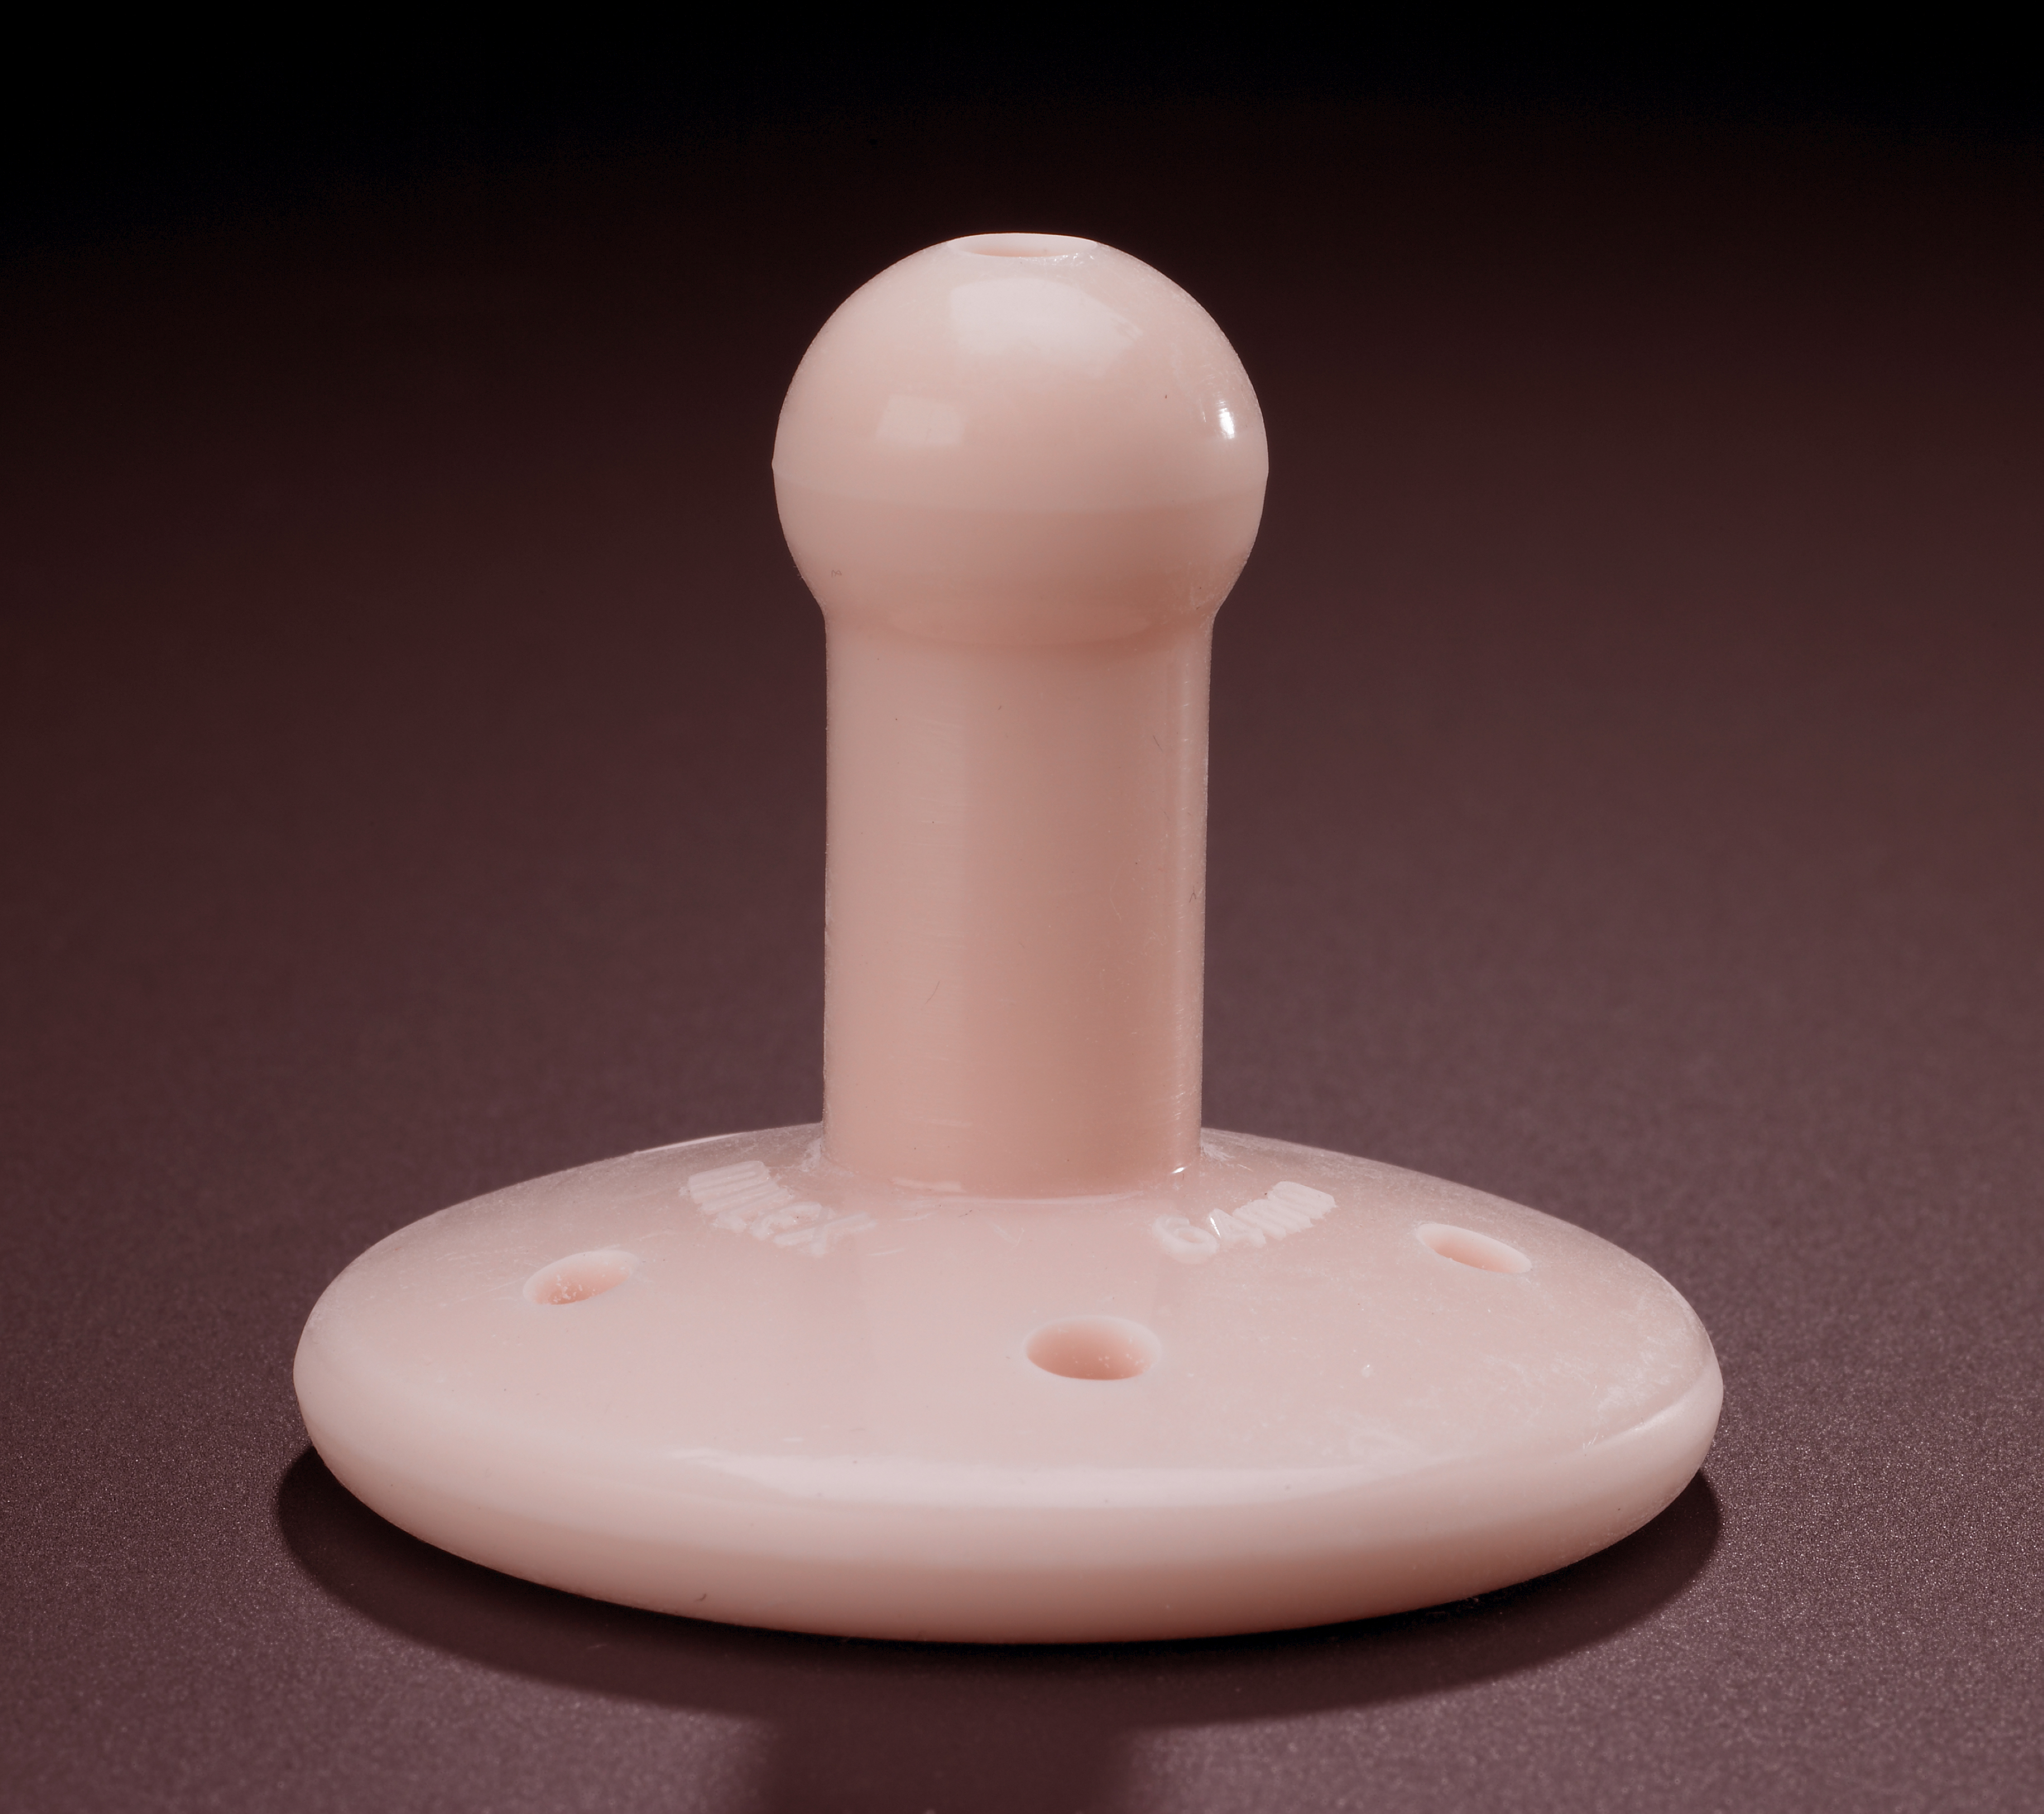
1. Name this device.
Gellhorn pessary.
2. What is this used for?
Apical prolapse.
3. List 3 potential complications of use.
Erosion, granulation tissue, infection, incarceration, fistula.
4. List 2 contraindications to use.
Inability to follow-up, non-healing erosion/ulceration, fistula
5. List 2 factors associated with unsuccessful pessary fitting.
TVL < 6 cm, introitus > 4 fingerbreadths

Slide 12
Pessaries
Candidate for pessary: anyone
Successful Fitting more likely if :
- Vaginal length > 6 cm
- Introitus < 4 fingerbreadths
Risks: erosion/ulceration, infection, incarceration, fistula
Pessary Care: self-care
office care q 3 months
vaginal estrogen tx for atrophy
Contraindications: non-healing erosion/ulceration
inability to follow-up for pessary care

Slide 13
Assess and proceed to next slide for questions.

Slide 14
Age
Childbirth
Family History
Chronic cough/Pulmonary Dz
Smoking
Obesity
Collagen Disorders
1. List 5 risk factors for this condition.
Behavioral Management
Pelvic Floor PT
Pessary
2. Name 3 non-surgical treatment options.
3. List 3 potential surgical treatment options.
Bulking Agent Injection
Burch Urethropexy
Midurethral Sling

Slide 15
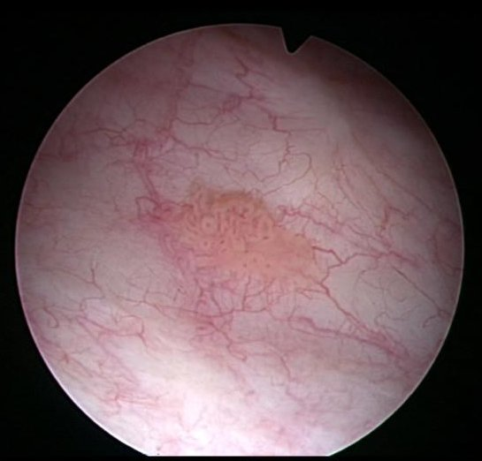
Most likely diagnosis:
a. Interstitial cystitis
b. Bladder cancer
c. Chronic UTI’s
d. Foreign body reaction to mesh erosion

Slide 16
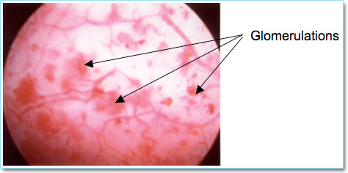
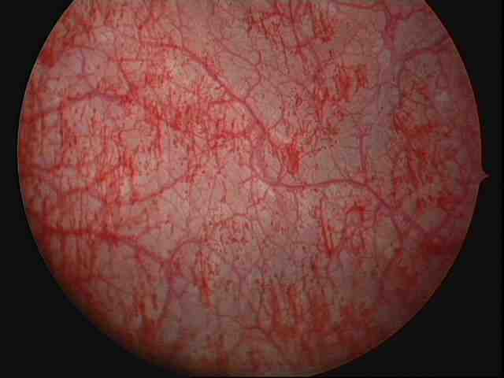
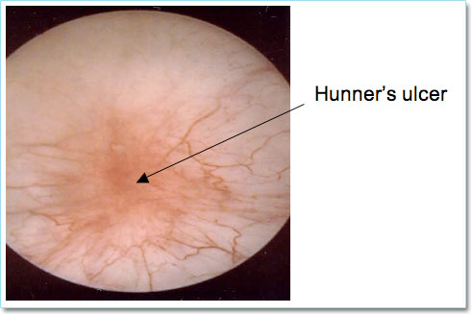
Interstitial Cystitis
Glomerulations & bleeding after hydrodistension
Found in 5-10% of IC cases

Slide 17
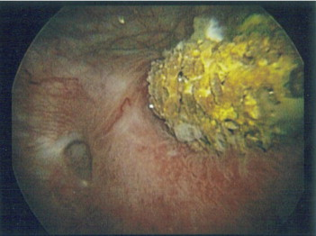
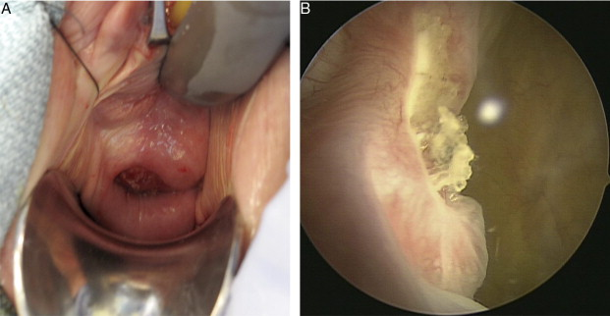
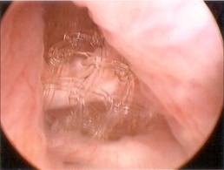
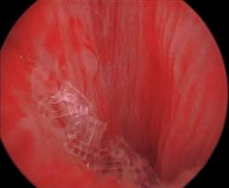
Mesh in the bladder
mesh
Calcification of eroded mesh
Mesh in urethra

Slide 18
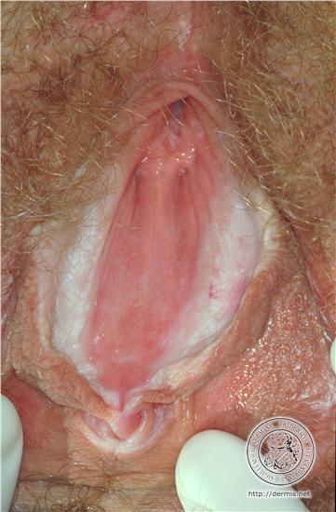
Louise is a 55 yo G3P3 PM ♀ with complaints of occasional burning with urination, itching, and pain with intercourse.
Best option for initial treatment is:
Water-based lubricant
b. Estrogen cream
c. Clobetasol ointment
d. Boric acid tabs + weekly Fluconazole x 4 weeks

Slide 19
What is Louise’s risk of developing vulvar cancer?
5%
10%
20%
30%
What type of vulvar cancer?
SCC

Slide 20
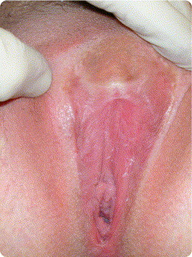
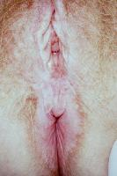
Lichen Sclerosus
Features
thin, white, wrinkled skin
fissures
obliteration of the labia minora, stenosis of the introitus
hourglass, butterfly, or figure-8 pattern involves the perivaginal and perianal areas
LS does not affect the inner reproductive organs, such as the vagina and uterus
Clitoral Phimosis
outer and inner lips of
the vulva fuse and
bury the clitoris
Figure of 8 Pattern

Slide 21
Lichen Sclerosus
** 20% of patients have extra-genital lesions
** 5% increased risk of vulvar malignancy (SCC) with genital LS
Onset:
prepubertal girls
peri/postmenopausal women
Cause: unknown
genetic predisposition with triggered onset
autoimmune
- assoc with alopecia, vitiligo, thyroid dz, pernocious anemia. DM
- 75% have Ab to extracellular matrix protein 1
- activation of CD1a+ Langerhans cells in epidermis
Tx:
annual exam with biopsy of suspicious lesions
1st line: clobetasol ointment daily x 6-12 weeks; then maintenance 1-2 x/wk
2nd line: intralesional triamcinolone injection

Slide 22
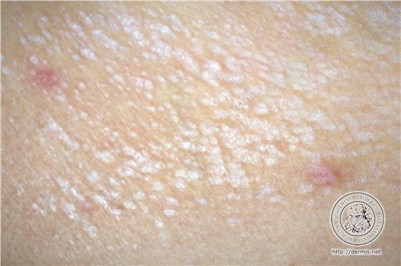
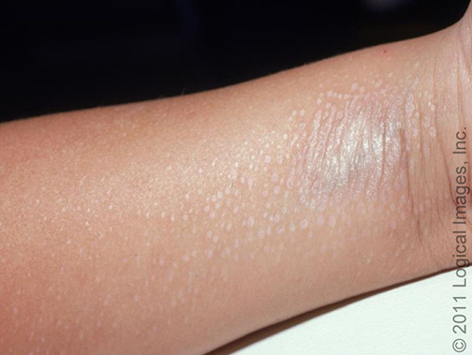
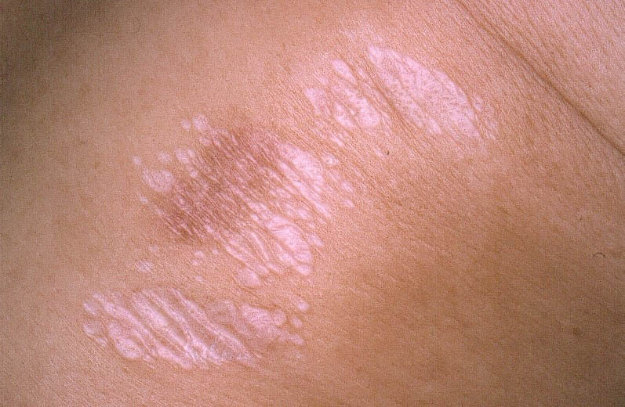
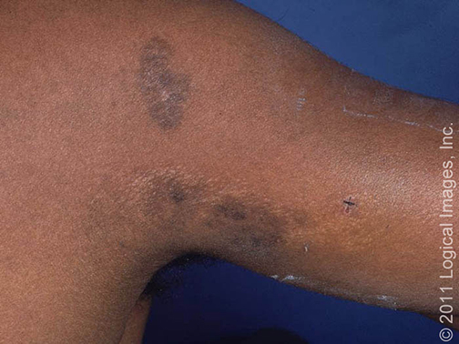
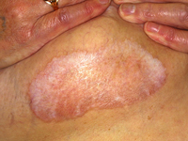
Extra-Genital Lichen Sclerosus
** 20% of patients have extra-genital lesions
** no increased risk of SCC at extra-genital lesion sites

Slide 23
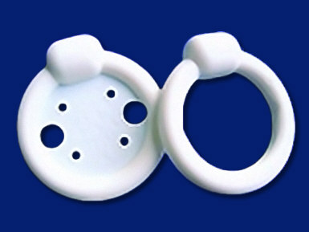
What is this device?
Continence ring & continence ring with support.
What is it used for?
Stress urinary incontinence.
What diagnostic testing is required before you can prescribe this type of pessary to a patient?
None. Can used based on symptoms even if cough stress test negative in office. Must visually confirm SUI before any surgery.

Slide 24
Which set of POP-Q measurements represents Stage IV prolapse?
a. Aa= 0, Ba= 0, Ap= 0, Bp= +2, C= +4, D= 0, TVL= 7
b. Aa= +3, Ba= +4, Ap= +3, Bp= +4, C= +6, D= +5, TVL= 9
c. Aa= +1, Ba= +5, Ap= 0, Bp= 0, C= 0, D= -2, TVL= 8
d. Aa= +3, Ba= +4, Ap= +2, Bp= +3, C= +5, D= +3, TVL= 7
Stage IV= leading > (TVL-2cm)

Slide 25
“ Seriously, every single time. I am almost there and -poof- nothing. Even my vibrator has given up on me.”
Most common cause of this sexual dysfunction is
a. Sexual trauma or abuse
b. Androgen insufficiency
c. Early surgical menopause
d. SSRI use

Slide 26
SSRI-related Female Orgasmic Disorder
What % of women taking SSRIs have anorgasmia or delayed orgasm?
30-40%
What is the anti-depressant of choice for women with this problem?
buproprion
What other medication can you try if a woman can not be adequately treated without an anti-depressant that causes her orgasm problems?
sildenafil

Slide 27
Female Orgasmic Disorder
Definition: persistent or recurrent difficulty, delay in or absence of attaining orgasm following sufficient sexual stimulation and arousal which causes personal distress
Prevalence: 19%¹
SSRI-associated Sexual Dysfunction
20% with loss of libido, 30-40% anorgasmia or delayed orgasm¹
may be due to peripheral effects of serotonin on genital smooth muscle and nerve function
The most common side effect in women is orgasmic disorder.
Recommendations for treatment include:
decreasing antidepressant dose (as possible)
changing to a different antidepressant
- buproprion is the alternative drug of choice; may also have prosexual effects
sildenafil
- improves ability to reach orgasm & orgasm satisfaction and decreases orgasm
delay compared to placebo²
1. Leiblum SR, Koochaki PE, Rodenberg CA, et al. Hypoactive sexual desire disorder in postmenopausal women: US results from the Women’s International Study of Health and Sexuality (WISHeS). Menopause 2006;13(1):46-56.

Slide 28
35 year old woman POD #1 s/p TAH for fibroids falls getting out of bed. She complains of difficulty bending at her right hip and straightening her right knee.
1. Diagnosis.
Femoral neuropathy.
2. Most likely cause(s).
Compression by retractor blades
- pressure on or retraction of psoas m overlying nerve
Excessive hip flexion/Extreme hip adduction & external rotation
- compression against inguinal ligament

Slide 29
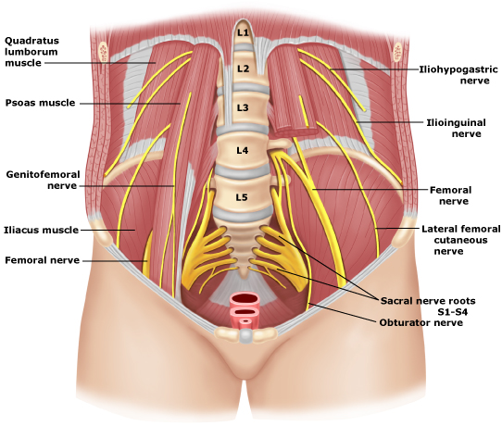
Femoral Nerve Anatomy
Risk factors for injury
wide Pfannenstiel
BMI < 20
OR time > 4 hrs
narrow pelvis
self-retaining retractors
poor patient positioning
exits lateral to psoas muscle to exit pelvis underinguinal ligament

Slide 30
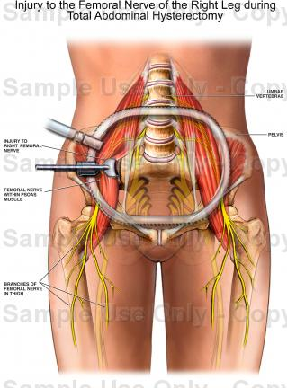
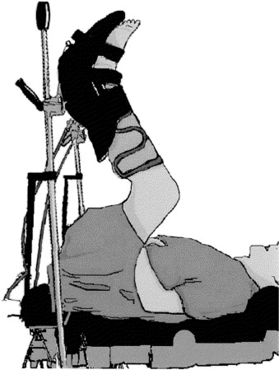
Femoral Nerve Injury in GYN Surgery
Compression by retractor blade or packing
Compression against inguinal ligament

Slide 31
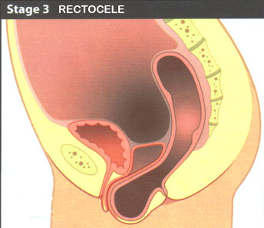

Most commonly reported symptom of rectocele.
Vaginal splinting to have a bowel movement.

Slide 32
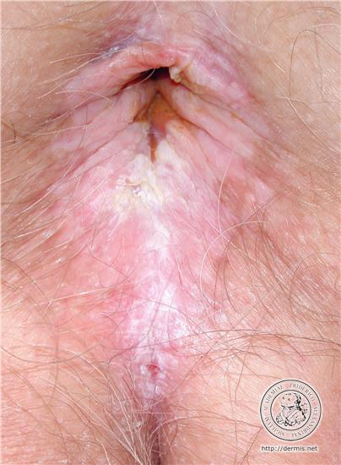
Louise is a 55 yo G3P3 PM ♀ with complaints of occasional burning with urination, itching, and pain with intercourse.
Best option for initial treatment is:
Water-based lubricant
b. Estrogen cream
c. Clobetasol ointment
d. Boric acid tabs + weekly Fluconazole x 4 weeks

Slide 33
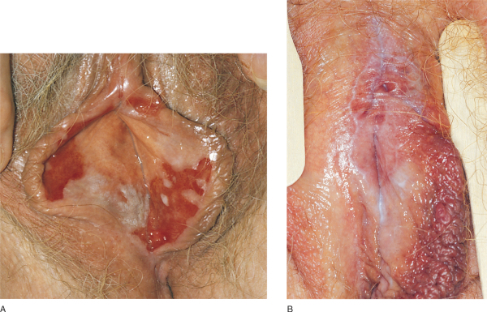
Lichen Planus
Cause: unknown
activated CD8+ T-cells against basal keratinocytes?
upregulation of ICAm-1 & cytokines?
Association with Hepatitis C: controversial
possible association in meta-analysis
have high suspicion for LS in HCV patients with sx
suggestive of LS
value of screening for HCV in patients diagnosed
with LS not established
Features:
may affect genitals, skin, nails, oral mucosa
may involve both vulva & vagina
most common type: erosive
lesions tend to be persistent & resistant to Tx
no increased risk of vulvar malignancy
Vulvar Tx:
1st line: clobetasol
2nd line: tacrolimus
Vaginal Tx:
1st line: hydrocortisone supps
2nd line: IM triamcinolone

Slide 34
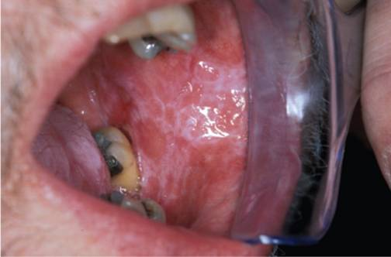
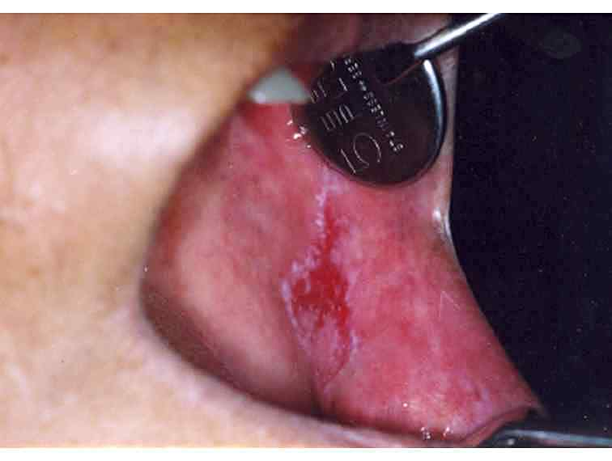
Oral Lichen Planus
Features:
bilateral & symmetric distribution
most common site: posterior buccal mucosa
other: gingiva, tongue, labial mucosa, lower lip
** 20% of women with oral lesions also have genital manifestations
** 50% of women with any type of lichen planus have genital manifestations
Reticular- Wickham’s striae
Erosive

Slide 35
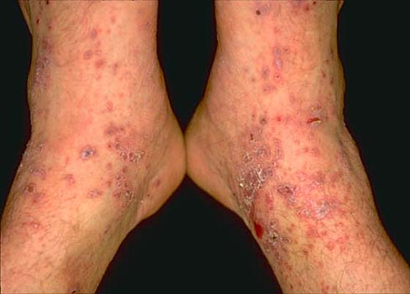
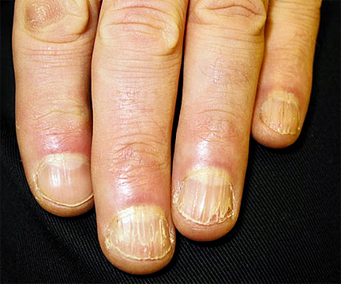
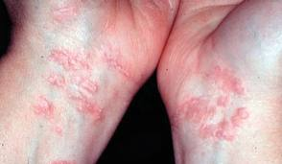
Other Lichen Planus
flexor surfaces of arms & legs
wrists are very common site

Slide 36
Please match the antibiotic commonly used for treatment of UTI to its potential adverse effect.
Toxic epidermal necrosis
Pelvic organ prolapse
Pulmonary fibrosis
Hepatitis
Achilles tendon rupture
Dry mouth
Ciprofloxacin
TMP-SMX
Nitrofurantoin

Slide 37
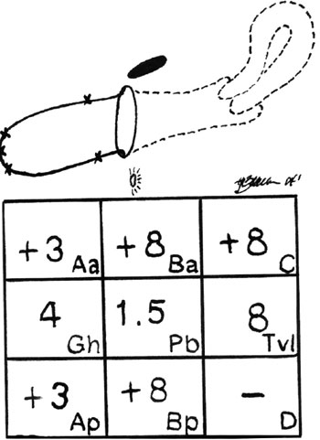
1. Diagnosis.
Stage III post-hysterectomy vaginal vault prolapse.
Aa= +3 Ba= +7
Ap= +3 Bp= +7
C= +7
TVL= 10
2. Treatment options.
Pessary (Gellhorn).
Vaginal suspension (SSLS).
Sacrocolpopexy.
Colpocleisis.

Slide 38
For treatment of uncomplicated acute bacterial cystitis, which of the following antibiotics should be given as a 3-day course?
Trimethoprim-sulfamethoxazole
Ciprofloxacin
Nitrofurantoin
a & b
b & c
All of the above.
3 days
3 days
7 days

Slide 39
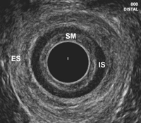
Anal US
IS= internal anal sphincter
ES= external anal sphincter
B
A

Slide 40
Most common causative organism for UTI in postmenopausal woman.
E. coli

Slide 41
Most commonly reported symptom of pelvic organ prolapse.
Bulge.

Slide 42
List 5 indications for multi-channel urodynamic testing.
Reported symptoms don’t match clinical picture
Unable to interpret patient symptoms
Previous incontinence or prolapse surgery
Neurologic disease
Urinary retention
No improvement with initial conservative management
Evaluate for occult SUI

Slide 43
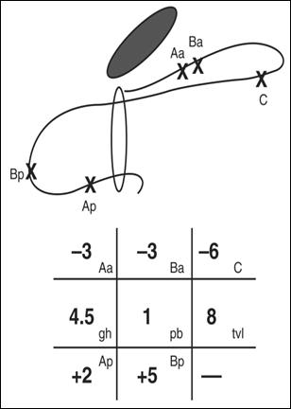
Aa=-3 Ba= -3
Ap= +2 Bp= +5
C= -6
TVL= 8
Diagnosis.
Treatment options.
Stage III rectocele.
Posterior colporrhaphy. Likely enterocele repair.
What reported symptom(s) would make you suspect the presence of an enterocele?
Sensation of incomplete evacuation, pressure.

Slide 44
Margaret is a 26 yo G4P3 woman at EGA 30 wks who presents with gross hematuria. She has previously undergone 3 CD at term. Her pregnancy has been complicated by placenta previa that has been followed on serial US. She denies dysuria, fever, chills, flank pain. She is not having any contractions and her uterus is non-tender. FHT is reactive.
Appropriate options for further evaluation/diagnosis include all of the following except:
a. Ultrasound
b. MRI
c. UA C&S
d. Cystoscopy

Slide 45
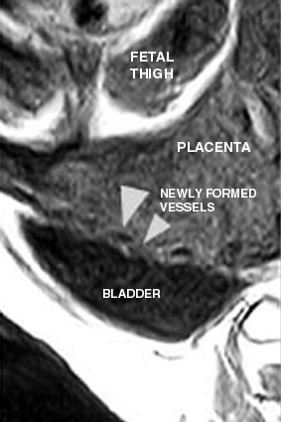
Hematuria in Pregnancy
Placenta percreta
Rare; 7% of all placenta accretas
which occur 1 in 500-2500 pregnancies
Sx: 30% with bladder invasion present
with hematuria
Dx: MRI or US
(Do not cysto.)

Slide 46
Name one defect not evaluated by the POP-Q system.
Paravaginal Defect
Enterocele
Apical contribution to a cystocele

Slide 47
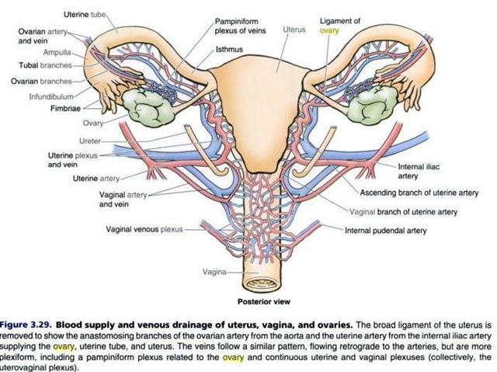
Name the two most common sites for ureteral injury during gynecologic surgery.

Slide 48
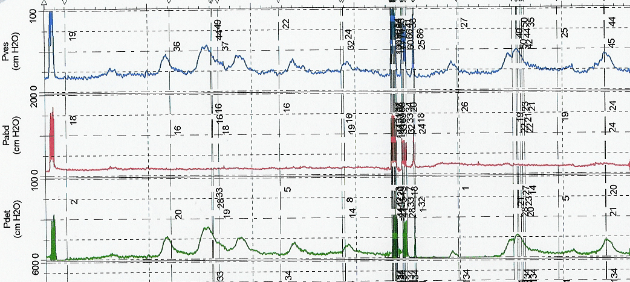
Vesical (bladder pressure)
Intra-abdominal pressure
Detrusor muscle pressure
Bladder contractions- seen only in bladder & detrusor channels (if also in intra-abdominal channel suggests Valsalva)
Diagnosis?
Detrusor overactivity.

Slide 49
The muscles of the levator ani include all of the following except:
a. puborectalis
b. obturator internus
  c. iliococcygeus
d. pubococcygeus

Slide 50
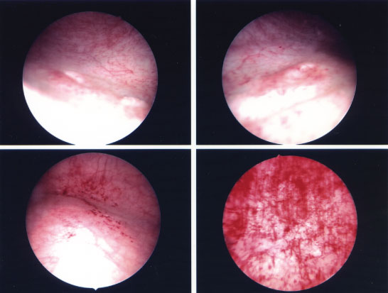
23 yo G0P0 woman with complaint of dysuria and urinary urgency & frequency. Repeated treatment for bladder infection with no improvement in symptoms.
Initial treatment?
IC diet
pentosan polysulfate
(Elmiron)
amitriptyline
hydroxyzine
bladder instillation
(lidocaine + heparin)
hydrodistension

Slide 51

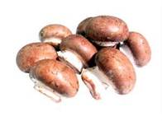



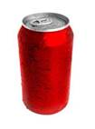

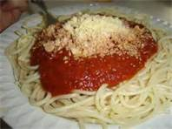


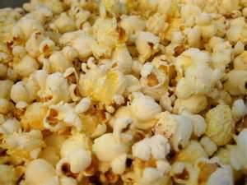
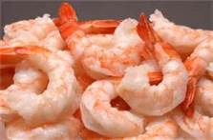
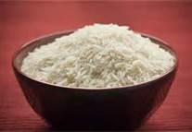




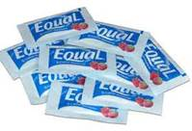



Which of these groupings is an appropriate part of the IC diet?
A
NO
B
NO
NO
NO
NO
NO
NONE
C
D
NO
NO
NO
NO

Slide 52


Etiology of IC: unknown
urothelial abnormality (altered HLA expression, decreased expression of uroplakin & chondroitin, altered cytokeratin profile, defective GAG layer.
Most commonly cited cause
GAG layer is disrupted allowing solutes in urine such as potassium to directly contact the urothelium leading to activation of nerves and onset of pain

Slide 53
Interstitial Cystitis/Painful Bladder Syndrome
** a visceral pain syndrome
5x more common in women than men
coexisting conditions: vulvodynia, IBS, fibromyalgia, CPP
Sx:
increased discomfort with bladder filling; relief with voiding
bladder pain, bladder spasm, bladder pressure
suprapubic and/or urethral pain, dysuria, urgency, frequency, nocturia
triggers: sexual intercourse, acidic foods, alcohol, stress
Dx: usually clinical
PE: tenderness of urethra/bladder base, abdominal wall, hip girdle, allodynia,
PFM tenderness/tightness
negative UCx; may have hematuria
check PVRV to rule-out urinary retention
Void Diary: multiple frequent small voids in response to increasing discomfort/pain
consider a trial of lidocaine instillation
Potassium Sensitivity Test not recommended
Cystoscopy not required for diagnosis

Slide 54
Mary is POD 15 from a “hysterectomy & bladder lift” for uterine fibroids and prolapse. She is complaining of worsening urinary incontinence which occurs consistently throughout the day but is worse with sudden exertion. Prior to surgery she occasionally leaked urine with coughing and with a strong urge to urinate.
Differential diagnosis?
UTI
Vaginal infection
Stress urinary incontinence
Urge urinary incontinence
Urinary retention
Fistula

Slide 55
Exam is somewhat limited by post-op discomfort but you ask her to cough and you see passage of clear fluid coming from between the labia. On speculum exam, the vaginal walls appear moist but no fluid is seen in the vaginal vault. No defects are visualized in the cuff or vaginal wall.
The best next step is to establish a diagnosis:
a. Urine culture
b. Urodynamics
c. Voiding cystourethrogram
d. Tampon test

Slide 56

You instill methylene blue colored saline into her bladder and ask her to insert a tampon and return in 3-4 hours after working out at the gym and doing some errands.
If she has a fistula, which is the most likely appearance of the tampon?
A
B
C
D

Slide 57
Your initial tampon test was negative but you are still worried she has a fistula- maybe 3 hours wasn’t long enough. You ask her to take Pyridium for 2 days and wear a tampon for 8 hours. The tampon looks like this:
The most likely diagnosis is
a. Vesicovaginal fistula
b. Urethrovaginal fistula
c. Ureterovaginal Fistula
d. Either a or c
e. All of the above
f. Tampon on fire

Slide 58
Aa= -3. Ba= -3. Ap= +1. Bp= +1. C= -8. D= -9.
TVL= 10. GH= 3. PB=2.
Grade 2 rectocele.

Slide 59
Classic sign of interstitial cystitis/painful bladder syndrome seen on cystoscopy.

Slide 60
Assess and proceed to next slide for questions.

Slide 61
Timed Voids
Normal Fluid Intake
Avoid Bladder Irritants
PFM Contraction to suppress urgency
Glaucoma
Gastric paresis
Dementia
Urinary retention
MG
Constipation
Dry mouth
Mental status changes
Blurry vision
Behavioral Management
Anti-cholinergic medication
1. List the 2 major components of treatment.
2. List 4 components of behavioral management.
3. List 4 potential side effects of anti-cholinergic medications.
4. List 3 contraindications to use of anti-cholinergic medications.

Slide 62

Carol is 10 days status post TLH-BSO for treatment of endometriosis. She has been experiencing watery vaginal discharge that has not resolved after treatment for presumed BV.
The incidence of this complication after GYN surgery is generally thought to be:
a. 0.0008%
b. 0.008%
c. 0.08%
d. 0.8%

Slide 63
Incidence of Vesicovaginal Fistula after hysterectomy:
2.2/1000 TLH
1.0/1000 TAH
0.2/1000 TVH
Incidence of Ureteral Injury during hysterectomy:
13.9/1000 TLH
0.4/1000 TAH
0.2/1000 TVH
Obstet Gynecol. 1998 Jul;92(1):113-8.

Slide 64
Recommended treatment for uncomplicated acute bacterial cystitis.
TMP-SMX (Bactrim) 160-800 BID x 3 days.
If > 15-20% resistance in community:
Ciprofloxacin 250 mg PO BID x 3 days.
Nitrofurantoin 100 mg PO x BID x 7 days
Fosfomycin 3 g x 1

Slide 65

Best treatment option(s):
Ring with support pessary
b. Gellhorn pessary
c. Posterior colporrhaphy
d. A & C
e. A & B

Slide 66

Sarah is a 27 yo G2P2 premenopausal woman referred for evaluation and treatment of prolapse. She feels a bulge and has some vaginal pressure and discomfort with intercourse. She denies leakage of urine with coughing and sneezing or with urge to urinate. She has some post-void dribbling. She has had 4 urinary tract infections in the last 6 months and is currently on trimethoprim prophylaxis.
Most likely diagnosis is
a. Urethral diverticulum
b. Gartner’s duct cyst
c. cystocele
d. Bartholin’s gland cyst

Slide 67


Urethral Diverticulum
Prevalence: 1-5% of adult women
Risk Factors: pelvic trauma, periurethral surgery, AA ♀
Location: most commonly in middle or distal urethra
Cause: unknown
acquired (not congenital)
common theory: rupture of an infected obstructed
periurethral gland into the urethral lumen
Sx:
post-void dribbling
anterior vaginal wall mass, usually tender
dysuria, dyspareunia, recurrent UTIs
Dx:
pelvic exam; attempt to express urine/discharge from
suburethral mass
MRI (US also, but may miss if diverticulum is not full of fluid)

Slide 68
Point D in the POP-Q system corresponds to ______.
Posterior fornix.

Slide 69


Aa= point 3 cm proximal to urethral meatus in absence of POP
Ba= point on anterior wall that comes out farthest
Ap & Bp same but for posterior wall.
C= cervix or cuff.
D= posterior fornix; not used after hysterectomy
TVL= total vaginal length (only measurement taken without Valsalva effort)
GH= genital hiatus.
PB= perineal body.

Slide 70

Thomasina is a 65 year old G5P5 PM woman with complaints of leakage of urine with exercise. She has no pelvic organ prolapse. Cough stress test is positive. Q-tip test shows 30 degrees of excursion with Valsalva.
Best treatment options include all of the following except:
a. Transurethral collagen injection
b. Midurethral sling
c. Burch urethropexy
d. Continence ring

Slide 71


Q-Tip Test
Protocol:
Pt in dorsal lithotomy position
lubricated mini-tip swab inserted so the tip
is at the proximal urethra (estimated)
Pt asked to cough or strain
resting angle and max angle of deflection
(from rest) are recorded
Results:
< 20 degrees = lack of mobility
21-29 degrees = intermediate
> 30 = presence of mobility (“hypermobility”)
Interpretation: Assessment for urethral mobility to decide on mode of surgical treatment of SUI
- > 30 degrees excursion = midurethral sling
- 21-29 degrees = repeat or counsel
- < 20 degrees = bulking agent

Slide 72
Miriam is an 80 year old woman POD 1 s/p TLH/BSO/LND for stage I endometrial cancer. You are called to evaluate the patient . The nurse informs you she is afebrile, alert, with stable vital signs, ambulating to and from the bathroom, and tolerating some liquids when prompted. When you arrive, Miriam is out of bed and packing her suitcase. She insists that she is ready to check out and that her daughter Sarah will be arriving in 30 minutes to take her to the airport. You call Sarah on your cell phone and after Miriam talks to her, she gets back in bed. Miriam says that remembers having surgery and this is why her tummy hurts and she would like some pain medicine. When the nurse returns with the pain medicine, Miriam smiles and asks her who she is and what the medicine is for.
Dementia or Delirium?
Probably dementia.
Why?
Memory impairment but able to be prompted & redirected, no altered level of consciousness, not agitated, not withdrawn, no apparent hallucinations.

Slide 73

Delirium in the Post-operative Period
Features¹: patient is easily distracted
disordered thinking with rambling or incoherent speech
reduced level of consciousness
perceptual disturbance (hallucinations, delusions)
disturbed sleep-wake cycle
disorientation to time/person/place
memory impairment
Evaluation: vital signs, O₂ saturation, physical examination, review
of prescribed and withheld medications, CBC, serum
electrolytes, urinalysis, EKG, Chest x-ray
Treatment: Find & Treat any underlying cause
Haloperidol
Minimize use of restraints
Visual & Verbal Cues, Support
1.Diagnostic and Statistical manual of mental disorders. 3rd rev.ed. Washington,DC: American Psychiatric Association, 1987:100-4
Notes:
The criteria for diagnosis listed here are from the DSM III. The key features are altered consciousness and perceptual disturbances such as hallucinations or delusions- things that should always raise red flags!
The evaluation of a patient with delirium should aim to uncover any underlying correctable cause. Delirium may be the only clue to an underlying sepsis or electrolyte imbalance. Initial evaluation includes assessment of vital signs and oxygen saturation as well as a complete physical exam including cardiac, pulmonary, abdominal, neurologic, and mental status exams. The most useful laboratory tests are CBC, serum electrolytes, and urinalysis. EKG, serial troponin values, and chest x-ray may be added if cardiac or pulmonary abnormalities are suspected. Both prescribed and withheld drugs should be reviewed. Treatment consists of supportive care, reorientation with verbal and visual cues. Environmental cues such as dark room at night and lights on during the day. Restraints should be minimized. Haloperidol is currently the treatment of choice; sedatives should be avoided.

Slide 74

What is this device?
Ring with support pessary.
What is it used for?
Cystocele, some apical prolapse.
Tell a patient how she should care for a pessary.

Slide 75

What is it?

Slide 76
25 year-old woman POD # 2 s/p laparoscopic cystectomy for endometrioma presents with difficulty walking. Examination shows foot drop.
1. Diagnosis.
Common Peroneal Nerve Injury
2. Most likely cause.
Compression of nerve when lateral knee presses against hard surface (such as a candy cane stirrup)

Slide 77


Peroneal Nerve Injury
wraps around lateral aspect of fibula just below knee
Presentation:
“foot drop”
- difficulty dorsiflexing foot against gravity or resistance)
“steppage gait”
- patient flexes hip higher when walking to compensate
for foot drop
paresthesia over dorsum of foot & lateral shin
knee up against stirrup
knee up against boot
assistant leaning on knee

Slide 78
80% of the normal resting tone of the anal canal is provided by the ___________________________.
internal anal sphincter
IAS
Type of innervation to the ___ includes:
Parasympathetic
b. Sympathetic
c. Somatic
d. a & b
e. all of the above

Slide 79

Normal Maintenance of Anal Continence
The Internal Anal Sphincter (IAS) is a circular layer of smooth muscle that is tonically contracted, providing 80% of the normal resting pressure of the anal canal. Innervation is sympathetic & parasympathetic from S2-4.
The External Anal Sphincter (EAS) is composed of striated muscle innervated by the pudendal nerve (S2,3,4) and under voluntary control. The EAS can be voluntarily contracted to increase pressure in the anal canal. The EAS also contracts in response to increases in intrabdominal pressure to help maintain continence during coughing & sneezing.

Slide 80
“ Seriously, I never think about it. My partner says I don’t want sex the way I used to- when we get started I still don’t get as excited as I used to. What is wrong with me?”
Which of the following is/are true regarding this sexual dysfunction?
a. Most common female sexual dysfunction
b. Can not be diagnosed when responsive desire is present
c. Surgical menopause is a risk factor
d. Treatment options include buproprion
e. a, b, & c
f. All of the above

Slide 81
Hypoactive Sexual Desire Disorder (HSDD)
Definition: persistent or recurrent deficiency or absence of sexual
fantasies/thoughts, and/or desire for or receptivity to sexual activity which
causes personal distress
Prevalence:
- most prevalent female sexual disorder
While having few spontaneous sexual thoughts or little desire for sexual activity ahead of time is not uncommon, most women will experience responsive desire when sexual activity is initiated. When responsive desire is absent and subjective distress regarding these symptoms is present, HSDD may be diagnosed. An important specific risk factor is surgical menopause (oophorectomy) in women under the age of 50.
Buproprion, an atypical antidepressant that does not cause sexual dysfunction, may increase arousal in non-depressed premenopausal women with HSDD. Increased levels of both dopamine and norepinephrine may facilitate sexual desire and orgasm in women.
1. Leiblum SR, Koochaki PE, Rodenberg CA, et al. Hypoactive sexual desire disorder in postmenopausal women: US results from the Women’s International Study of Health and Sexuality (WISHeS). Menopause 2006;13(1):46-56.

Slide 82
Constance is a 32 year old G1P0 woman at 18 weeks EGA with complaints of gross hematuria and severe flank and groin pain. Urine dipstick shows hematuria but no leukocytes, nitrites, or protein. She is afebrile with stable vitals. Fundal height is appropriate and uterus is non-tender. CVAT is present on the left. Urine culture is negative.
Most appropriate treatment options include all of the following except
a. Pain control & expectant management
b.Cystoscopy & ureteroscopy with stent
c. Lithotripsy
d. Nephrostomy tubes

Slide 83



Nephrolithiasis in Pregnancy
1 in 3000-5000 pregnant women
80% present 2nd & 3rd trimester
most common stone in pregnancy: calcium phosphate
Presentation
flank pain (90%)
hematuria (80%)
gross hematuria (30%)
Diagnosis
renal & pelvic US
MR urography
low dose CT (only in 2nd & 3rd trim)
ureteroscopy
Treatment
pain control
85% of stones will pass spontaneously
ureteroscopy/stenting/nephrostomy tubes
(stents/tubes must be changed every 4-6 weeks)
shock wave lithotripsy is contraindicated
(laser lithotripsy during ureteroscopy may be possible)
laser lithotripsy

Slide 84

Diagnosis.
Disrupted EAS.
Most likely cause.
Obstetric laceration.
What % of women with this finding will develop anal incontinence?
20-30%
Long-term success rate of surgical repair of this finding?
50-60%

Slide 85
Endoanal Ultrasound
Endoanal US is the modality of choice for identification of anal sphincter defects. The central circle in the image is the location of the ultrasound probe. The inner hypoechoic (black) ring represents the IAS (labeled IS). The outer hyperechoic (gray) ring is the EAS (labeled ES).
In the lower photo, a defect in the EAS is seen as a hypoechoic break in the usually hyperechoic ring. An IAS defect would appear as a hyper echoic break in the normally hypoechoic ring.
Ultrasound-identified EAS & IAS defects are associated with lower anal squeeze pressure and lower resting tone on anal manometry.
Endoanal ultrasound can confirm suspected disruption of the anal sphincter and help identify patients who may benefit from surgical repair.

Slide 86
Aa= +7. Ba= +7. Ap= +6. Bp= +6. C= +7.
TVL= 8. GH= 5. PB= 2.
Stage IV post-hysterectomy vaginal vault prolapse.

Slide 87
“ Seriously, we can try for an hour and nothing. Even that special thing with the feather leaves me cold. I used to be good to go at the drop of a hat- nothing gets me excited anymore.”
Identify the female sexual dysfunction.
a. Sexual aversion disorder
b. Hypoactive sexual desire disorder
c. Sexual arousal disorder
d. Orgasmic disorder

Slide 88
Female Sexual Arousal Disorder
Definition: persistent or recurrent inability to attain or maintain until completion of the sexual activity, sufficient sexual excitement causing personal distress. (may be expressed as lack of subjective excitement, inadequate lubrication/swelling, or other somatic response)
Prevalence: 22%¹
Female sexual arousal disorder is diagnosed when a biological component of the expected sexual response is absent or inadequate and the patient experiences distress from the problem. A woman who sometimes experiences inadequate vaginal lubrication but is not distressed by this does not have a sexual dysfunction.
1. Leiblum SR, Koochaki PE, Rodenberg CA, et al. Hypoactive sexual desire disorder in postmenopausal women: US results from the Women’s International Study of Health and Sexuality (WISHeS). Menopause 2006;13(1):46-56.

Slide 89

55 year old woman POD # 65 s/p TVH. Complains of new bulge from opening of vagina.
1. Diagnosis.
Vaginal cuff dehiscence & evisceration.
2. Most appropriate initial treatment.
Surgical repair with bowel evaluation for viability.

Slide 90

Which of the following is the least appropriate management plan?
Gelhorn pessary
TVH, A & P repair
LeFort colpocleisis
TAH, Sacral Colpopexy

Slide 91
Marjorie is a 75 year old G2P2 postmenopausal woman presenting for an annual well-woman visit. She has no chronic medical problems except HTN currently well-controlled on metoprolol. She takes no other medications. History of appendectomy at age 23. All routine medical screening is up-to-date and normal. In the course of your usual screening, Marjorie complains of leakage of loose stool. This happens a few times a week. She has bowel movements daily- usually well-formed but looser stool a few times a week.
Describe your physical examination.
perianal inspection for fissures, hemorrhoids, rectal prolapse
anal wink reflex
digital rectal exam: resting tone, voluntary squeeze pressure,
assessment for disruption of anal sphincter
20%
Anal wink reflex may be normally absent in _____ of adults.
What visual sign might you see on visual inspection that is suggestive of anal sphincter disruption?
Dovetail Sign.

Slide 92
Evaluation of Fecal Incontinence: Physical Exam
Dovetail Sign
EAS disrupted anteriorly
normal stellate skin folds
are only seen posteriorly;
absent anteriorly where
sphincter is disrupted
Vaginal introitus
Loss of stellate folds where sphincter is disrupted
Normal stellate folds around anus

Slide 93
Marjorie’s exam is normal.
What are your initial recommendations for conservative management of Marjorie’s anal incontinence?
physical therapy
fiber supplementation to improve stool consistency
loperamide 2-4 mg PO 1 hr before meals or social occasions prn
hyoscyamine 0.125 - .25 mg PO before meals or prn

Slide 94
Anal Incontinence: Summary of Key Points
Fecal incontinence (FI) refers to the involuntary loss of stool, either solid or liquid (or both).
FI occurs in up to 9% of community dwelling adults in the US and in up to 50% of nursing home residents
Normal continence of stool is maintained by the combined actions of the puborectalis muscle (maintains anorectal angle), the IAS (tonic contraction of the anal canal, and the EAS (voluntary and reflex contraction).
Neurologic control of anal continence is predominantly via S2,3,&4.
Initial evaluation of fecal incontinence includes a thorough history for medical and obstetric risk factors, visual inspection of the anus, testing of perianal sensation & reflex, and digital rectal exam to evaluate resting tone and voluntary contractility of the anal sphincter as well as voluntary contractility of the puborectalis muscle.
Anorectal manometry & endoanal ultrasound are the most commonly used tests for evaluation of fecal incontinence.
Medical therapies are aimed at improving stool consistency and decreasing stool frequency, and may include bowel regimen, fiber supplementation, loperamide or hyoscyamine. Medical therapy is often augmented with pelvic floor physical therapy & biofeedback.

Slide 95
“Oh my God. There is no way I can do this- get away from me. I think I am going to throw up.”
This type of sexual dysfunction is most commonly treated with
a. sildenafil
b. testosterone
c. buproprion
d. psychotherapy

Slide 96
Sexual Aversion Disorder
Definition: persistent or recurrent phobic aversion to and avoidance of
sexual contact with a sexual partner
- feelings of fear, disgust, revulsion, panic attacks
- may occur with any or all aspects of sexual activity
Prevalence: unknown
patient avoids nearly all genital contact with her partner and has very strong negative feelings about potential or actual genital contact
Situation-specific sexual aversion: severe relationship problems including marital infidelity and domestic violence (?adaptive response)
More commonly- sexual trauma or abuse
Treatment: individual psychotherapy and/or couples counseling
Medications may be used to control severe reactive symptoms such as panic attacks but should not be used to mask an untreated underlying problem

Slide 97
44 year-old woman POD # 1 s/p TAH-BSO & LOA for endometriosis. Complains of groin pain and numbness over anterior thigh.
1. Diagnosis.
Genitofemoral Nerve Injury
2. Most likely cause.
Compression by retractors pressing on psoas muscle or transection during retroperitoneal dissection.

Slide 98

Genitofemoral Nerve Injury
runs on the psoas muscle lateral to the external iliac vessels
Mechanisms of Injury
pressure from retractor blades
transection during LND around
external iliac vessels
transection during retroperitoneal
dissection
Presentation
paresthesia of labia + upper
medial thigh
no motor defecits

Slide 99
Medications that may potentially cause urinary retention include
a. oxybutinin
b. oxycontin
c. ativan
d. sudafed
e. metoprolol
f. paroxetine
g. a, b, c, & d
h. a, b, c, d, & e
i. all of the above

Slide 100

What is Erin Duecy’s least favorite pessary?
Cube.
Why?
Increased discharge, increased risk vaginal erosion/laceration; if used, must be taken out every night and left out overnite

Slide 101
Diagnostic criteria for microscopic hematuria.
a. > 3 RBC per hpf on microscopic evaluation of urinary sediment from 3 of 4 properly collected urine specimens
b. > 3 RBC per hpf on microscopic evaluation of urinary
sediment from a properly collected urine specimen in the
absence of an obvious benign cause
c. > 5 RBC per hpf on microscopic evaluation of urinary sediment from 2 of 3 properly collected urine specimens
d. > 5 RBC per hpf on microscopic evaluation of urinary
sediment from a properly collected urine specimen in the
absence of an obvious benign cause

Slide 102

Urine Dipstick
Potential causes of false positives for hematuria on urine dipstick include all of the following except
a. High urine concentration of ascorbic acid
b. iodine
c. rigorous exercise
d. rhabdomyolysis

Slide 103
Urine Dipstick
Urine dipstick analysis may be used as a simple rapid screening test for microscopic hematuria but is not a diagnostic test. It will detect RBCs, free Hgb, and myoglobin.
Hemoglobin catalyzes oxidation of a chromagen indicator on the cellulose strip, turning it green. The degree of color change is related to amount of Hgb present.
For detection of > 3 RBC/hpf the sensitivity is 91-99% and specificity is 65-99%.
False negatives:
high urine concentration of ascorbic acid high or low specific gravity
prolonged exposure to air
False positives:
myoglobin (rhabdomyolysis)
free hemoglobin (spotted pattern)
porphyrins
povidone-iodine
rigorous exercise

Slide 104

1. Procedure.
Retropubic midurethral sling/TVT
2. List 3 potential postoperative complications.
urinary retention
retropubic hematoma
sepsis from bowel injury
hemorrhage from great vessel injury
de novo urge incontinence
mesh erosion
dyspareunia

Slide 105


1. Name the procedure.
Sacrospinous ligament suspension.
2. What muscle overlies the sacrospinous ligament?
Coccygeus muscle.
3. What vessels pass behind (deep to) the sacrospinous ligament?
Pudendals. Inferior gluteal a.

Slide 106





1. Apical prolapse
B, C, D, maybe E
A
2. Cystocele
E, maybe C if apical origin
B
none
3. Rectocele
4. Stress incontinence
A
C
5. Urge incontinence
none
D
E

Slide 107
Time | Void | Leak? | Activity at time of leak | Urge present? | Fluid Intake
700 | 200 cc | yes- large |  | yes | 8 oz OJ
730 | 150 cc | yes- drops |  | yes | 8 oz coffee
830 | 50 cc |  |  | yes
1000 | 100 cc |  |  | yes
1200 | 100 cc |  |  | yes | 16 oz iced tea
1330 | 200 cc | yes- drops | walking to BR | yes
1430 | 100cc |  |  | yes | 8 oz water
1600 | 200 cc | yes- drops | standing up | yes
1730 | 100 cc | yes-drops | coming home | yes
1830 | 50 cc |  |  | yes | 8 oz wine
2000 | 200 cc |  |  | yes
2100 | 150 cc | yes- drops |  | yes
2200 | 100 cc |  | walking to BR | yes | 8 oz water
2300 | 200 cc | yes- drops | walking to BR | yes | 8 oz water
130 | 100 cc |  |  | yes
430 | 50 cc |  |  | yes
700 | 150 cc | yes-drops |  | yes | 20 oz coffee
2200 cc
64 oz/1900 cc
1. Diagnosis.
2. Initial treatment options.
OAB/Urge Incontinence
See next page.
Notes:
24 hour UOP 2200 cc 24 hour fluid intake 64 ounces/1900 cc
Void interval 1-1.5 hrs Void volume 100 cc
Nocturia x 2 Bladder irritants: coffee, iced tea, wine
Incontinence episodes: 7 urge-related
OVERACTIVE BLADDER

Slide 108
Initial treatment options for OAB/Urge Incontinence.
Behavioral Management
Timed voids during the daytime (generally every 2 hrs, no longer than 3 hrs)
Normalize fluid intake (48-64 ounces)
Avoidance of bladder irritants (caffeine, carbonation, tea, coffee, artificial sweeteners,
alcohol)
Use of pelvic floor muscle contractions to suppress urinary urgency
Avoidance of triggers; relaxation techniques
Pelvic Floor PT
pelvic floor muscle training & biofeedback
Medications
usually anti-cholinergics
given in combination with behavioral management for optimal effect
most useful if patient has frequent small voids, normal fluid intake
Voiding diary on previous page shows fairly normal fluid intake, void intervals of 1-1.5 hrs, small voids, intake of irritants. Would emphasize decrease in irritants, goal of q 2hr voids, and consider starting low dose of anti-cholinergic.

Slide 109
Mechanism of action of anti-cholinergic medications for treatment of OAB/Urge Incontinence.
MOA: M3 and M2 receptor blockade
reduction of spontaneous myocyte activity during storage phase
Inhibitory effect on C-fiber afferent nerves during storage phase
decreased frequency and intensity of detrusor contractions
Increased bladder capacity

Slide 110
Time | Void | Leak? | Activity at time of leak | Urge present? | Fluid Intake
700 | 400 cc | yes- drops | walking to BR | yes | 8 oz OJ
800 | 150 cc |  |  | yes | 16 oz coffee
900 | 200 cc | yes- drops | walking to BR | yes
1030 | 200 cc |  |  | yes | 8 oz iced tea
1100 | 150 cc |  |  | yes
1230 | 200 cc | yes- drops | walking to BR | yes | 8 oz water
1430 | 300 cc |  |  | yes
1700 |  |  |  | yes | 16 oz water
2100 | 200 cc |  |  | yes
2330 |  |  |  | yes | 8 oz water
330 | 300 cc |  |  | yes
700 | 300 cc |  |  |  | 16 oz coffee
2000 cc
64 oz/1900 cc
What intervention is most likely to improve this woman’s incontinence symptoms?
Decrease or eliminate caffeinated beverages (bladder irritants).
Notes:
24 hr UOP 2000 cc 24 hr fluid intake 64 oz/1900cc
Void interval 30 min to >5 hrs Void volume 150-200 AM 200-300 PM
Nocturia 0-1 IE’s: 3 in AM
UUI with CAFFEINE/BALDDER IRRITANTS

Slide 111
Time | Void | Leak? | Activity at time of leak | Urge present? | Fluid Intake
700 | 300 cc |  |  | yes | 8 oz OJ
900 |  |  |  | yes | 8 oz tea
1200 | 450 cc | yes- drops | walking to BR | yes
1400 |  |  |  | yes | 16 oz iced tea
1800 | 550 cc | yes- drops | walking to BR | yes
1930 | 200 cc |  |  | yes | 8 oz water
2230 | 350 cc | yes- drops | walking to BR | yes
2230 |  |  |  |  | 16 oz water
2300 |  |  |  |  | 8 oz water
2330 | 250 cc |  |  | yes
700 | 300 cc |  |  |  | 10 oz coffee
2200 cc
64 oz/1900 cc
What intervention is most likely to improve this woman’s incontinence symptoms?
Timed voids.
Notes:
24 hr UOP 2100 cc 24 hr fluid intake 64 oz/1900 cc
Void interval: 1.5-6 hrs Void Volume: 200-550 cc
Nocturia: 0 IE’s: 3
PROLONGED VOIDING INTERVALS

Slide 112
Time | Void | Leak? | Activity at time of leak | Urge present? | Fluid Intake
700 | 400 cc | yes- drops | walking to BR | yes | 16 oz OJ
800 | 300 cc |  |  | yes | 20 oz coffee
900 | 300 cc | yes- drops | walking to BR | yes
1030 | 300 cc |  |  | yes | 20 oz iced tea
1100 | 300 cc |  |  | yes
1230 | 400 cc | yes- drops | walking to BR | yes | 20 oz water
1430 | 300 cc |  |  | yes
1530 | 400 cc |  |  |  | 20 oz diet coke
1700 | 400 cc |  |  | yes | 20 oz water
1830 | 350 cc
2000 | 250 cc |  |  | yes | 12 oz wine
2330 | 400 cc | yes- drops | walking to BR | yes | 20 oz water
330 | 300 cc |  |  | yes
700 | 500 cc | yes- drops |  |  | 20 oz coffee
4500 cc
148 oz/4400 cc
What intervention is most likely to improve this woman’s incontinence symptoms?
Normalize her fluid intake.
Notes:
24 hr UOP: 4500 cc 24 hr fluid intake: 148 oz/4400 cc
Void interval: 30 min-01.5 hrs Void Volume: 250-500 cc
Nocturia: 0-1 IE’s: 5
High FLUID INTAKE

Slide 113
Time | Void | Leak? | Activity at time of leak | Urge present? | Fluid Intake
700 | 300 cc | yes- drops |  | yes | 8 oz OJ
1030 | 200 cc |  |  | yes | 8 oz coffee
1300 |  |  |  | yes
1430 | 200 cc |  |  | yes | 16 oz iced tea
1700 | 250 cc |  |  | yes
1630 | 150 cc | yes-drops | coming home from work | yes | 20 oz water
2000 |  |  |  |  | 8 oz wine
2230 | 200 cc |  |  | yes
2300*bed | 250 cc | yes- drops | walking to BR | yes | 8 oz water
30 | 300 cc |  |  | yes
130 | 300 cc
430 | 400 cc |  |  | yes
645 | 350 cc
800**up | 300 cc | yes-drops |  | yes | 20 oz coffee
2500 cc
2000 cc
1. Diagnosis.
OAB/Urge Incontinence & Nocturnal polyuria.
2. How do you diagnose nocturnal polyuria?
Calculate % of UOP occurring at night- this patient’s is 64%.
Notes:
24 hr UOP: 2500 cc 24 hr fluid intake: 68 oz/2000 cc
Voided Volume: 100-400 cc Void Interval: 30 min- >3 hrs
Nocturia: 5 % UOP at night: 64%

Slide 114
Nocturnal Polyuria
increased proportion of the 24-hr urine output
occurs at night (excludes the last void before
sleep but includes the first void of the morning)
[ICS 2003]
> 20% on young adults
>33% in adults over 65 years
Medical Conditions: CHF, DM, peripheral edema, nephrotic syndrome, hypoalbuminemia/liver failure
Life-style: excessive fluid intake, nighttime diuretics
Physiologic Changes
- Altered renal function & age-related patterns of urine production
- Obstructive Sleep Apnea

Slide 115

39 year old woman, POD # 7 s/p TAH/BSO for fibroids.
T: 38.6°C. P 100. RR 20. BP 130/80. Right Flank Pain.
1. Diagnosis.
Ureteral injury.
2. Most appropriate immediate treatment.
Nephrostomy tube.
3. Sy/Sx of ureteral injury in postop period.
Anuria (bilateral), flank pain, fever, elevated Cr, prolonged ileus, tachycardia.

Slide 116

Ureteral Injury: Surgical Options
You should not be up here.
ureteroureterostomy
transureteroureterostomy
ureteroureterostomy
transureteroureterostomy
reimplantation
Psoas hitch

Slide 117


Ureteral Injury: Surgical Options
transureteroureterostomy
ureteroureterostomy
spatulated tension-free anastomosis
can bridge 2-5 cm gap
10% risk leak, stricture

Slide 118



Ureteral Injury: Surgical Options
Psoas Hitch
Reimplantation (Ureteroneocystotomy)
only very distal injuries
< 2 cm gap
Boari Flap
12-15 cm gap
a flap is created to bridge the longer gap; still hitched to psoas
for injuries distal to iliacs
can bridge 6-8 cm gap
watch out for genitofemoral n.!

Slide 119



Origin of obturator nerve?
What happens if you injure the obturator nerve?
L2, 3, 4 (2 often very small)
Gait difficulty
Difficulty crossing legs
(loss of adduction)
Pain or numbness of medial thigh
Groin pain
Notes:
L2, 3, 4 (2 often very small)- runs under psoas major, behind common iliac, lateral to internal iliac, above obturator vessels
Pain or numbness of skin of medial thigh, adductor weakness: difficulty with gait and crossing legs

Slide 120

1. Procedure.
Burch urethropexy/retropubic colposuspension
2. Indication.
Stress incontinence with urethral mobility
3. Name 3 potential intra- or post-op complications.
Hemorrhage, cystotomy, suture in bladder, obturator injury, urinary retention

Slide 121
Name 5 reversible causes of urinary incontinence.
Reversible Causes of UI: DIAPERS
Drugs
Infection
Atrophic Vaginitis
Psych/Behavioral (depression, delirium, dementia)
Endocrine (hyperglycemia, hypercalcemia)
Restricted mobility
Stool impaction or constipation
How can hypercalcemia cause incontinence?
Increased excretion of sodium and water diuresis.
(an acquired nephrogenic diabetes insipidus)

Slide 122

Retropubic Anatomy
2
1
3
4

Slide 123

Cough stress test.
Diagnosis.
Stress incontinence.

Slide 124

Susan is a 45 year old woman with a symptomatic prolapse.
Aa= +1 Ba= +2
Ap= -2 Bp= -2
C=-4 D= -5
TVL= 9
List Susan’s surgical options.
sacrospinous ligament suspension + TVH
uterosacral ligament suspension + TVH
supracervical hysterectomy + sacrocolpopexy
Describe 3 ways to evaluate Susan for occult stress urinary incontinence as part of surgical planning.
cough stress test with manual or pessary reduction of prolapse
simple office cystometry with manual or pessary reduction of prolapse
multi-channel urodynamics with manual or pessary reduction of prolapse

Slide 125

Simple Office Cystometry
patient voids; void measured
non-ballooned catheter placed in bladder
post-void residual volume measured
remove plunger from 60 cc syringe and insert tip into end of catheter
hold syringe 15 cm above patient’s urethra
slowly pour sterile water into syringe in 50 cc increments to fill bladder
continue until patient experiences urge to void- note volume
continue to strong urge to void- note volume
may stop at 350 cc or if bladder contractions occur
bladder contractions will cause water level in syringe to rise;
patient may leak urine from urethra- note if this occurs
remove catheter
perform cough stress test
allow patient to void- measure void
Allows assessment for:
urinary retention
detrusor overactivity
bladder capacity
stress incontinence

Slide 126

When would expectant management be appropriate for this patient?
not bothered by the prolapse (it is possible)
no ulcerations, erosions (risk of infection, bleeding)
no urinary retention
no recurrent bladder infections (usually related to retention)

Slide 127
List the “steps” of the classic sexual response curve proposed by Master & Johnson in 1966.
Excitement
Plateau
Orgasm
Resolution
Offer at least 1 criticism of this model.
assumes similar responses for men and women
does not account for non-biologic experiences contributing to response

Slide 128
Female Sexual Response
Excitement
↑ HR & RR
Skin flushing
Erect nipples
↑ blood flow to genitals
Clitoral, labial, vaginal swelling
Vaginal lubrication
Orgasm
Involuntary muscle contractions
Highest HR, RR, & BP
Vaginal muscle & uterine contraction
Flushing
Sudden forceful release of sexual tension
Plateau
Vaginal swelling
↑clitoral sensitivity
Clitoral retraction
↑ HR, RR, BP
Muscle spasms
Resolution
Slow return to normal functioning
Sense of well-being
Fatigue
Classic female sexual response cycle by Master & Johnson 1966
assumes similar sexual responses & behaviors in men and women
does not take into account non-biologic experiences contributing to
response
Human Sexual Response, W.H. Masters & V.E. Johnson, 1966

Slide 129
Female Sexual Response
Emotional Intimacy
Seeking out & being receptive to
Emotional & Physical Satisfaction
Spontaneous Sexual Drive
Sexual Stimuli
Arousal & Sexual Desire
biologic
Sexual Arousal
psychological
non-linear model by Basson
Women may experience spontaneous desire and initiate sexual activity but may also engage in sexual activity for other reasons such as desire for emotional intimacy or in response to sexual stimulation before onset of desire
A woman’s goal for sexual activity may be to achieve physical satisfaction (orgasm), to achieve emotional satisfaction, or both
Basson R. Female sexual response: the role of drugs in the management of sexual dysfunction. Obstet Gynecol 2001;98:350-353.

Slide 130
Tabitha is an 80 year old woman POD 1 s/p TLH/BSO/LND for stage I endometrial cancer. You are called to evaluate the patient . The nurse informs you she is afebrile, with stable vital signs, ambulating to and from the bathroom with assistance when prompted, and tolerating some liquids when prompted. When you arrive Tabitha is in bed and appears to be asleep. When you call her name and touch her shoulder she wakes but falls asleep several times while you are evaluating her and spends much of your conversation looking out the window & picking at her robe. Upon questioning, she states that it is 1982 and that she is living in Boca Raton. She is not interested in conversing with you and asks you to leave and take the cat out with you when you go.
Dementia or Delirium?
Probably delirium.
Why?
Fluctuating level of consciousness, decreased attention, disorientation, visual hallucination, withdrawal.

Slide 131
Delirium in the Post-operative Period
“Acute Confusional State”
Prevalence: up to 50% of hospitalized elderly¹
Incidence: *31% of hospitalized patients 65 years or older
(medical & surgical)²
*9% of patients over 50 years, undergoing major
elective non-cardiac surgery³
Risk Factors: Drug Interactions, Alcohol or Sedative Withdrawal, Dehydration, Endocrinopathies, Depression, Dementia, Anesthetics, Hypoxia, Sepsis
1. Delirium in Elderly Patients. Am J Ger Psych Feb 2004;12:7-21
2. Risk factors for delirium in hospitalized elderly. JAMA 1992 Feb 12;267(6):827-31.
3. A clinical prediction rule for delirium after elective noncardiac surgery. JAMA 1994 Jan 12;271(2):134-9.
Notes:
Delirium, or acute confusional state, is a disturbance in consciousness and cognition that develops over a short period of time.
Much of the data available on delirium rates is from studies that evaluated patients undergoing orthopedic surgery for hip fracture or cardiac surgery. Less information is available about elderly patients undergoing elective surgeries such as GYN surgery.
There are multiple risk factors for delirium, but delirium can be precipitated by any acute medical condition. Drugs commonly implicated in development of delirium include narcotics and sedatives which are commonly used in the postoperative period. As either initiation or withdrawal of sedatives can precipitate delirium, these medications should not be withheld from patients on chronic treatment and should not be initiated as treatment for agitation or sleeplessness in the postoperative period as these may be signs of delirium and administering sedatives may actually worsen the situation.

Slide 132
Delirium in the Post-operative Period
“Acute Confusional State”
Prevalence: up to 50% of hospitalized elderly¹
Incidence: *31% of hospitalized patients 65 years or older
(medical & surgical)²
*9% of patients over 50 years, undergoing major
elective non-cardiac surgery³
Risk Factors: Drug Interactions, Alcohol or Sedative Withdrawal, Dehydration, Endocrinopathies, Depression, Dementia, Anesthetics, Hypoxia, Sepsis
1. Delirium in Elderly Patients. Am J Ger Psych Feb 2004;12:7-21
2. Risk factors for delirium in hospitalized elderly. JAMA 1992 Feb 12;267(6):827-31.
3. A clinical prediction rule for delirium after elective noncardiac surgery. JAMA 1994 Jan 12;271(2):134-9.
Notes:
Delirium, or acute confusional state, is a disturbance in consciousness and cognition that develops over a short period of time.
Much of the data available on delirium rates is from studies that evaluated patients undergoing orthopedic surgery for hip fracture or cardiac surgery. Less information is available about elderly patients undergoing elective surgeries such as GYN surgery.
There are multiple risk factors for delirium, but delirium can be precipitated by any acute medical condition. Drugs commonly implicated in development of delirium include narcotics and sedatives which are commonly used in the postoperative period. As either initiation or withdrawal of sedatives can precipitate delirium, these medications should not be withheld from patients on chronic treatment and should not be initiated as treatment for agitation or sleeplessness in the postoperative period as these may be signs of delirium and administering sedatives may actually worsen the situation.

Slide 133
Delirium in the Post-operative Period
Features¹: patient is easily distracted
disordered thinking with rambling or incoherent speech
reduced level of consciousness
perceptual disturbance (hallucinations, delusions)
disturbed sleep-wake cycle
disorientation to time/person/place
memory impairment
Evaluation: vital signs, O₂ saturation, physical examination, review
of prescribed and withheld medications, CBC, serum
electrolytes, urinalysis, EKG, Chest x-ray
Treatment: Find & Treat any underlying cause
Haloperidol
Minimize use of restraints
Visual & Verbal Cues, Support
1.Diagnostic and Statistical manual of mental disorders. 3rd rev.ed. Washington,DC: American Psychiatric Association, 1987:100-4
Notes:
The criteria for diagnosis listed here are from the DSM III. The key features are altered consciousness and perceptual disturbances such as hallucinations or delusions- things that should always raise red flags!
The evaluation of a patient with delirium should aim to uncover any underlying correctable cause. Delirium may be the only clue to an underlying sepsis or electrolyte imbalance. Initial evaluation includes assessment of vital signs and oxygen saturation as well as a complete physical exam including cardiac, pulmonary, abdominal, neurologic, and mental status exams. The most useful laboratory tests are CBC, serum electrolytes, and urinalysis. EKG, serial troponin values, and chest x-ray may be added if cardiac or pulmonary abnormalities are suspected. Both prescribed and withheld drugs should be reviewed. Treatment consists of supportive care, reorientation with verbal and visual cues. Environmental cues such as dark room at night and lights on during the day. Restraints should be minimized. Haloperidol is currently the treatment of choice; sedatives should be avoided.

Slide 134
Penny is an 82 year old woman POD 0 s/p TAH/BSO/LND for endometrial cancer. She has hypertension and diet-controlled diabetes. You are called to evaluate her for low UOP. She is pale but alert & oriented. Lungs CTA with some basilar crackles but otherwise clear. Heart rhythm is regular. Abdomen is soft, slightly distended, tender to palpation around the incision no rebound. BP 100/50. P 80. RR 12. UOP averaging 25 cc/hr since surgery- 15 cc over the last hour. You decide to gently bolus her as she is probably dry- you order a 250 cc bolus and labs. You check on her an hour later- clinical picture is the same. Vitals unchanged. UOP about 25 cc over the last hour. Hct is 22% (pre-op 30%). BUN:Cr 30:1. You give a second bolus and recheck the Hct because you think it might be wrong based on your clinical assessment.
1 hour later the nurse stat pages you to her room. Penny is unresponsive. BP 70/40. P 70. RR 8. UOP is 0 cc over the last hour. Abdomen is distended- quick US shows large amount of fluid in peritoneum. As you rush to the OR, the nurse passes you stat lab results. Hct is 15%. In the OR you ligate a bleeder at the vaginal cuff.
Why did you miss the fact that she was bleeding?

Slide 135
Geriatric response to Hypotension
Changes in Blood Pressure Control
Baroreceptor Insensitivity
Decreased Activity of Renin-Angiotensin-Aldosterone System
Decreased Ability of Vasculature to Constrict
Increased frequency of Orthostatic Hypotension
Little or No increased Heart Rate in response to hypotension
Cardiac Output = Stroke Volume x Heart Rate
Decreased Heart Rate response to Stress
Cardiac Output is dependent on Stroke Volume
Penny never showed a tachycardic response to hypotension.

Slide 136

Cardiac Output
Preload:
end-diastolic volume
Afterload:
aortic pressure
Cardiac Output = Stroke Volume x Heart Rate
↑ Preload
fluid overload
Temporary Increase
Congestive Heart Failure
↓Preload
hypovolemia
arrhythmia
Decreased End-Organ Perfusion; heart failure
Decreased
↑ Afterload
systolic HTN
aortic stenosis
Decreased End-Organ Perfusion; Congestive Heart Failure
Decreased
Notes:
The elderly patient’s heart is less able to respond to stress by increasing rate of contraction or strength of contraction. Maintenance of cardiac output depends on maintenance of stroke volume, which is determined by preload, afterload, and contractility of the heart muscle. Preload, or end-diastolic volume is the amount of blood in the ventricle at the end of filling. In states of hypovolemia, preload is decreased. Ventricular muscle fibers are less stretched decreasing force of ventricular contraction. Stroke volume decreases and thus cardiac output decreases. When fluid overload is present, preload is increased but once ventricular fibers are maximally stretched, no further increase in force of ventricular contraction can be achieved. Stroke volume will be maximized but if fluid overload persists, congestive heart failure will develop. Either hypo- or hypervolemia can adversely affect cardiac output in elderly patients and appropriate fluid management after surgery must aim to avoid both under- and over-hydration. Complicating this balance in older patients is the coexistence of medical conditions that can impact cardiac output. Arrhythmias such as atrial fibrillation can decrease ventricular filling and preload, reducing cardiac output and leading to congestive heart failure. Systolic hypertension and aortic valve stenosis increase afterload, or the pressure the ventricle must generate to eject blood, thereby decreasing stroke volume. Elderly patients may also have history of cardiac disease such as myocardial infarction or cardiomyopathy that decreases ventricular muscle strength further decreasing stroke volume and cardiac reserve.

Slide 137
Cardiovascular System: Clinical Considerations
Do not rely on heart rate as a marker for stress or volume
status
Conditions that decrease preload are more likely to lead to
heart failure in the elderly (Atrial Fibrillation, hypovolemia)
Increased preload and afterload (fluid overload,
hypertension,aortic stenosis) may lead to congestive heart
failure
Orthostatic hypotension is more common in the elderly
Notes:
In elderly patients, you can not rely solely on heart rate as a marker for stress or volume status. Conditions such as hypovolemia or arrhythmias that decrease preload are more likely to lead to heart failure due to a greater dependence on stroke volume for maintenance of cardiac output. Fluid overload and conditions that increase afterload may more commonly lead to congestive heart failure in elderly patients. Postoperative fluids and urine output must be closely monitored in older patients. Orthostatic hypotension is more common and patients are at increased risk of falls. Ambulation should be assisted. Isolated systolic hypertension is a risk factor for cardiac morbidity and mortality and should be treated.

Slide 138
Fecal Incontinence
HPI/Symptom Diary
Endoanal US
Anal Manometry
Physical Exam
+/-
Disrupted AS
Intact AS
Combine surgical & conservative therapies to maximize effects
PT with Biofeedback
Medical Management
Consider AS Repair
Fiber
Bowel Regimen
Loperamide
Hyoscyamine
unsuccessful
unsuccessful
Consider Other AS Surgeries

Slide 139
Female Sexual Dysfunction
Sexual Desire Disorder
Sexual Arousal Disorder
Orgasmic Disorder
Sexual Pain Disorder
Sexual Aversion Disorder
Dyspareunia
HSDD
Manage SSRIs
Buproprion
Sildenafil
Vaginismus
Estrogen
Testosterone
Buproprion
L-arginine
Massage oils
Lubricants
Clitoral therapy device
Sildenafil
Treat underlying cause
Relaxation
Vaginal Trainers
psychotherapy

Slide 140
Complaint of Nocturia
Voiding Diary
UOP > 40 ml/kg/24 hrs
Nocturnal UOP >
33% total UOP
+
Decreased NBC
Global Polyuria
Nocturnal Polyuria
Mixed
↓ NBC
H₂O deprivation test
Rx Review (? Li)
Fluid Intake Evaluation
Sleep study
? Medical Conditions
? Peripheral Edema
? Detrusor Overactivity
Cystoscopy

Slide 141
Evaluation of Hematuria: Summary
+ AMH
(> 3 RBC/hpf on UA with microscopy)
+
History & Physical to assess for other causes (infection, menstruation, recent urologic procedure, etc.)
+
Repeat UA after treatment of other cause(s)
-
-
Release from care
Renal Function Testing
Cystoscopy
Imaging (CT Urography)
Continue to next page

Slide 142
Concurrent nephrologic work-up if proteinuria, RBC morphology, or other signs of nephrologic causes
If unable to undergo CT Urography, less optimal options are:
-MR Urography
-Retrograde pyelogram with non-contrast CT, MRI, or renal US
Renal Function Testing
Cystoscopy
Imaging (CT Urography)
+
-
Treatment
Follow-up with at least 1 UA/micro yearly for at least 2 years
Follow persistent AMH with annual UA. Consider nephrologic evaluation. Repeat anatomic evaluation within 3-5 years or sooner if clinically indicated.
+
Follow-up as indicated by diagnosis. Re-evaluate for AMH after resolution of identified condition.
-
Release from care

Slide 143


