Slide 1
Eclampsia Case 2
Hypertensive Disorders Simulation
June 10th, 2021

Slide 2
Stem
A 27 year-old African American G1P0 presents to labor and delivery at 38+5 weeks with headache unresponsive to acetaminophen, blood pressure of 176/104 mmHg, and 3+ proteinuria on dip at her prenatal care appointment.
She denies nausea, right upper quadrant abdominal pain, and visual changes. No vaginal bleeding, rupture of membranes, or contractions. Her prenatal course is complicated by pregestational DM and food/housing instability.
Ultrasound showed EFW at the 7th percentile, AFI 3.6cm, BPP 6/10.
On physical exam she appears moderately uncomfortable. Fetal heart tracing is category 2.
1

Slide 3
Follow-up Vitals, Exam, Labs
Vitals |  | Exam | Findings
BP | 185/110 mmHg | LE Edema | 2+ pitting
Pulse | 96 BPM | Reflexes | 3+
O2 Saturation | 99% | Clonus | 2 beats
Lab | Result
Creatinine | 0.78 mg/dL
AST | 24 U/L
ALT | 17 U/L
Platelets | 210 k
Pr:Cr | 1.55
2

Slide 4
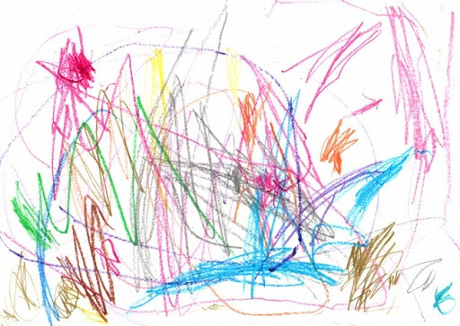
Risk Factors
The patient is diagnosed with preeclampsia with SF.
The risk of seizure is (circle):
0.6%
2-3%
10%
The patient has the following risk factors for eclampsia (list as appropriate or write “none”)
3
Notes:
Answer
AMA
Non-white

Slide 5
Treatment
Find a trade card with the medications that you want to order.
4

Slide 6
She was started on magnesium for seizure prophylaxis.
Short acting antihypertensive medication was given for sustained severe-range blood pressure.
S

Slide 7
Treatment
Find a trade card with the dose(s) of the medication(s) that you want to order.
5

Slide 8
The following magnesium orders were placed:
Loading dose
4 grams IV over 15 min
Maintenance dose
2 gram/hour IV
Labetalol 20mg IV
B

Slide 9
Delivery Plan
On exam her cervix is 4-5cm/50%/-2.
She is contracting infrequently.
6

Slide 10
Delivery
Find a trade card with the most appropriate delivery plan.
7

Slide 11
Induction of labor with oxytocin
C

Slide 12
2hrs after admission
You are called by the nurse because she is unresponsive with shallow respirations.
Vitals |  | Exam | Findings
BP | 136/87 mmHg | LE Edema | 2+ pitting
Pulse | 101 BPM | Reflexes | absent
O2 Saturation | 88% | Clonus | absent
8

Slide 13
Mg2+ level
Find a trade card with the magnesium level that matches the patient’s evaluation at 2hrs.
9

Slide 14
Her magnesium level is 14.2 mg/dL
How would you manage this (list 3 actions)?
D

Slide 15
4hrs after admission
Shortly after evaluation, the nurse re-enters the room to find the patient unresponsive, and demonstrating generalized, tonic-clonic seizure activity with tensing of the muscles, then jerking and twitching. Her IV becomes displaced.
Vitals
BP | 185/120 mmHg
Pulse | 122 BPM
O2 Saturation | 84%
10

Slide 16
DDx
What is the differential diagnosis of seizure during pregnancy (list 5)?
11

Slide 17
Dx
You suspect she is having an eclamptic seizure.
12

Slide 18
Initial Management
Find a trade card with the initial management steps you want to perform.
13

Slide 19
You call for help,
Place the side rails of the bed up,
Place the patient in the left lateral position,
Hook up a suction,
Reposition EFM/Toco as needed,
Administer oxygen via 100% NRB,
Short acting antihypertensive medication if repeat blood pressure is elevated,
Obtain peripheral IV access.
E

Slide 20
Prevention of Recurrent Seizure
Her nurse is unable to rapidly obtain peripheral IV access.
You administer 10gms IM 50% solution, 5gms each buttock.
14

Slide 21
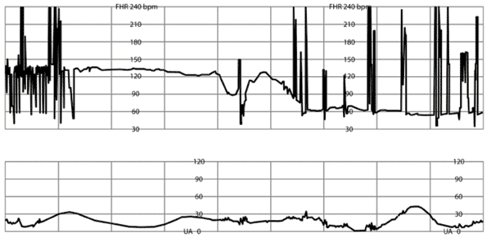
Fetal Assessment
During the seizure the fetal heart rate is as shown below.
15

Slide 22
Fetal Assessment and Labor Management
Find a trade card with the next most appropriate steps in delivery.
16

Slide 23
Fetal bradycardia is still present after 8 minutes.
Cervix is 10cm/100%/+2.
You perform a forceps assisted vaginal delivery.
F

Slide 24
Postictal Period
Tonic movement resolved after approximately 1 minute and clonic movements resolved after approximately 2 minutes. After 30 minutes the patient has not consciousness.
17

Slide 25
Imaging
Find a trade card with imaging tests that you want to order
18

Slide 26
You decide to order an MRI.
G

Slide 27
6hrs After Admission
The patient’s nurse calls out for assistance. The patient is having another episode of generalized, tonic-clonic seizure activity.
19

Slide 28
Alternatives
Medications for recurrent seizures (List 3):
20
Notes:
Benzodiazepines
Phenytoin
Keppra

Slide 29
Benzos: Match Drug, Dose, Frequency
Drug | Dose | Frequency | Notes
Diazepam (Valium) |  | Every: | Max 30mg
Lorazepam (Ativan) |  | Repeat once in: | Max 2 doses
Midazolam (Versed) |  | Every: | Max 10mg
Answers:
Dose | Frequency
1-2 mg IV | 5 min
2-4mg IV | 5-10 min
5-10mg IV | 10-15min
21

Slide 30
Wrap up
The patient is started on Keppra and has no further seizures.
MRI shows evidence of posterior reversible encephalopathy syndrome (PRES).
Blood pressure was initially normal to mildly hypertensive but became severe on PPD#3. Labetalol was started and titrated to 600mg TID.
The OB team debriefed the patient and her family about the course of events.
She was advised that the recurrence risk is 2%. Antenatal consultation with MFM and low dose aspirin were recommended.
22

Slide 31
Your Cards
Keep Trade Do

