Slide 1
Eclampsia Case 3
Hypertensive Disorders Simulation
June 10th, 2021

Slide 2
Stem
A 32 year-old Caucasian G3P0201 presents to labor and delivery at 29+1 weeks with vaginal bleeding. Otherwise, she is asymptomatic.
She has gained 20lbs in the past week.
Her prenatal course is complicated by history of preterm birth secondary to preeclampsia in both prior pregnancies.
Initial blood pressure is 166/100 mmHg.
1

Slide 3
Follow-up Vitals, Exam, Labs
Vitals |  | Exam | Findings
BP | 162/98 mmHg | LE Edema | 1+ pitting
Pulse | 91 BPM | Reflexes | 3+
O2 Saturation | 99% | Clonus | Absent
Lab | Result
Creatinine | 0.66 mg/dL
AST | 90 U/L
ALT | 72 U/L
Platelets | 253 k
Pr:Cr | 2.23
2
Notes:
Exam shows 2+ pitting edema, 3+ DTRs, 2 beats of clonus.

Slide 4
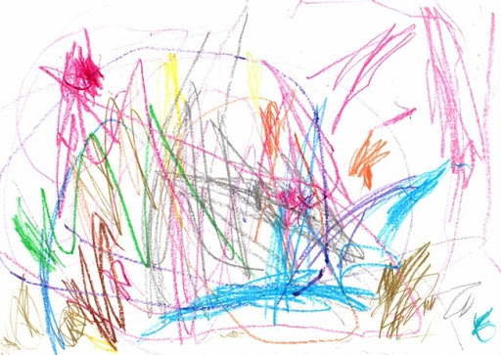
Risk Factors
The patient is diagnosed with preeclampsia with SF.
The risk of seizure is (circle):
0.6%
2-3%
10%
The patient has the following risk factors for eclampsia (list as appropriate or write “none”)
3
Notes:
Answer
AMA
Non-white

Slide 5
Treatment
Find a trade card with the medications that you want to order.
4

Slide 6
She was started on magnesium for both seizure prophylaxis and neuroprophylaxis.
Steroids were given for fetal lung maturity.
Short acting antihypertensive medication was given for sustained severe-range blood pressure.
A long acting antihypertensive medication was started.
H

Slide 7
Treatment
Find a trade card with the dose(s) of the medication(s) that you want to order.
5

Slide 8
The following magnesium orders were placed:
Loading dose
6 grams IV over 15 min
Maintenance dose
2 gram/hour IV
Betamethasone 12mg IM Q24 hours x 2 doses
Labetalol 20mg IV
Labetalol 200mg PO TID
K

Slide 9
Delivery Plan
On exam her cervix is long/thick/closed.
There is a small amount of old blood in the vaginal vault.
6

Slide 10
Delivery
Find a trade card with the most appropriate delivery plan.
7

Slide 11
Expectant management.
M

Slide 12
6hrs after admission
Six hours later she is resting comfortably. No further vaginal bleeding. No HA, vision changes/scotoma, RUQ pain stable.
Decision is made to continue expectant management.
Magnesium is stopped.
Vitals |  | Exam | Findings
BP | 139/97 mmHg | LE Edema | 1+ pitting
Pulse | 95 BPM | Reflexes | 2+
O2 Saturation | 98% | Clonus | absent
Lab | Result
Creatinine | 0.65 mg/dL
AST | 28 U/L
ALT | 20 U/L
Platelets | 251 k
8

Slide 13
Mg2+ level
Find a trade card with the magnesium level that matches the patient’s evaluation at 2hrs.
9

Slide 14
Her magnesium level is 2.2 mg/dL
What is the normal therapeutic range?
N

Slide 15
12hrs after admission
Shortly after evaluation, the nurse re-enters the room to find the patient unresponsive, and demonstrating generalized, tonic-clonic seizure activity with tensing of the muscles, then jerking and twitching. Her blood pressure 10 min earlier was 172/103 mmHg.
Vitals
BP | 205/107 mmHg
Pulse | 109 BPM
O2 Saturation | 86%
10

Slide 16
DDx
What is the differential diagnosis of seizure during pregnancy (list 5)?
11

Slide 17
Dx
You suspect she is having an eclamptic seizure.
12

Slide 18
Initial Management
Find a trade card with the initial management steps you want to perform.
13

Slide 19
You call an OB TEAM,
Place the side rails of the bed up,
Place the patient in the left lateral position,
Hook up a suction,
Reposition EFM/Toco as needed,
Administer oxygen via 100% NRB,
Short acting antihypertensive medication.
P

Slide 20
Prevention of Recurrent Seizure
You administer an additional 6 gram bolus of magnesium.
14

Slide 21
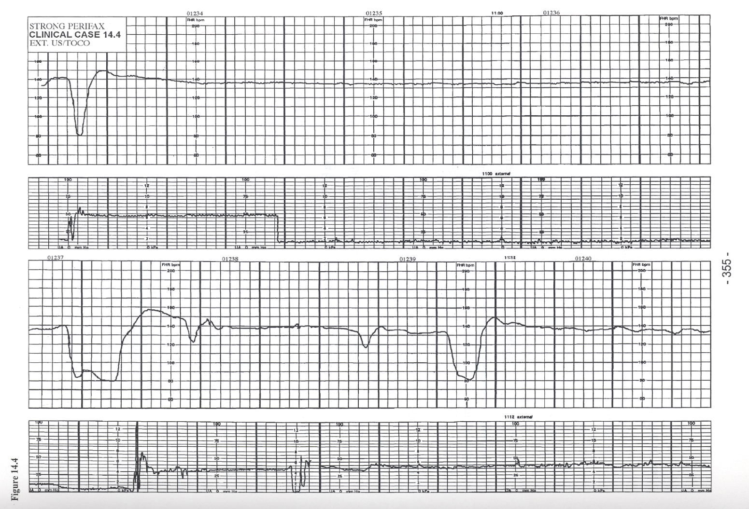
Fetal Assessment
During the seizure the fetal heart rate is as shown below.
15

Slide 22
Fetal Assessment and Labor Management
Find a trade card with the next most appropriate steps in delivery.
16

Slide 23
You proceed with cesarean section after the patient is stabilized.
Q

Slide 24
Postictal Period
Tonic movement resolved after approximately 1 minute and clonic movements resolved after approximately 2 minutes. After 12 minutes the patient has regained consciousness but she has left arm weakness.
17

Slide 25
Imaging
Find a trade card with imaging tests that you want to order
18

Slide 26
You decide to order a CT.
The results demonstrate a small amount of perimesencephalic blood.
V

Slide 27
POD#1
The patient’s nurse calls out for assistance. The patient is having another episode of generalized, tonic-clonic seizure activity.
19

Slide 28
Alternatives
Medications for recurrent seizures (List 3):
20
Notes:
Benzodiazepines
Phenytoin
Keppra

Slide 29
Benzos: Match Drug, Dose, Frequency
Drug | Dose | Frequency | Notes
Diazepam (Valium) |  | Every: | Max 30mg
Lorazepam (Ativan) |  | Repeat once in: | Max 2 doses
Midazolam (Versed) |  | Every: | Max 10mg
Answers:
Dose | Frequency
1-2 mg IV | 5 min
2-4mg IV | 5-10 min
5-10mg IV | 10-15min
21

Slide 30
Wrap up
The patient was given another 2gm bolus of magnesium followed by a 2gm/hr infusion for 24hrs and has no further seizures.
Her neurologic exam improves and SAH resolves without intervention.
Postpartum, she required additional treatment for blood pressure and was started on nifedipine XL 30 mg with good effect.
The OB team debriefed the patient and her family about the course of events.
She was advised that the recurrence risk is 2%. Antenatal consultation with MFM and low dose aspirin were recommended.
She was discharged home on POD#5.
22

Slide 31
Your Cards
Keep Trade Do

