Slide 1
JEOPARDY JEOPARDY JEOPARDY JEOPARDY JEOPARDY JEOPARDY JEOPARDY JEOPARDY JEOPARDY JEOPARDY JEOPARDY JEOPARDY JEOPARDY JEOPARDY JEOPARDY JEOPARDY JEOPARDY JEOPARDY JEOPARDY
JEOPARDY JEOPARDY JEOPARDY JEOPARDY JEOPARDY JEOPARDY JEOPARDY JEOPARDY JEOPARDY JEOPARDY JEOPARDY JEOPARDY JEOPARDY JEOPARDY JEOPARDY JEOPARDY JEOPARDY JEOPARDY JEOPARDY

Slide 2
Ground rules
First player is being chosen at random.
Person who chose the square gets first chance to answer verbally. If no answer within 1min and/or a wrong answer, the first person to type the correct answer into the chatboard wins and chooses next.
Dr. Geevarghese will be keeping score.
Shouting out answers and wrong answers are ENCOURAGED without penalty!! ☺
Questions during the game are ENCOURAGED!! ☺
There are is no Daily Double.
A Final Jeopardy round will only be used, if we need a tie-breaker.
There will be one winner. Prize is a $25 Amazon gift card (sent via email after game is over) and bragging rights for as long as your co-residents will tolerate you ☺

Slide 3
HERE ARE TODAY’S CATEGORIES

Slide 4
GTN

Slide 5
TUMOR MARKERS

Slide 6
PATHOLOGY

Slide 7
HPV

Slide 8
BRCA

Slide 9
POTPOURRI (Available After Categories Are Completed)

Slide 10
GTN
TUMOR MARKERS
PATHOLOGY
HPV
BRCA
POTPOURRI
$100
$100
$100
$100
$100
1
$200
$200
$200
$200
$200
2
$300
$300
$300
$300
$300
3
$400
$400
$400
$400
$400
4
$500
$500
$500
$500
$500
5
FINAL JEOPARODY

Slide 11
This single drug is usually successful in treating low risk GTN.

Slide 12
What is Methotrexate?

Slide 13
This dangerous outcome can occur after biopsy of vaginal metastasis of GTN.

Slide 14
What is heavy bleeding / hemorrhage?

Slide 15
Choriocarcinoma is classically diagnosed after this type of a pregnancy.

Slide 16
What is a complete molar pregnancy?

Slide 17
After first diagnosis of choriocarcinoma, this form of imaging is recommended in addition to baseline labs (T+S, CBC, CMP, coags, and a quantitative HCG).

Slide 18
What is a CXR?

Slide 19
This scoring system is in place to separate low risk GTN from high risk GTN and those patients with a score above 6 are less likely to be cured by methotrexate alone.

Slide 20
What is the WHO scoring system?

Slide 21
This tumor marker is elevated in over 80% of epithelial ovarian cancers.

Slide 22
What is CA-125?

Slide 23
This dimeric tumor marker is elevated in nearly all granulosa cell tumors.

Slide 24
Inhibin (most patients will have an elevated Inhibin A or Inhibin B or both)

Slide 25
This tumor marker is elevated in nearly all dysgerminoma cases.

Slide 26
What is LDH?

Slide 27
This tumor marker is elevated in nearly all endodermal sinus tumors (aka yolk sac tumors).

Slide 28
What is AFP?

Slide 29
This tumor marker is the first tumor marker recognized in human malignancies and is still the tumor marker with greatest consistency in response to treatment for choriocarcinoma.

Slide 30
What is Beta-HCG?

Slide 31
These rosettes of round, pale cells with coffee-bean nuclei surrounding a central cavity are not always found on the slide of a granulosa cell tumor. But, they are pathognomonic and will confirm the diagnosis.

Slide 32
What are Call-Exner bodies?

Slide 33
This benign ovarian tumor is associated with anti-NMDA encephalitis and, if removed early in the course of the disease, can prevent devastating effects.

Slide 34
What is a mature teratoma (aka a dermoid cyst)?

Slide 35
Mucinous borderline tumors of the ovary may present with a large tumor of appendiceal origin and a “belly full of jelly.” This phenomenon is known by what another name.

Slide 36
What is pseudomyxoma peritonei?

Slide 37
A 70yo woman presents with a solid ovarian mass, significant ascites, and a pleural effusion. On frozen section, she is found to have a fibroma and no metastases. The ascites is drained and she completely recovers. Her diagnosis is known as this eponymous phenomenon.

Slide 38
What is Meig’s syndrome?

Slide 39
A 4yo with vaginal bleeding and no trauma has “grape like tissue” seen at the distal vagina. This rare, but important, form of rhabdomyosarcoma should be known to gynecologists.

Slide 40
What is sarcoma botryoides?

Slide 41
This viral protein of HPV degrades p53, allowing dangerous mutations during cellular replication.

Slide 42
What is E6?

Slide 43
This HPV viral protein inactivates Rb, allowing cells to continually enter the cell cycle and replicate.

Slide 44
What is E7?

Slide 45
These high risk subtypes of HPV are responsible for approximately 70% of all cervical cancers.

Slide 46
What are HPV 16 and 18?

Slide 47
The nanovalent HPV vaccine that we now routinely recommend is actually a VLP (virus-like particle) of this HPV viral protein.

Slide 48
What is L1?

Slide 49
This immunohistochemical stain will be strongly positive in nearly all HPV-affected tissue.

Slide 50
What is p16?

Slide 51
The BRCA1 mutation is located on this chromosomal locus.

Slide 52
What is 17q21?

Slide 53
The BRCA2 mutation is located on this chromosomal locus.

Slide 54
What is 13q12?

Slide 55
These are the lifetime risks of breast and ovarian cancer respectively for a woman with a BRCA1 mutation who never undergoes risk reducing surgery are approximately 70% and 40%. This risk-reducing surgical recommendation is supported by ACOG for patients with a BRCA1 mutation.

Slide 56
What is a risk-reducing BSO (+/- hysterectomy, per patient wishes) at age 35-45 or when child-bearing is complete and a risk-reducing mastectomy (RRM) at approximately the same time.

Slide 57
This is the ACOG recommendation for breast surveillance for women with a BRCA mutation aged 25+ until she has her risk reducing mastectomy.

Slide 58
What is q12mo tomo/mammo and q12mo MRI?

Slide 59
As is seen in germline BRCA mutations, ovarian cancer tumors can acquire this DNA repair deficiency.

Slide 60
What is homologous recombination deficiency?

Slide 61
66 year old healthy female is seen for intense vulvar itching that has worsened over the past 8 months. She has no history of abnormal vaginal bleeding, urinary or fecal incontinence, abnormal cervical cytology, or abnormal findings on mammography. The result from a colonoscopy 3 years ago was normal. A Keyes dermal punch biopsy specimen of a 2cm, well-demarcated, thickened red lesion was the left labium majus was notable for extramammary Paget’s disease. No associated mass or histologic evidence of invasive disease was found. The most appropriate treatment to minimize the risk of recurrence and preserve vulvar anatomy is
(A) local excision with laser vaporization of a 2cm margin
(B) unilateral simple vulvectomy with ipsilateral inguinal node dissection
(C) radiation therapy with concomitant chemotherapy
(D) wide local excision
(E) topical application of clobetasol proprionate

Slide 62
Paget disease of vulva
Intraepithelial adenocarcinoma
Eczematoid appearance: well demarcated, slightly raised edges, red background, dotted with small pale islands
Can be multifocal
Invasive adenocarcinoma may be present within or beneath the surface in upto 25%
Evaluate for synchronous neoplasms
20-30% will have noncontinguous CA (breast, bladder, rectum, urethra, cervix, ovary)
WLE or vulvectomy with 2cm margin

Slide 63
34 year old woman, gravida 3, para 2, is referred to you after her Pap test shows a high-grade squamous intraepithelial lesion (HSIL). Speculum examination reveals a normal-appearing cervix. On bimanual examination, you find a palpable mass on the anterior vaginal wall in the upper vagina. The best next step in evaluation is:
(A) a second Pap test with human papillomavirus (HPV) DNA typing
(B) colposcopic examination with biopsies, if indicated
(C) transvaginal ultrasonography
(D) examination under anesthesia with cystoscopy and proctoscopy

Slide 64
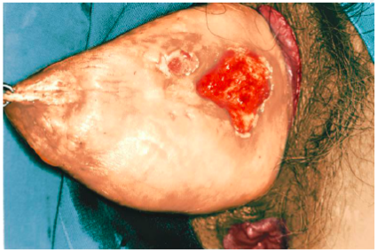
Primary vaginal cancer
Early: asymptomatic
Often upper third of vagina
Stage I (isolated to the upper vagina): Surgery
Rad hyst, upper vaginectomy, pelvic LND
If prior hyst: radical upper vaginectomy, pelvic LND
All other: Radiation
MORE

Slide 65
A 47-year-old woman presents with postmenopausal bleeding. Endometrial biopsy reveals papillary serous carcinoma. In contrast to endometrioid adenocarcinoma of the endometrium, the factor with which uterine papillary serous carcinoma is associated is:
younger age at time of presentation
unopposed estrogen
TP53 mutations
PTEN mutations
obesity

Slide 66
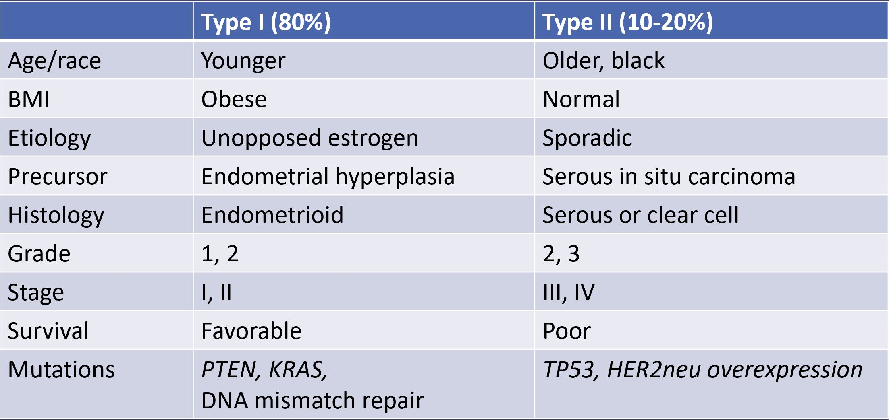
Characteristics of Type I & Type II Endometrial Cancers

Slide 67
A 33-year-old nulligravid woman comes in for preconception counseling. On physical examination, a complex adnexal mass is palpated. Ultrasonographic evaluation of the mass confirms solid and cystic areas, internal debris, and no ascitic fluid. The ovary measures 10 cm x 14 cm. During preoperative counseling, the patient indicates that preservation of fertility is a priority. You tell her that the minimum required surgery to stage an epithelial ovarian cancer adequately is
Unilateral salpingo-oophorectomy, pelvic and paraaortic lymph node sampling, omentectomy, peritoneal cytology and biopsies
Bilateral salpingo-oophorectomy (BSO), pelvic and paraaortic lymph node sampling, omentectomy, peritoneal cytology and biopsies
Unilateral salpingo-oophorectomy, pelvic and paraaortic lymph node sampling, hysterectomy, omentectomy, peritoneal cytology and biopsies
Bilateral salpingo-oophorectomy, pelvic and paraaortic lymph node sampling, hysterectomy, omentectomy, peritoneal cytology and biopsies
Unilateral salpingo-oophorectomy and contralateral ovary biopsy

Slide 68
Management of epithelial ovarian, fallopian tube, and primary peritoneal cancers
Adjuvant chemotherapy
None: Stage IA/B, grade 1-2
Stage IC-IV
Neoadjuvant chemotherapy: Stage III/IV
Followed by interval cytoreduction, adjuvant chemo
Chemo: Carboplatin/paclitaxel +/- bevacizumab
Maintenance: bevacizumab, PARP inhibitors

Slide 69
A 34 year-old nulligravid woman comes to your office for counseling before initiation of her second cycle of in vitro fertilization (IVF) after failed ovulation induction with clomiphene citrate. She has no significant prior medical history except for obesity and anovulation. She reports a 6-year history of oral contraceptive pill (OCP) use and a family history remarkable for a maternal aunt with gastric cancer and a sister with melanoma. Her most significant risk factor for ovarian cancer is
(A) OCP use
(B) nulligravidity
(C) family history
(D) clomiphene use
(E) IVF use

Slide 70
Risk factors for ovarian cancer
Infertility, nulligravity, increasing age, endometriosis, family history of breast or ovarian cancer, early menarche, late menopause. Substantial risks: hereditary syndromes
BRCA, Lynch, BRIP1, RAD51C, RAD51D
Protective effect: prior pregnancy, history of breastfeeding, OCPs, tubal ligation

Slide 71
Classification of vaginal CA
Squamous cell carcinoma: most common, HPV related
Verrucous carcinoma: SCC variant, rarely metastasizes
Adenocarcinoma:
Clear cell variant occurs in in-utero DES (cervical & vaginal CA)
Sarcoma
Most common vaginal sarcoma: Embryonal rhabdomyosarcoma (sarcoma botryoides)
Melanoma

