Slide 1
Eclampsia Case 1
Hypertensive Disorders Simulation
June 10th, 2021

Slide 2
Stem
A 40 year-old Hispanic G2P1001 presents to labor and delivery at 34+1 weeks with nausea and right upper quadrant abdominal pain.
She denies any vaginal bleeding, rupture of membranes, or contractions.
Her prenatal course is complicated by a history of preeclampsia in her previous pregnancy which resulted in induction of labor at 37wks.
On physical exam she appears moderately uncomfortable. Her blood pressure is 155/100 mmHg.
You place an IV and order labs.
1

Slide 3
Labs
Lab | Result
Creatinine | 1.63 mg/dL
AST | 208 U/L
ALT | 173 U/L
Platelets | 148 k
Pr:Cr | 5.46
2

Slide 4
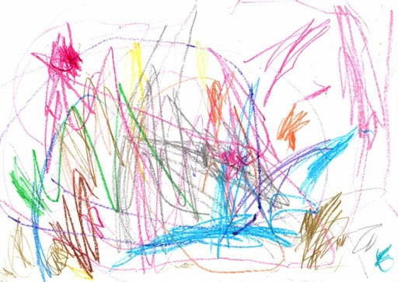
Risk Factors
The patient is diagnosed with preeclampsia with SF.
The risk of seizure is (circle):
0.6%
2-3%
10%
The patient has the following risk factors for eclampsia (list as appropriate or write “none”)
3
Notes:
Answer
AMA
Non-white

Slide 5
Treatment
Find a trade card with the medications that you want to order
4

Slide 6
She was started on magnesium for seizure prophylaxis and given late preterm steroids for fetal lung maturity.
T

Slide 7
Treatment
Find a trade card with the dose(s) of the medication(s) that you want to order
5

Slide 8
The following magnesium orders were placed:
Loading dose
4 grams IV over 15 min
Maintenance dose
1 gram/hour IV
Betamethasone 12mg IM Q24 hours x 2 doses
U

Slide 9
Delivery Plan
On exam her cervix is long/thick/closed.
6

Slide 10
Delivery
Find a trade card with the most appropriate delivery plan.
7

Slide 11
Cervical ripening was started with a cervical Foley and misoprostol.
O

Slide 12
2hrs after admission
Two hours later she is resting comfortably. No HA, vision changes/scotoma, RUQ pain stable.
FHT Category 1.
Vitals |  | Exam | Findings
BP | 144/89 mmHg | LE Edema | 2+ pitting
Pulse | 102 BPM | Reflexes | 2+
O2 Saturation | 97% | Clonus | Absent
8

Slide 13
Mg2+ level
Find a trade card with the magnesium level that matches the patient’s evaluation at 2hrs.
9

Slide 14
Her magnesium level is 5.5 mg/dL
What is the normal therapeutic range?
R

Slide 15
4hrs after admission
Shortly after evaluation, the nurse re-enters the room to find the patient unresponsive, and demonstrating generalized, tonic-clonic seizure activity with tensing of the muscles, then jerking and twitching.
Vitals
BP | 153/94 mmHg
Pulse | 115 BPM
O2 Saturation | 95%
10

Slide 16
DDx
What is the differential diagnosis of seizure during pregnancy (list 5)?
11

Slide 17
Dx
You suspect she is having an eclamptic seizure.
12

Slide 18
Initial Management
Find a trade card with the initial management steps you want to perform.
13

Slide 19
You call for help,
Place the side rails of the bed up,
Place the patient in the left lateral position,
Hook up a suction,
Reposition EFM/Toco as needed.
I

Slide 20
Prevention of Recurrent Seizure
You administer an additional 2 gram bolus of magnesium and order a STAT repeat magnesium level.
14

Slide 21
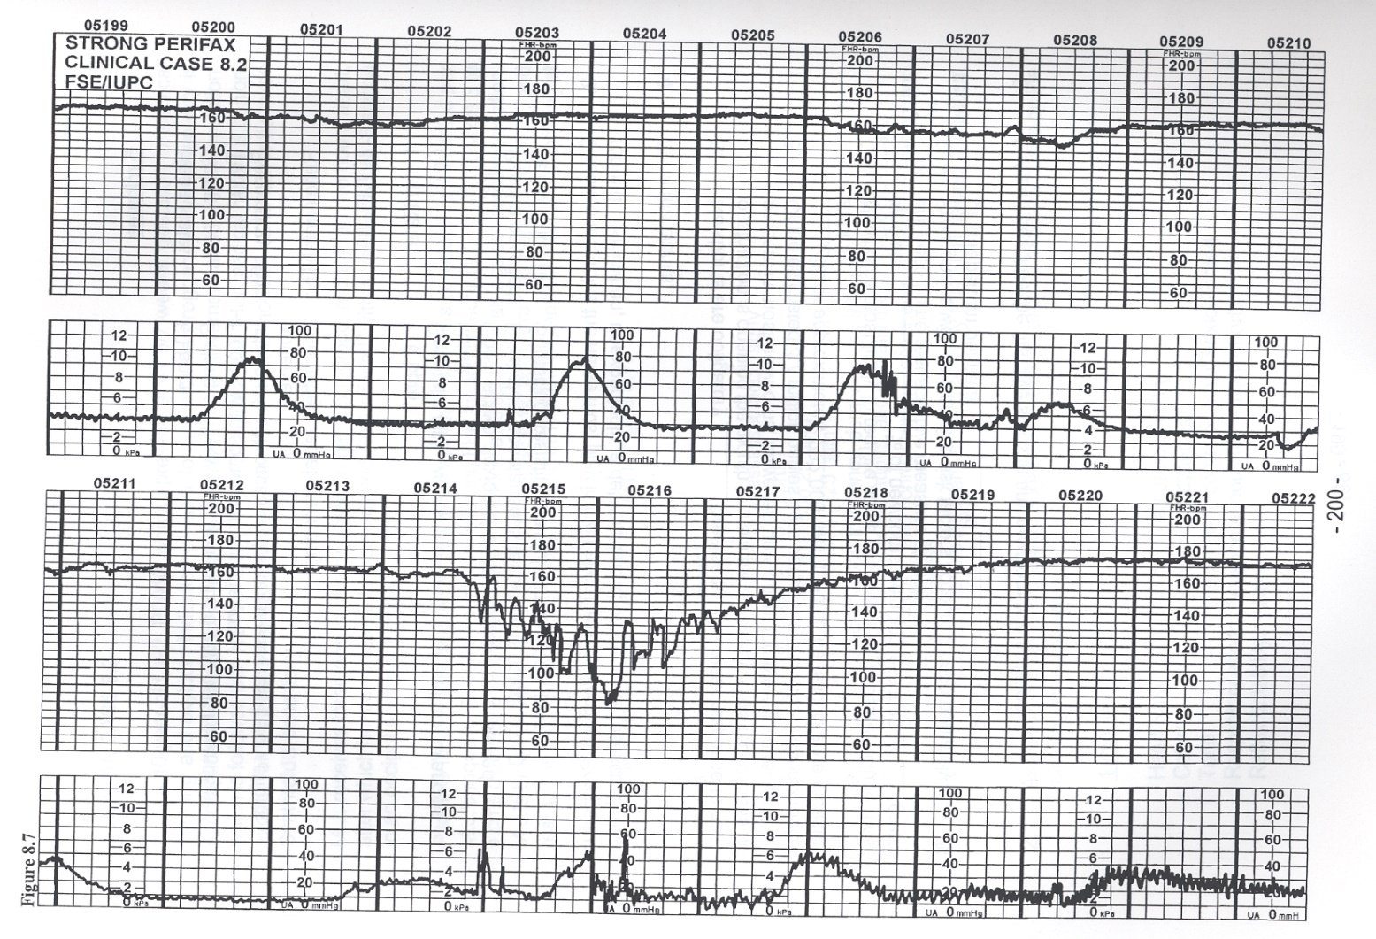
Fetal Assessment
During the seizure the fetal heart rate is as shown below.
15

Slide 22
Fetal Assessment and Labor Management
Find a trade card with the next most appropriate steps in delivery.
16

Slide 23
Baseline is now 170 BPM with minimal variability.
Foley expelled spontaneously. Cervix is 4-5cm/50%/-2.
You continue induction of labor with Pitocin after the variability improves.
A

Slide 24
Postictal Period
Tonic movement resolved after approximately 1 minute and clonic movements resolved after approximately 2 minutes. After 12 minutes the patient has regained consciousness but has a headache and is slightly altered. She has no recollection of the seizure.
17

Slide 25
Imaging
Find a trade card with imaging tests that you want to order
18

Slide 26
You decide not to order a CT scan.
L

Slide 27
6hrs After Admission
The patient’s nurse calls out for assistance. The patient is having another episode of generalized, tonic-clonic seizure activity.
19

Slide 28
Alternatives
Medications for recurrent seizures (List 3):
20
Notes:
Benzodiazepines
Phenytoin
Keppra

Slide 29
Benzos: Match Drug, Dose, Frequency
Drug | Dose | Frequency | Notes
Diazepam (Valium) |  | Every: | Max 30mg
Lorazepam (Ativan) |  | Repeat once in: | Max 2 doses
Midazolam (Versed) |  | Every: | Max 10mg
Answers:
Dose | Frequency
1-2 mg IV | 5 min
2-4mg IV | 5-10 min
5-10mg IV | 10-15min
21

Slide 30
Wrap up
The patient is started on phenytoin and has no further seizures.
She progressed to fully dilated and had an uncomplicated SVD.
Postpartum, she required additional treatment for blood pressure and was started on nifedipine XL 30 mg with good effect.
The OB team debriefed the patient and her family about the course of events.
She was advised that the recurrence risk is 2%. Antenatal consultation with MFM and low dose aspirin were recommended.
22

Slide 31
Your Cards
Keep Trade Do

